Slide 1
FRIS: a research information infrastructure in Flanders
Integrating aspects of interoperability, policy and governance
euroCRIS Strategic Members meeting
Amsterdam 11-12 November 2014

Slide 2

Geert Van Grootel
Economy, Science & Innovation dept.
Flemish government
geert.vangrootel@ewi.vlaanderen.be
Notes:
Logo ECOOM UHasselt

Slide 3
FRIS: Flanders Research Information Space
industry
research institutions
editors
Investment
opportunities
Research organisation
publications
libraries
patents
products
researchers
data centres
projects
government
research data
equipment
facilities
researchers
funders
Notes:
Presenter: Geert
Verscheidene informatieobjecten
Informatie zit verspreid bij verschillende stakeholders (vaak in operationele processen)
Informatie wordt gezocht door verschillende stakeholders
Breng deze informatie op transparante manier samen in één virtuele onderzoeksinformatieruimte = FRIS
Er is een zeer sterke behoefte aan raadplegen van databanken, vinden van onderzoekers, projecten … (zie bevraging e-onderzoek, nov 2007)

Slide 4

FRIS Needs & drivers
Better Research Information: correct, actual , complete
Open FRIS data for services and application development
Flemish government Open Data policy
Maximum reuse of components
Increase strategic intelligence
Maximum reuse of data
Policy monitoring:
efficient & effective
More information services
Connect data silo’s
Reduce system costs
Notes:
Presenter: Geert

Slide 5






















The Information Providers Landscape
Universities
University Colleges
Strategic Research
Centers
Research Institutes
Funding Agencies
Others
Notes:
Logo’s van alle Hogescholen post fusie

Slide 6
The Challenge
Information integration from sources with large difference in:
  Scope:
    research,
    education
    data centre's
    services
  Scale:
    8 to >6.600 researchers
  Internal integration maturity
    Application silo’s
      HR
      Finance
      Asset management
      The library silo
    ERP
    CRIS System

Slide 7
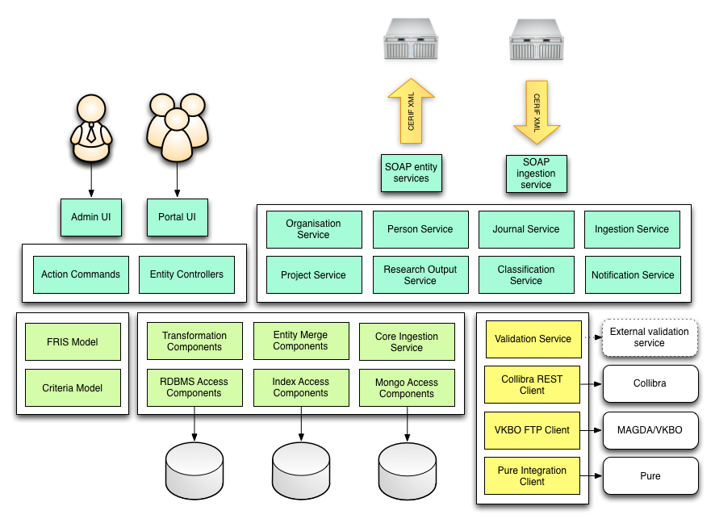
The core of the Architecture: FRIS Shared Services

Slide 8
Goals
Implementation of FRIS information principles and policy
  Information quality
    Completeness
    Accurate
    Timeliness
  Information is integrated
    360° view on all information dimensions

Slide 9
Goals
  Semantics
    Shared and managed vocabularies for
      Terms
      Business objects
      Business rules
      KPI
      Reports
    Traceability from policy to data and back
      Policy →Business rule → Validation rule
      Validation rule compliancy → Business rule →Policy

Slide 10

Goals
Incremental information exchange
  Continuous flow of information driven by agreed state
  → Consequence:
    reporting is realised on integrated FRIS data
    KPI’s continuously monitored
Process alignment
  Information collection efficiency
    “I shall ask this only once” principle
    Master Data integration
      Reuse and sharing of master data
      Available on the FRIS shared services layer
    Reference data
      Agreed and managed semantics
      Available on the FRIS shared services layer
Notes:
Variant on the Michelle Dubois principle

Slide 11
FRIS requirements for semantic management
What
  High level conceptual models
  Provider information models
  Business Rules
  KPI’s
  Reference data:
    Classifications, allowed value sets,
  Codes and code sets
  Data Validation Rules
  Exchange formats and reporting standards
    CERIF
    CASRAI

Slide 12
FRIS requirements for semantic management
How
  Collaborative management of information models
  Collaborative management of classification schemes and code sets
  Machine readable classification schemes and codes sets
  Machine readable information models including business rules in anticipation of automated validation of exchanged information.

Slide 13
FRIS requirements for semantic management
Who
  EWI
    Policy developers
    Monitoring group
    Enterprise Architect and team
    CIO
    FRIS Information architect
    FRIS services functional analyst
    IT developer
    Operations:
      Data validation
      Report design
      KPI implementation
  Information providers
    Roles very comparable to EWI
    Subject matter experts

Slide 14
FRIS requirements for semantic management
Organisation
DATA GOVERNANCE
Methodology
Proactively managing your data, to support your business
Tools

Slide 15
FRIS Information Modelling Stack
Principles, Guidelines, Governance structures
Meta model
High Level Conceptual models
Governance models
Governance Implementation
Information models
Information
Modeling
Information templates
Classification Schemes
Code Sets
Business Rules
Data base schemes

Slide 16
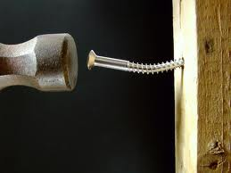
TOOLS
The Law of the Instrument:
“ If you only have a hammer, everything looks like a nail”
Notes:
Cerif and ER modelling:
Limited scope: Logical and Physical modeling of in essence closed world data system
limited semantics management
Entities ( more or less equivalent of FRIS Business objects) predefined and inflexible
Relationships have limited scope: only so-called binary relationships
CASRIA:
document driven, good for standarization of cross organistion information exchange
limeted number of reporting templates
Even a combination of both does not fullfil the needs for FRIS

Slide 17
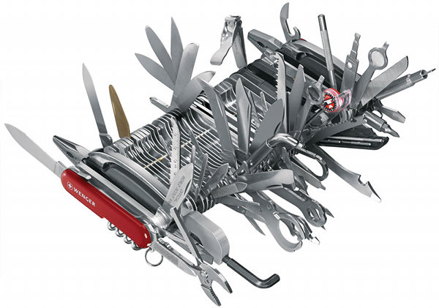

Tool Scope
One tool for all,
all for one tool

Slide 18
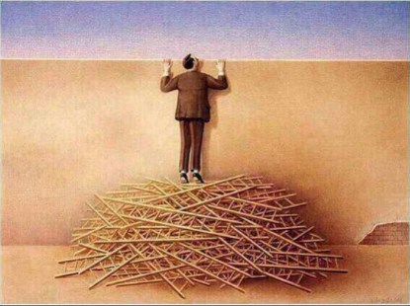
Usage

Slide 19
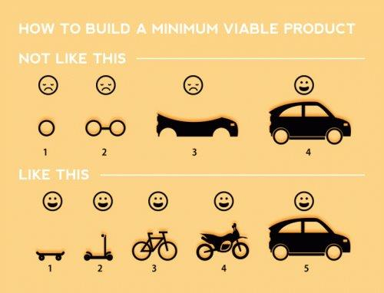
Data Governance Implementation Strategy

Slide 20
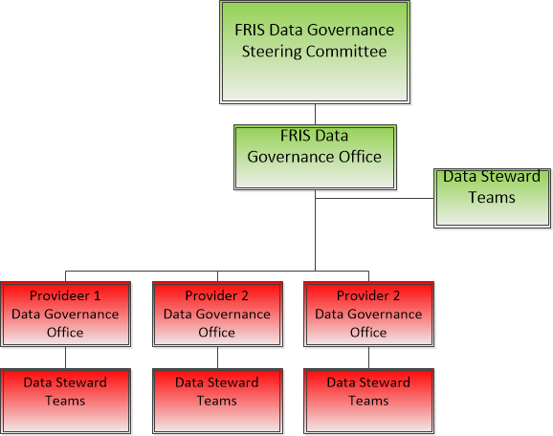
Governance Organisation

Slide 21
The FRIS Business Object
    Business Object
      Definition: “A Business Object is a Business Concept, concrete or abstract, that has the capability to influence behavior of a Business System. Typical examples are Person, Organization, Project, Location, Instruction, Account, etc. “
      A Business Object is represented by a Business Term
      A FRIS Business is composed of
        Identifiers
        Properties
        Classifications
        Relationships
        Life Cycle

Slide 22
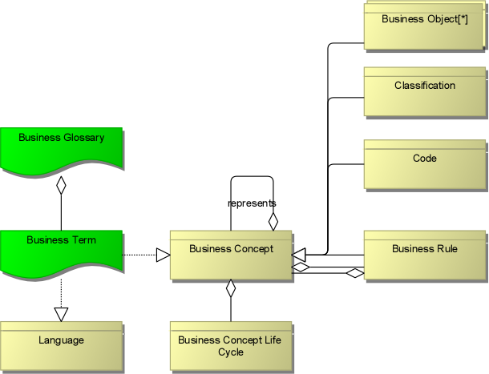
FRIS Meta model
Project
  Research Output
Person
Organisation
Book
Journal
Location
Book Contribution
Journal Contribution
Electronic
Location
Physical
Location
Notes:
FRIS Business Objects

Slide 23
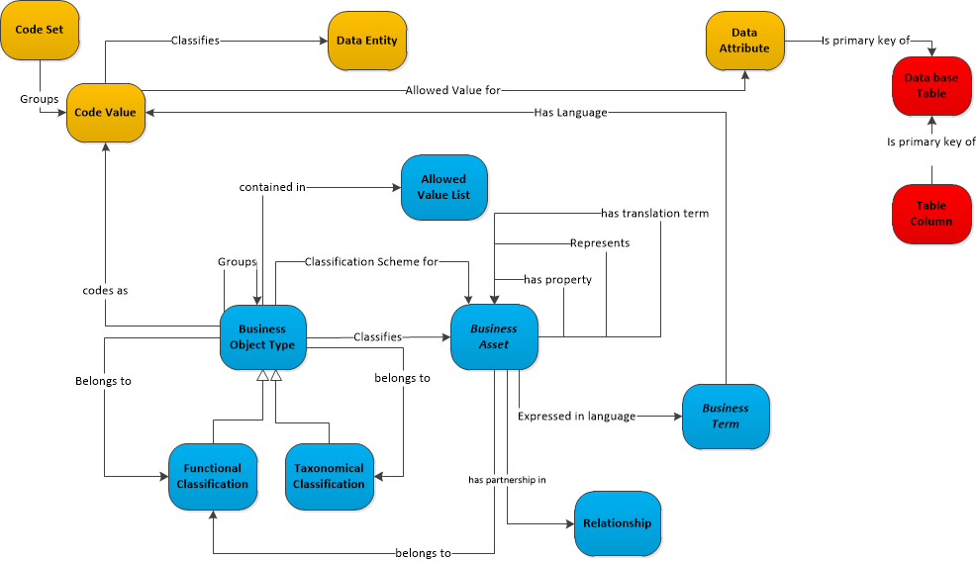
FRIS Data Governance Operating Model fragment

Slide 24
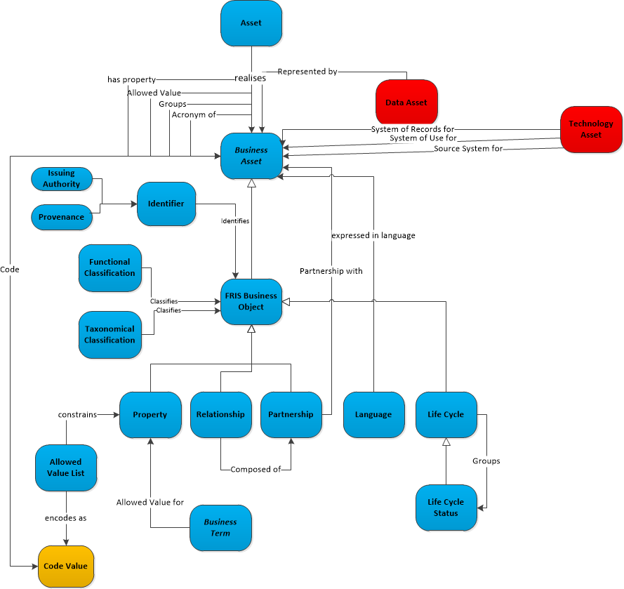
FRIS Data Goverance Operating model fragment

Slide 25
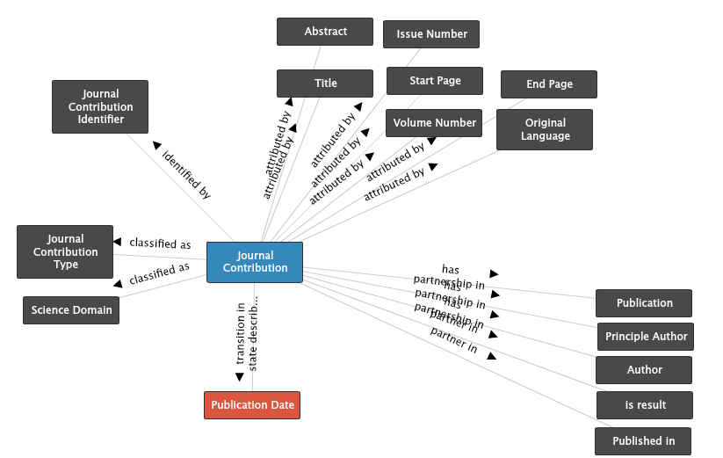
A FRIS Business Object

Slide 26
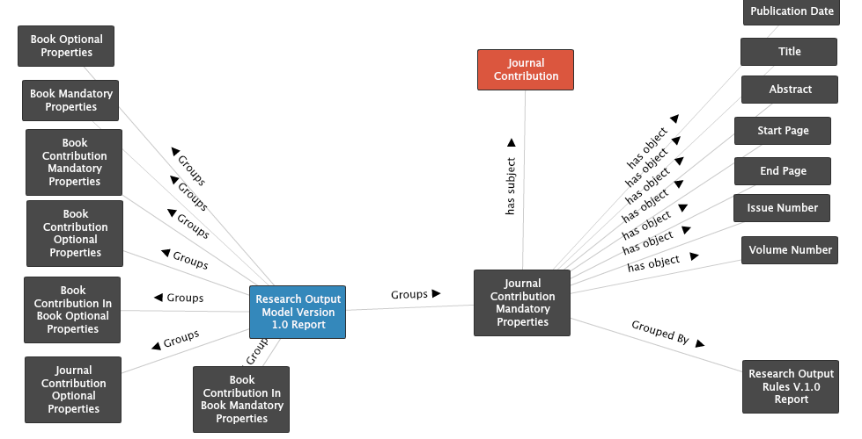
Business Rule Traceability

Slide 27
What has been realised so far
FRIS Business Objects
  Identifiers
  Properties
  Classification
    Taxonomies
    Functional Classifications
  Relationships
  Life Cycle

Slide 28
What has been realised so far
Codes, Codes sets and management
Business Rules
  Policy
  Rule types
  Versioning
    Implementation roadmap dependant
    Context dependant

Slide 29
Roadmap 2015
Implement complete governance structure in Data Governance Center
  Roles and responsibilities
  Workflows
    Design
    Implementation
Implement Data Governance Center Validation Rules

Slide 30
Roadmap 2015
Integrate the Data Governance Center API with FRIS services layer
  Reference Data
    Classifications
    Allowed values
  Rule based data validation
Integration of Business Rules – Data Rules stack in Data Governance Center with the DataFlux validator services
KPI development.

Slide 31


