Slide 1
The Catalan Research portal: collecting information from Catalan
universities via CERIF
Ramon Ros i Gorné
also Lluís M. Anglada i de Ferrer, Sandra Reoyo i Tudó and Ricard de la Vega i Sivera
(CSUC)
EuroCRIS Strategic Membership Meeting 2014
Amsterdam, November 12th

Slide 2
Outline
Who we are
What we have (repositories and CRIS systems)
The PRC project and decisions taken
      Identifiers
      Software
      Data mapping
      Data flow
      Data exchange format
Current status
Work to be done

Slide 3



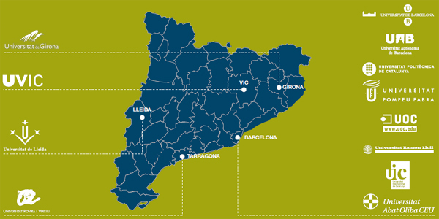
New merged consortium in 2014
for catalan universities
with more services and projects
The current CBUC ones
The current CESCA ones
Join purchases (electricity, printing, cleaning, facilities, etc.)
Common data center
Portal for the research output (PRC)
Etc.

Slide 4
Outline
Who we are
What we have (repositories and CRIS systems)
The PRC project and decisions taken
      Identifiers
      Software
      Data mapping
      Data flow
      Data exchange format
Current status
Work to be done

Slide 5









CSUC’s repositories
from 2001
www.tdx.cat
from 2005
www.recercat.cat
from 2009
www.mdx.cat
from 2010
calaix.gencat.cat
from 2006
www.recercat.cat
from 2012
repositori.filmoteca.cat
Pilot on 2012
from 2013
www.cirax.cat
Coming soon
Coming soon

Slide 6
CSUC’s university CRIS systems
CSUC have 10 member universities
They use 4 different commercial CRIS system
    5 use GREC from UB (inhouse developed)
    2 use CRIS/PPC from Sigma
    1 use DRAC from UPCnet
    1 use UXXI from OCU
One small university does not have a CRIS system (but implementing one)

Slide 7
Outline
Who we are
What we have (DSpace repositories)
The PRC project and firsts decisions
      Identifiers
      Software
      Data mapping
      Data flow
      Data exchange format
Current status
Work to be done

Slide 8
Situation in 2012 (before PRC)
  CBUC promotes IR since 1999
  Some universities (UPC & UPF) already have research portals
  There are new standards and protocols that help interoperability between IR and CRIS
  Research output is becoming more important for the university managers.

Slide 9
Decision in 2012
What
To create a portal to find the research outputs of the Catalan research system
Why
To increase the visibility of the research done in Catalonia
To foster OA
To increase interoperability between data
How
Taking advantage of the leverage work previously done
  In IR, CRIS and statistical data (Uneix)
The central idea: the works done for the portal will improve local IR and CRIS
Following international best practices
  Narcis / The Netherlands; HKU Scholars Hub / Hong Kong

Slide 10
PRC building. Firsts decisions
  Identifiers → ORCID
  Software → Dspace-CRIS from CINECA
  Data mapping
  Data flow → from local CRIS systems
  Data exchange format → CERIF XML

Slide 11
ORCID as researcher identifier
Selection of identifier
  Decision based in a CBUC report: Sistemes d’identificació unívoca d’investigadors / Àngel Borrego
Technical work
  Modify all the local CRIS in order to allow to load the ORCID identifier
  Promotion of ORCID id in other working groups: repositories, CCUC, Mendeley…
ORCID diffusion
  We studied the ORCID API to create ORCID id automatically, but we decided not to use it
  Merchandising, translations, videos, ‘good practices’ document ...

Slide 12
Evoloution of ORCID registered researchers
 | oct-13 | feb-14 | abr-14 | jun-14 | TOTAL
UB | 206 | 106 | 1263 | 128 | 1703
UAB | 176 | 90 | 36 | 287 | 589
UPC | 368 | 59 | 39 | 196 | 662
UPF | 135 | 75 | 299 | 119 | 628
UdG | 69 | 38 | 16 | 20 | 143
UdL | 6 | 7 | 1 | 2 | 16
URV | 102 | 48 | 42 | 25 | 217
UOC | 43 | 11 | 11 | 14 | 79
UVic | 18 | 150 | 2 | 24 | 194
UIC | 11 | 2 | 5 | 41 | 59
URL | 30 | 33 | 78 | 22 | 163
TOTAL | 1164 | 619 | 1792 | 878 | 4453
* Data provided by ORCID. Number of researchers registered with their university email.

Slide 13
Software
Based on DSpace-CRIS of CINECA (like Hong Kong University)
Main challenges (to adapt/develop)
  From one institution to multi-institution
  From submit contents to harvest from local CRIS instances
  Massive import mechanisms are needed (XML-CERIF….)

Slide 14
PRC entities
Universities
Departaments & Institutes
Research groups
Researchers
Research projects
Publications
(Articles + Books+ ETDs)
Notes:
Amb els comentaris que ens heu enviat i les conclusions extretes de la reunió de contrast amb la UB, UPC i UPF s’han redefinit els apartats.
Grup/Institut/Unitat/Centre/Departament. En la reunió de contrast 23.01.14 ens diuen que aquesta agrupació és incorrecte i que s’hauria de dividir en: Grups de recerca i Departaments i Instituts. No incloure Unitats (Carina Álvarez tb va comentar que no ho veia clar) i Centres
Abans parlàvem d’”Organitzacions”, mentre no s’afegeixin institucions d’altre tipus parlarem d’Universitats i de “Departaments i Instituts” i de “Grups de recerca”. Abans aquestes 3 categories estaven juntes
Abans parlàvem de “Recerca” i ara de “Projectes de recerca”
En la segona fase:
A part de les universitats hi haurà també centres CERCA
Com investigadors s’afegiran els doctorands
Apartat Transferència spin-off
A part de projectes de recerca també s’inclourà informació sobre ajuts i convenis
I com a publicacions també s’afegiran Informes + Working papers + Contribucions a congressos + Patents

Slide 15
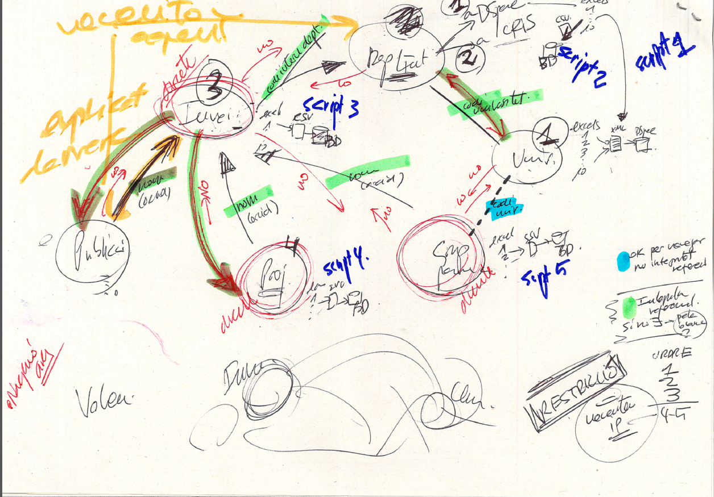
Lots of discussion on data mapping...

Slide 16
DSpace with the CRIS module. Main entities
DSpace
Publication
CRIS module
Person
Organization
Project
Organization

Slide 17
DSpace with the CRIS module. Detailed entities
DSpace
Publication
CRIS module
Person. Researcher
Organization. Research group
Project
Organization. University -> comunities
Organization. Department -> collections
Author

Slide 18

Data flow, protocols, sources and formats
Protocol: XLS files
Format: UNEIX defined
Universitas XXI
Other
GREC
DRAC
UNEIX
SIGMA
Protocol: OAI-PMH/SWORD
Format: DC
Catalan government DataWarehouse
Local and consortia repositories.
Mainly DSpace
12 university CRIS systems (from 4 different vendors)
Protocol: OAI-PMH
Format: CERIF-XML
PRC
PRC. Based on Dspace-CRIS (CINECA)

Slide 19
CERIF model
cfFederated Identifier
cfFunding
cfEquipment
cfExpertise
AndSkills
cfFacility
cfResult
Publication
cfService
cfQualification
cfPrize
cfResultPatent
cfResultProduct
cfElectronicAddress
cfProject
cfPostalAddress
cfCurriculum
Vitae
cfPerson
cfOrganisation
Unit
cfGeographic
BoundingBox
cfCitation
cfIndicator
cfMeasurement
cfEvent
cfCountry
cfLanguage
cfCurrency

Slide 20
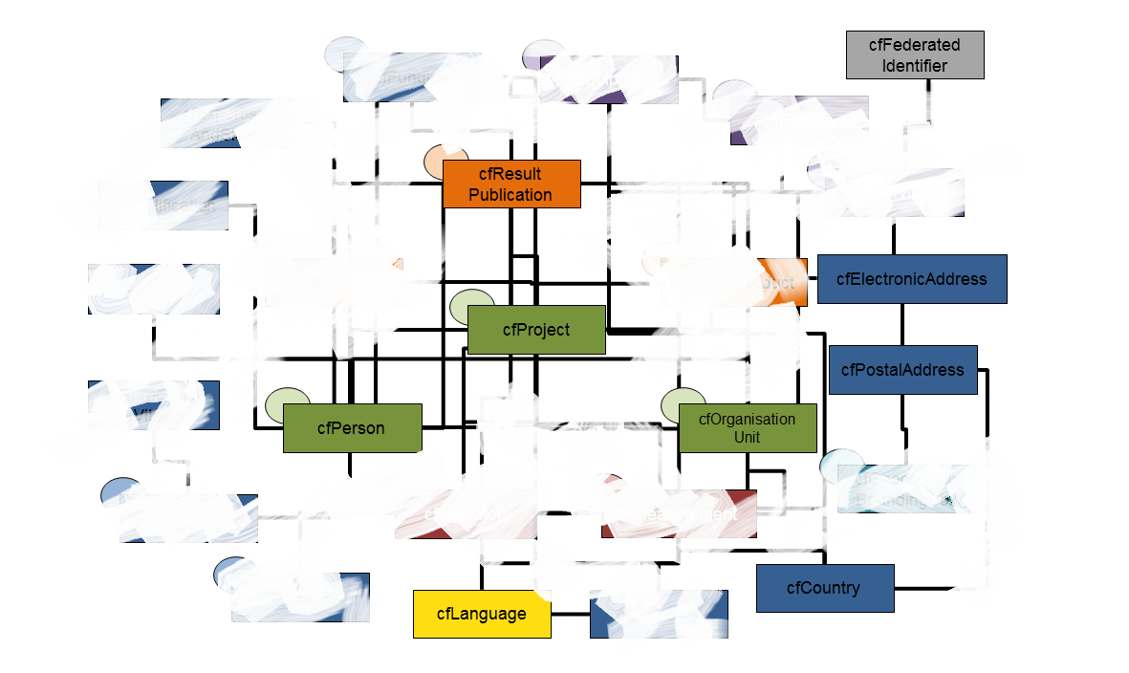
Simplification of CERIF for PRC

Slide 21
Simplified CERIF subset for PRC
cfResult
Publication
cfProject
cfPerson
cfOrganisation
Unit

Slide 22
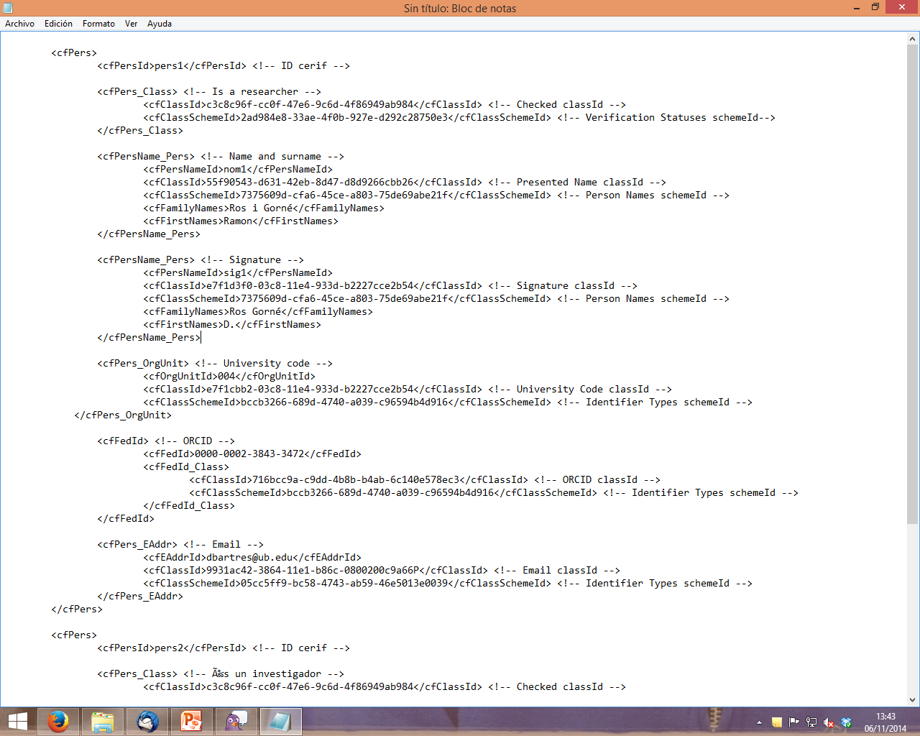
Anyway, not so easy…
A PRC internal researcher:
A PRC external researcher:
No ORCID, less data
A CERIF person:
perfectly defined
A PRC author:
No ORCID, even less data
Some CRIS authors:
(R.Ros)
just the signature!!

Slide 23
Outline
Who we are
What we have (DSpace repositories)
The PRC project and firsts decisions
      Identifiers
      Software
      Data mapping
      Data flow
      Data exchange format
Current status
Work to be done

Slide 24

Current status/Work in progress
Universities/CRIS
    All the CRIS systems already have a field for ORCID
    Working on CERIF-XML extraction
PRC
  data loading:
    Sample data from all universities
    Full data from one univerisity
    Partial CERIF-XML data from one university
  portal creation
    External redesign and adapt
    CERIF validator
    CERIF ingest mechanism

Slide 25
Ingest process, two options
Excel file (CSV)
CRIS
PRC
mapping
program
CERIF ingest
procedure
CERIF-XML

Slide 26
Outline
Who we are
What we have (DSpace repositories)
The PRC project and firsts decisions
      Identifiers
      Software
      Data mapping
      Data flow
      Data exchange format
Current status
Work to be done

Slide 27

Work to be done & challenges
  Organizational
    More meetings with the experts group
    ORCID ids implementation
    Need to create/find more unique identifiers (for research groups, projects, etc.)
  External adaptation
    Local CRIS system to adapt XML-CERIF wrapping (export)
  Portal implementation
    Ingest the full data of all institutions
    Think about depuration & deduplication data mechanisms
    Think on data refreshment frequency

Slide 28
Implementation steps
Step 1: prototipe
Sample data
Manual entry
Step 2: first batch load
Data sample from all universities.
CSV/XLS format
Step 3: full batch load
All data from all universities.
CSV/XLS format
Step 4: CERIF-XML ingest
First manual CERIF-XML ingest
Step 5: OAI-PMH automatic ingest.
Full syncronization with local CRIS systems.

Slide 29

Thanks!
Any question?
Ramon Ros i Gorné
(CSUC)
ramon.ros@csuc.cat
http://www.csuc.cat

