Slide 1

Current Research Information System in Norway
Even minor integrations can deliver great value – A case study
Mona Hide Klausen
m.h.klausen@cristin.no

Slide 2

Sharing is caring!
Notes:
«Sharing is caring»
great societal impact
Disclaimer
technical difficulties -- in place by the end of June.
Failure is just not an option!

Slide 3
CRIStin – the basics
Organisation + system
158 member institutions
  Higher education, hospitals, private research institutes
1 central database
Notes:
background information
organisation
the Ministry of Education and Research and the Ministry of Health and Care services
support and promote Norwegian research
three different research sectors: higher education, hospitals and private research institutes
report their academic publications to the Ministries
158 member institutions
one central database
shared between collaborating institutions

Slide 4

From CRISt-IN to CRISt-OUT
Old web services – issues with scalability
New REST API service
See also:
Vallipuram & Sachse (2016). Managing
and sharing research data using
RESTful web services. CRIS2016
Notes:
focus on the benefits
REST API - paper
Data more easily accessible and «sharable»

Slide 5
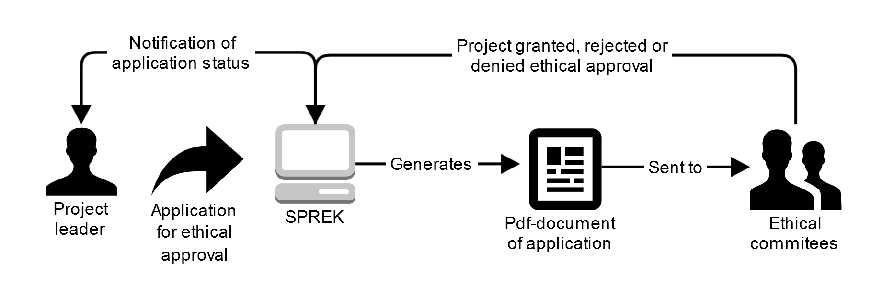
The SPREK system
National system for applying for ethical approval of health related research projects
Notes:
Project application system of the Regional Committees for Medical and Health Research Ethics, called SPREK.

Slide 6
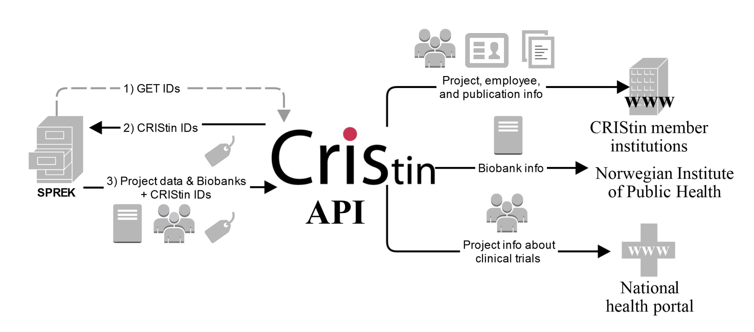
SPREK + CRIStin
Notes:
ethical approval - project + other info in Cristin
implemented CRIStin’s IDs - update the project
overview of their clinical trials
helseportalen - health related issues – manual updates
applications to establish biobanks - Norwegian institute of public health - national biobank registry
in a dialog with several other organisations

Slide 7

Benefits
Overview of clinical trials + portfolio
Updated biobank registry
Data quality and integrity
Time!
Positive researchers
Notes:
institutions to fulfil a legal requirement + project portfolio
Norwegian Institute of Public Health - update the biobank registry
national “health portal’s” - inform patients
better data quality in the “network” of integrated systems - Registering and editing information in one place
the time saved for researchers and administrators
potentially save up to half a work year annually, just on the registration process alone.
No formalized study – estimate not include time spent on locating info
dependent on the institutions actually using our services.
positive feedback we are getting from researchers

Slide 8

Challenges
Document system (free text based) + relational database
Different methodologies (testing)
Data integrity
Notes:
relational database with highly structured data, like CRIStin, from what was originally a document system based mainly on free text fields, is like pulling teeth with a pair of tweezers.
generating pdf files for the meetings of the ethical committees
Cooperation between the developers
continuous testing of the integration is crucial
ensure data integrity - SPREK is the authoritative source - key to the ethical approval
formal application for changes
national, authoritative chart of the data flow

Slide 9

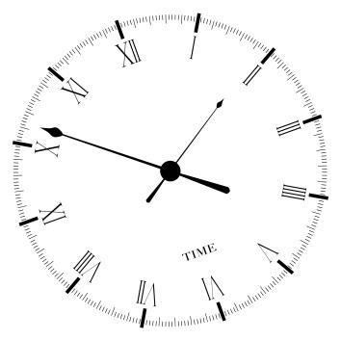

Potentials of a CRIS-system
Fewer local systems – saves money
Information registered once – saves time
Richer datasets – adds value
Notes:
gather and give an overview of relevant data - less need for separate, local systems
harvests information from a source system, or distributes - less need for manual registration
publication data from Scopus - 50-60 %
presentations, attended conferences, art work, reports, news paper interviews
connect specific information to other relevant data - enrich the original dataset
Related projects can be linked together - increase the visibility and discoverability
institution registry

Slide 10

The way forward
National and international standards
Integrations with other
national systems
ORCID, CASRAI, CERIF
Notes:
a minor integration can generate great value - reducing administrative costs
Norwegian higher education sector - structuring key information shared between two or more of the systems - facilitate integrations - new types of statistics
National or international standards
CASRAI dictionary
implement a more standardised format for data sharing
The first step is to ensure that our system and our services are «integration ready»

Slide 11

System integrations
Saves
  time and money
Increases
  data quality and integrity
  visibility and discoverability
  the reputation of the CRIS
Icons from gliffy.com, images from Colourbox
Notes:
To sum up the presentation:
Gathering and sharing research information through system integrations:
Saves time and money - removing need for manual registrations - local systems
Increases data quality and integrity - registered and edited in one system
increases the visibility and discoverability of the research.
saving time for researchers
Any questions?

Slide 12
Contact
Mona Hide Klausen
m.h.klausen@cristin.no

