Slide 1

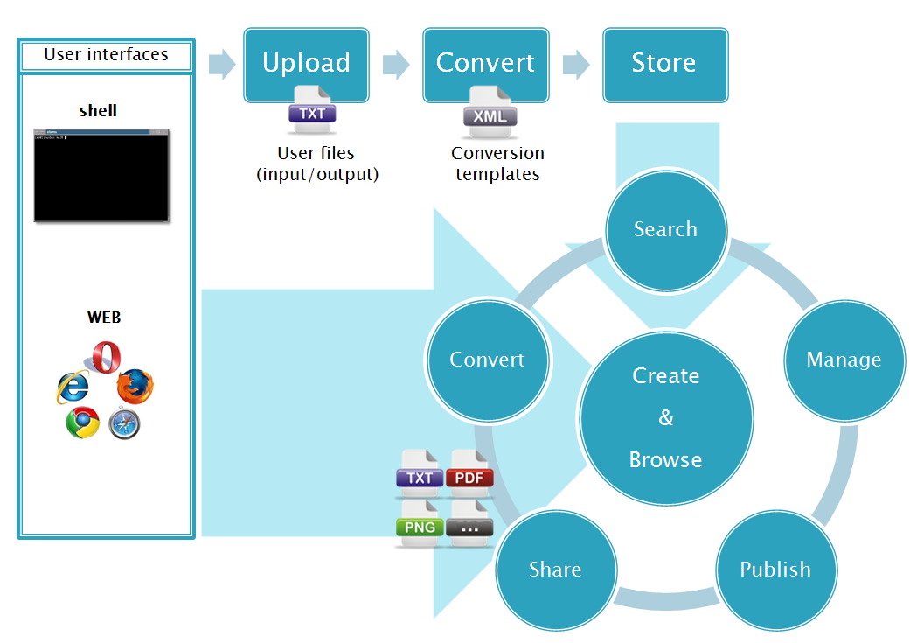


Taming the Big Data in Computational Chemistry
#euroCRIS2015
Barcelona 9-11-XI-2015
Carles Bo
ICIQ (BIST) - URV
cbo@iciq.cat
@Carles_Bo

Slide 2
Computational Chemistry
Taking experiment to cyberspace
Nobel Prize Chemistry 2013 (see also 1981, 1998)

Slide 3
Well stablished theories
Standard computer codes Permanent storage
Re-use results
Certify results
Number of citations of CompChem papers per year

Slide 4
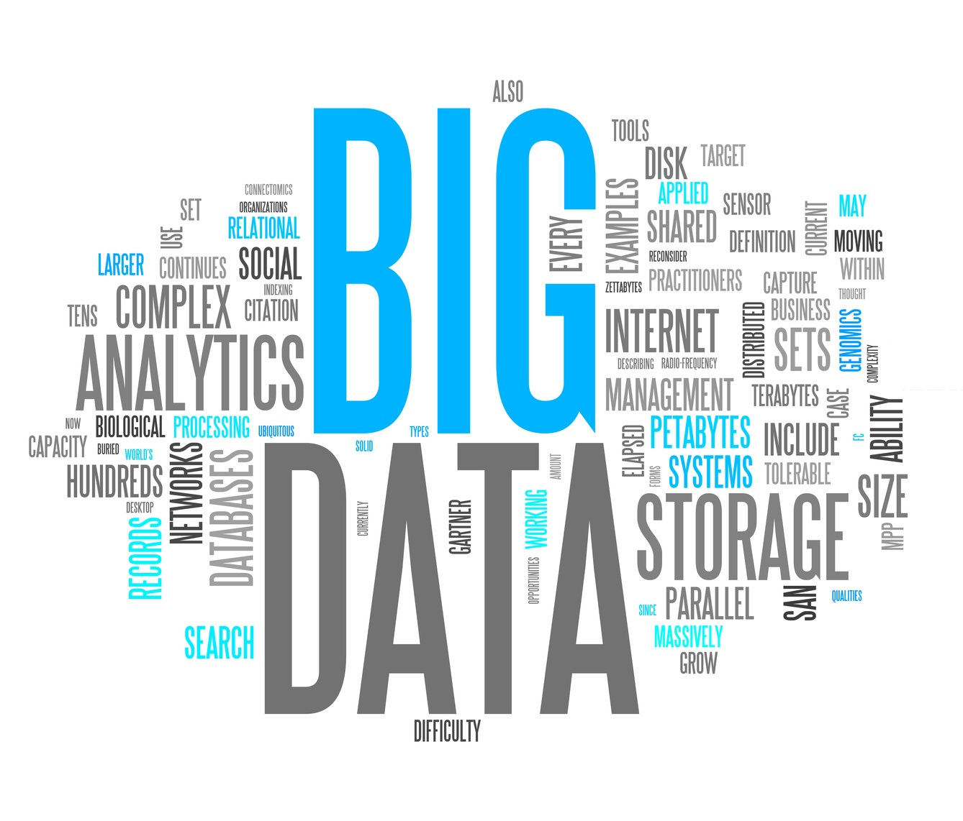
Is Comp Chem a Big Data Problem?

Slide 5
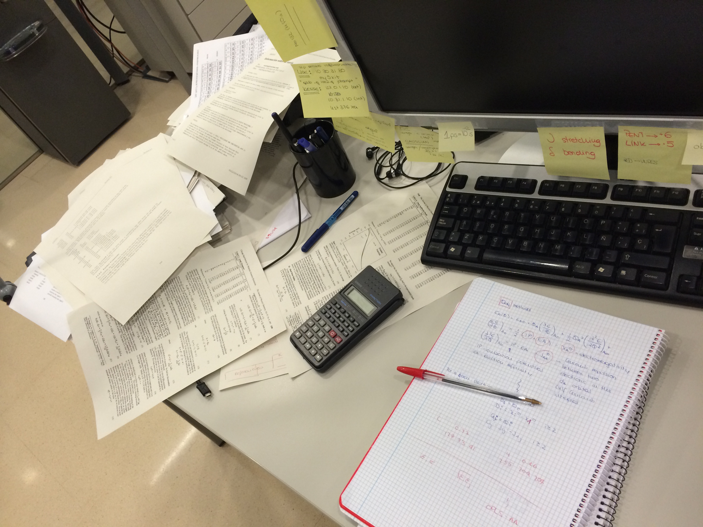
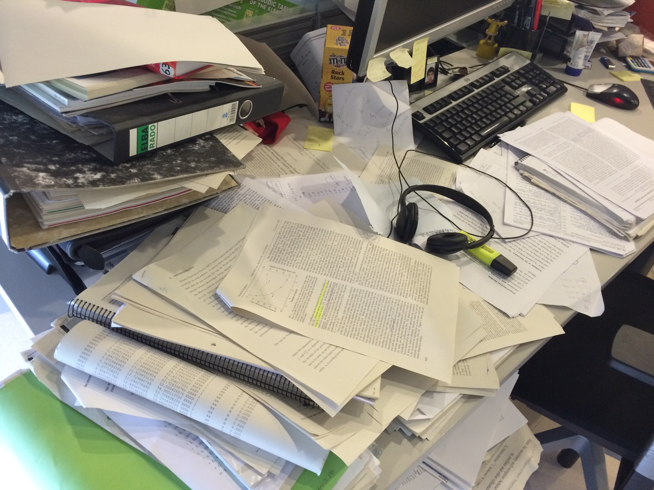
Our Big Data Problem (1)
Help researchers in their daily tasks
(manage results, apps & tools)

Slide 6
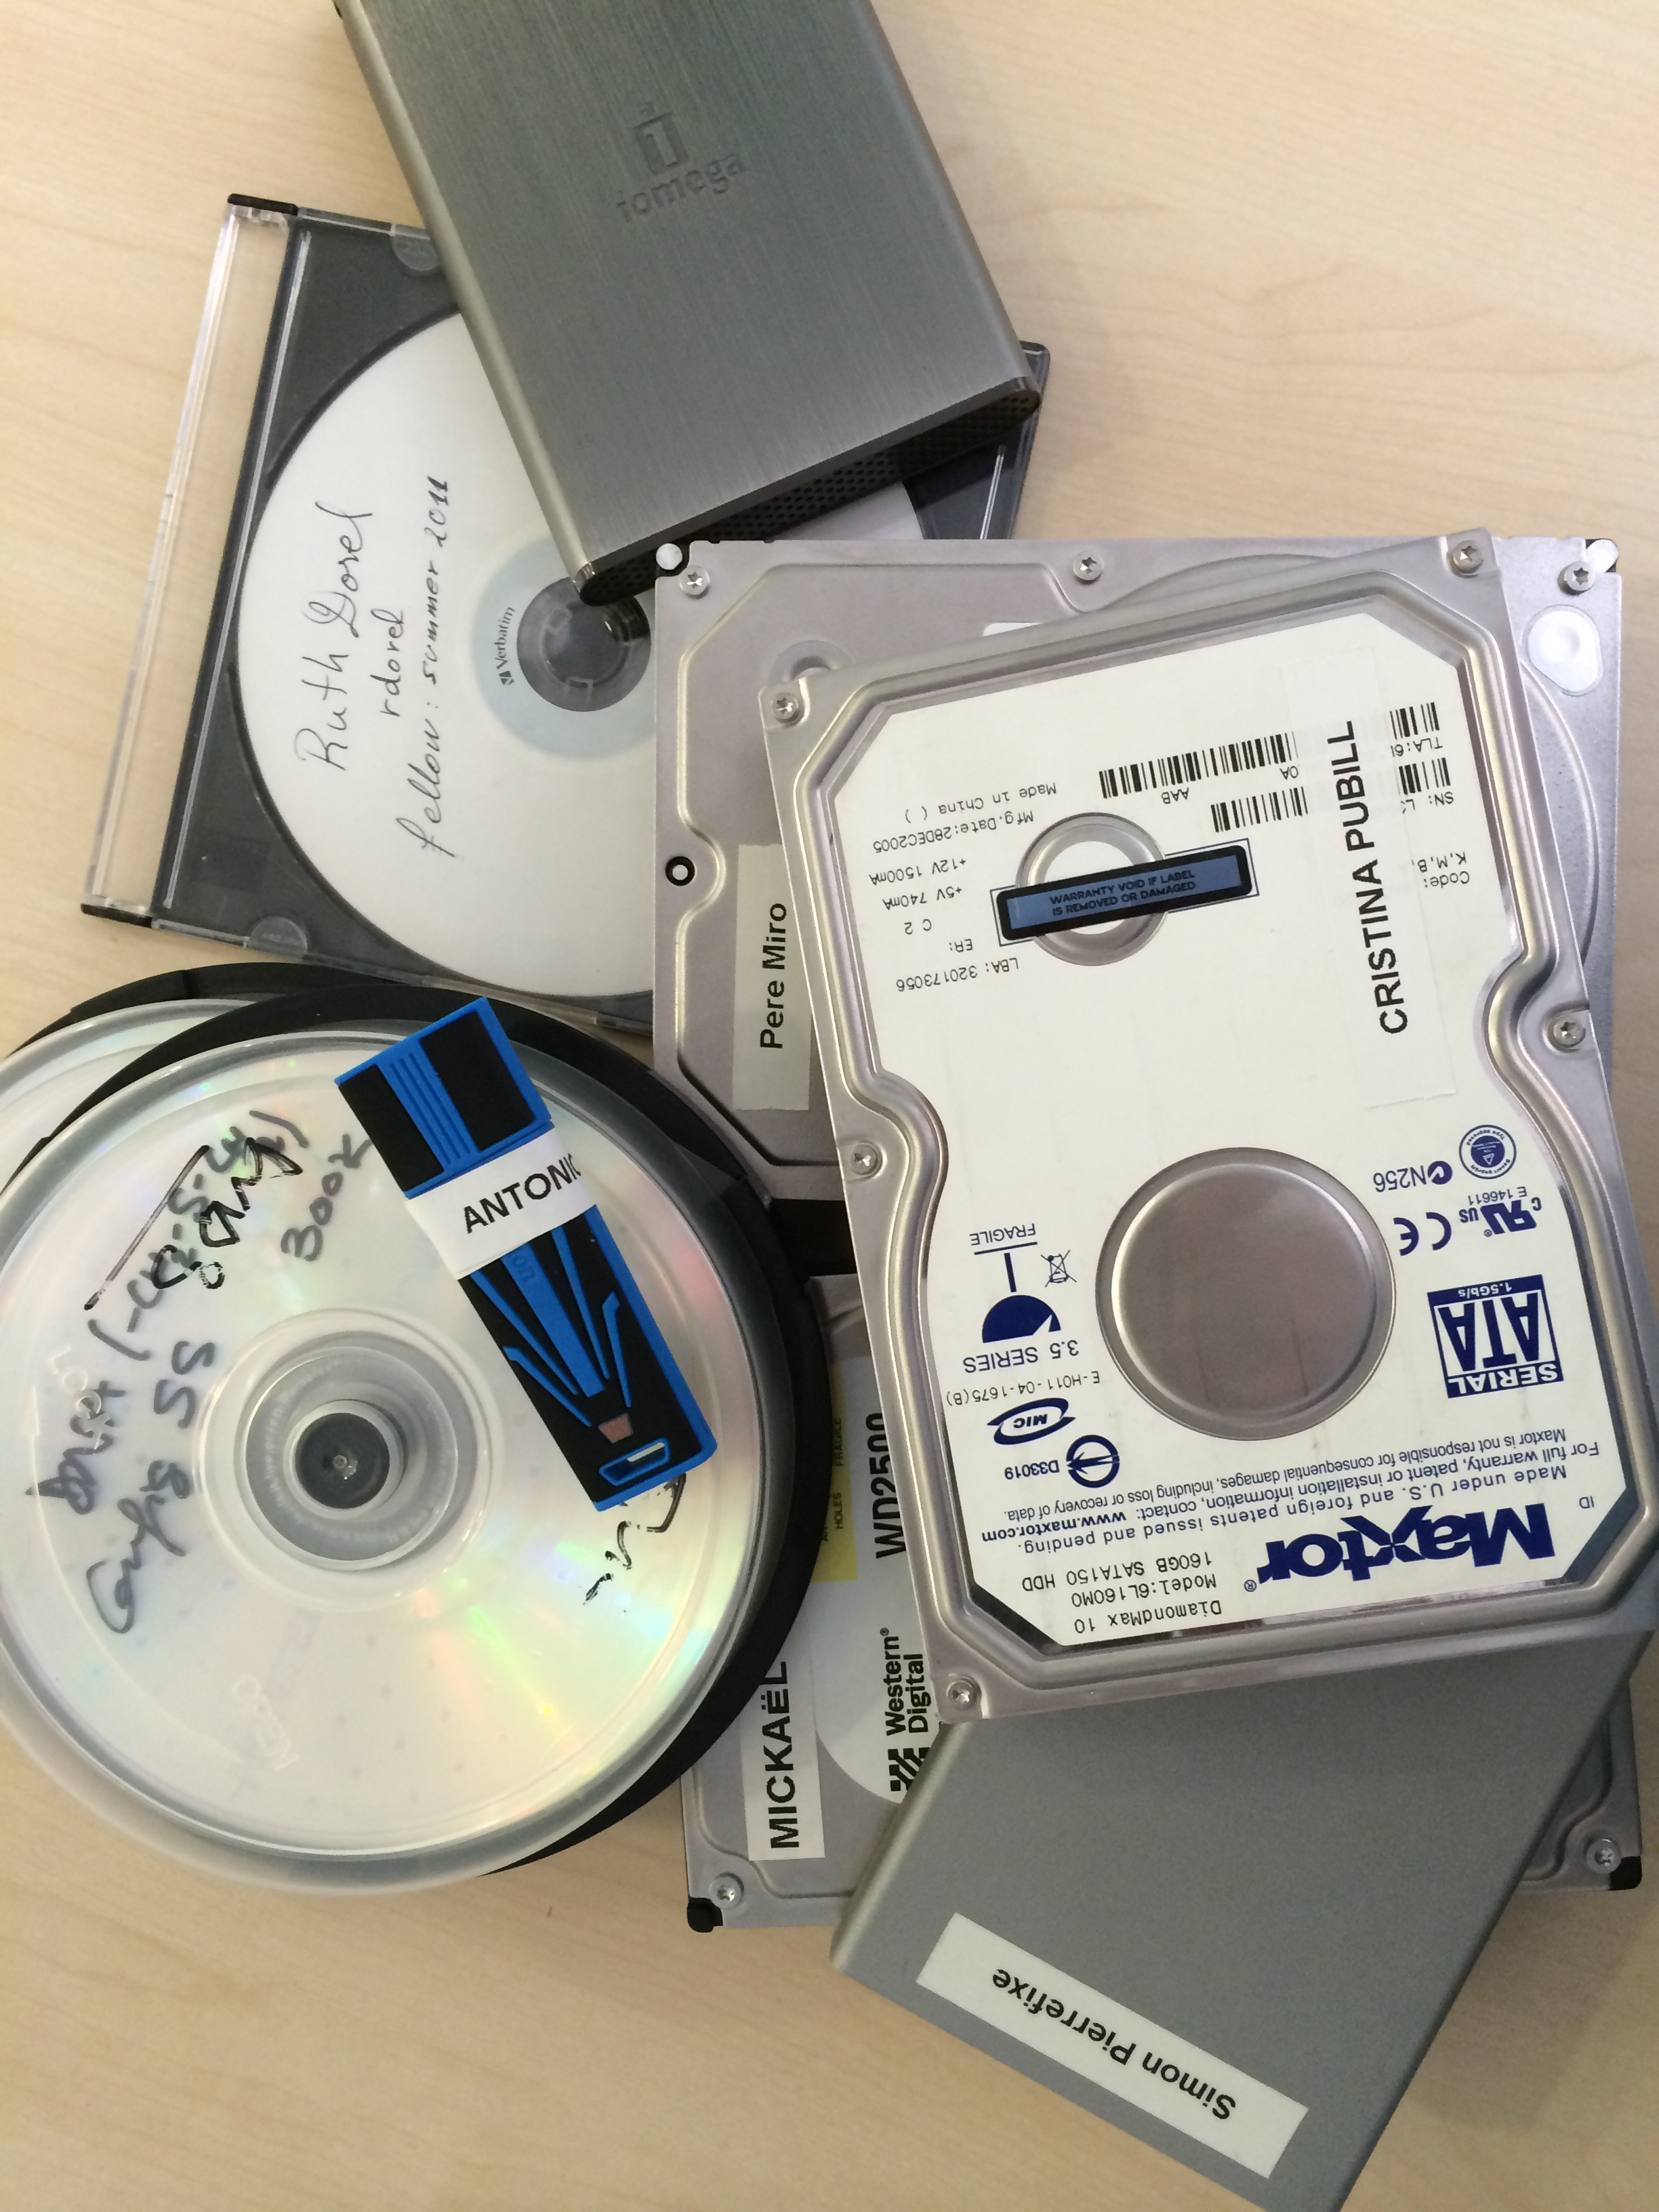
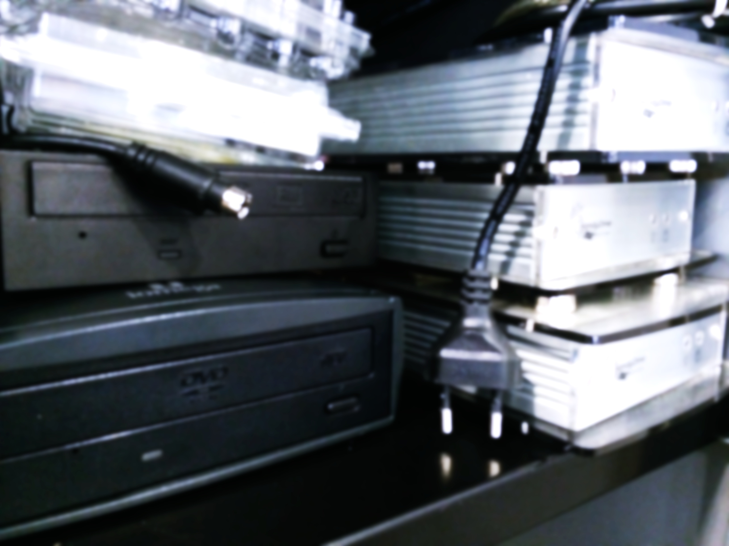
Our Big Data Problem (2)
Store and manage files of former group members

Slide 7
Our Big Data Problem (3)
Supporting Information files
Certify results - Reuse results

Slide 8
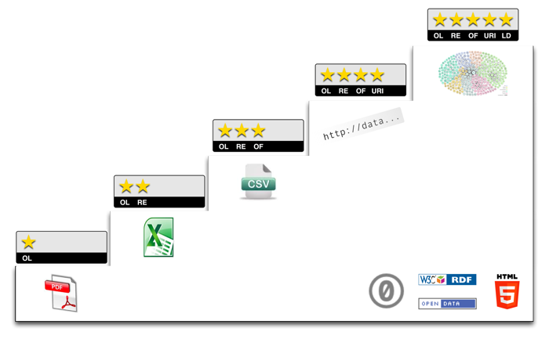
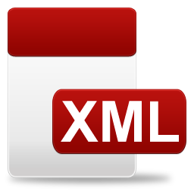
5 ★ Open Data
Tim Berners-Lee
ioChem-BD
Present

Slide 9
Present
Scientists
Submit jobs
Data Collection Manually
HPC
Files TeraBytes >95% waste
Publishers
Files
Reports (pdf files) Manually
Public
Information

Slide 10
Future
Scientists
Submit jobs Workflows
Data Collection Automated
Cloud
HPC
HPC on demand
Publishers
Reports XML Automated
Public
Information
Results Databases
XML
Information
Files

Slide 11
ioChem-BD
Scientists
Submit jobs
Data Collection Automated
HPC
HPC
Publishers
Reports XML Automated
Public
Files
Results Databases
XML
Files
Information

Slide 12
Objectives
Build a handy tool for:
  Managing any type of datasets
  Generating reports (xml, pdf, jpg)
  Making research data public access
Redefine daily workflows and publishing protocols
Set a common data standard for Comp. Chemistry formats (XML - CML)
Open to add future functionalities for data manipulation and analysis. Open to queries by third parties.
Build a distributed knowledge database → data becomes social
Notes:
So we setup a roadmap to develop a tool that fill these objectives :
Become a handy and daily tool in your data management, search and manipulation
Redefine current workflows by including ioChem-BD software in the middle of your work process.
Example : preparation and publication of supporting information (EXPAND THIS)
Set a common data standard among all quantum chemistry calculation package formats
Build a distributed knowledge database of result synthesis, our public calculations will be with others from different institutions, becoming a bigger distributed dataset.

Slide 13
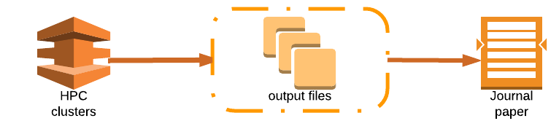




Definition
ioChem-BD is a Digital Repository aimed to manage and store Computational Chemistry files (inputs & outputs), and comes to fill the gap between results generation and manuscripts publication, and raise data to 5* quality.

Slide 14
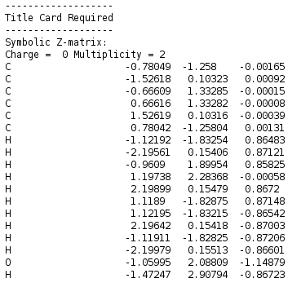
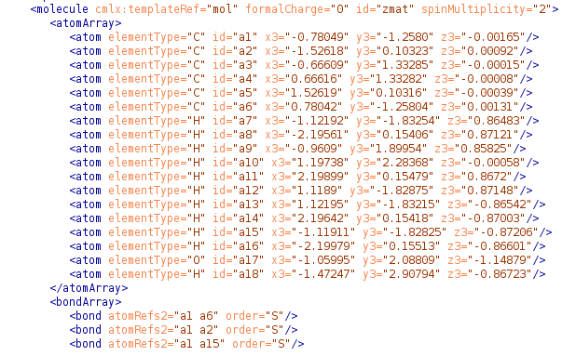
N starting formats → 1 final format
All output files are converted to CML
CML → Chemical Markup Language
Notes:
All output files, whatever its original format, are converted to CML for it’s later management by ioChem-BD.
Chemical Markup Language: Same markup structure as HTML / XML but oriented to chemistry.
Not user friendly but, computer friendly.

Slide 15
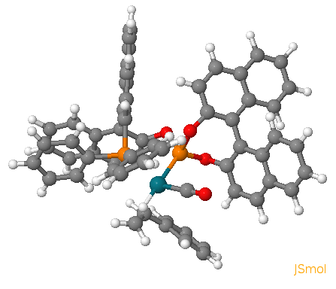
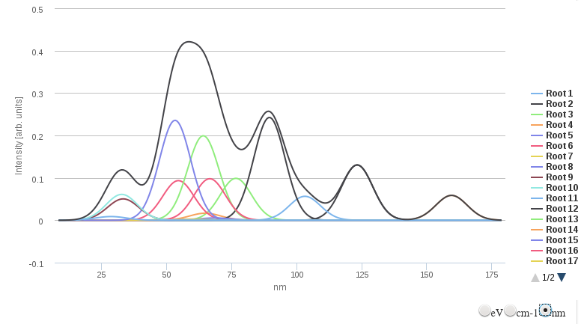
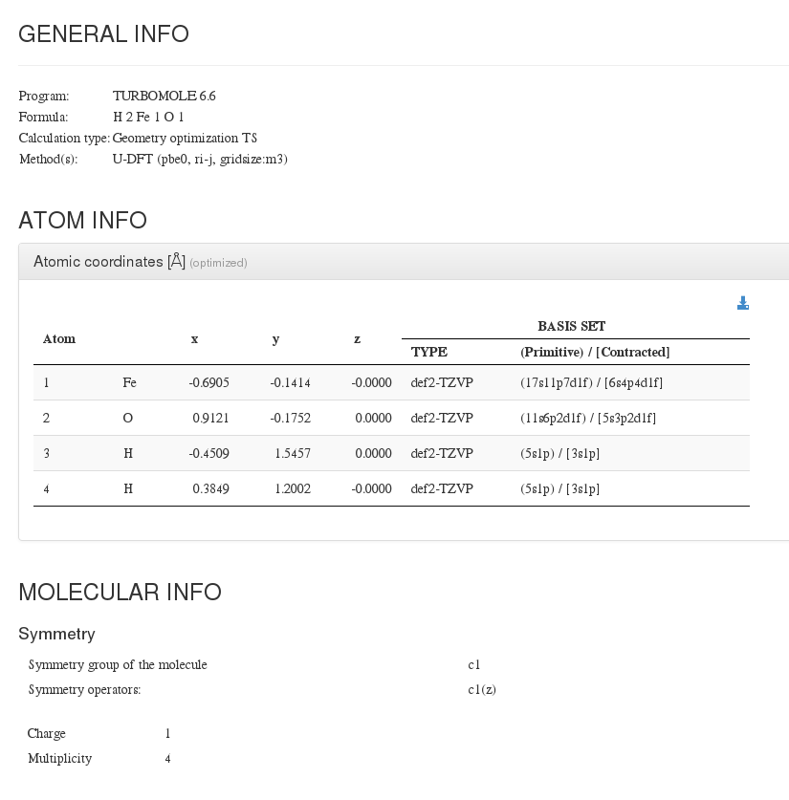
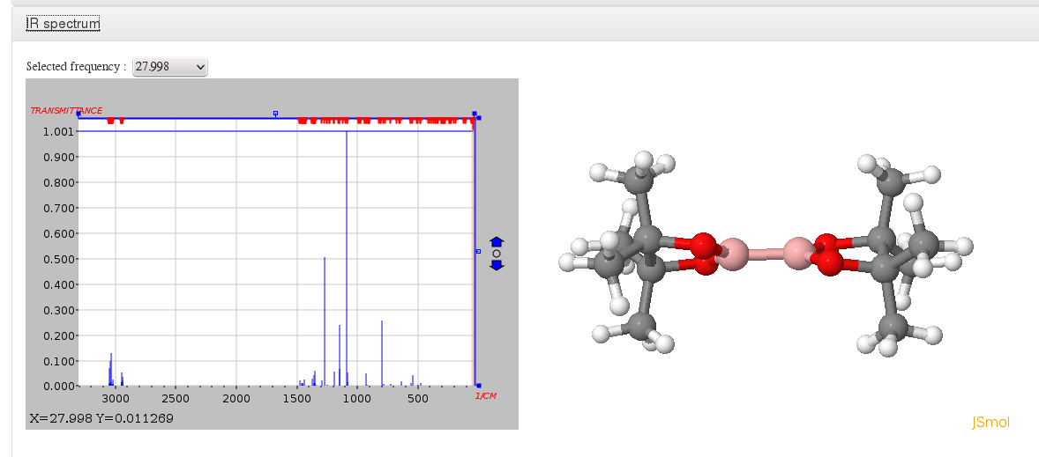
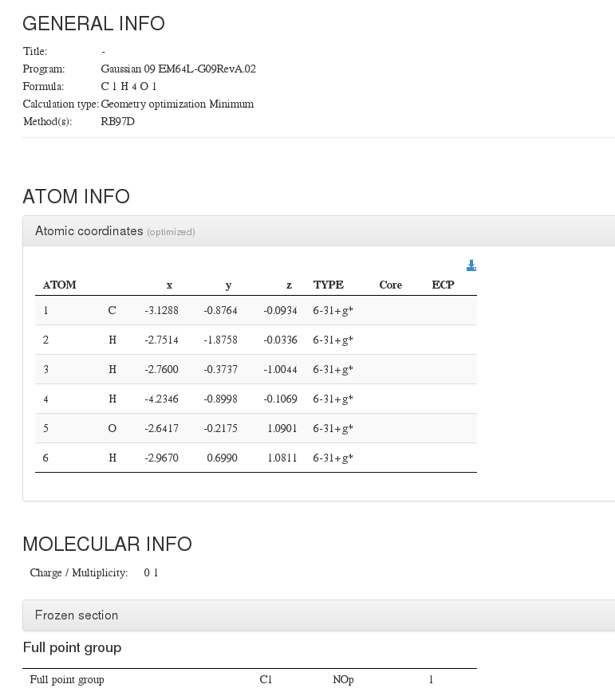
What does CML allow?
<CML/>
Notes:
Having our calculations in a structured and tagged format allows us to transform it into whatever format we can think of.
Today we convert your these files to XYZ coordinates files, Jcamp-Dx format to view vibrations,

Slide 16
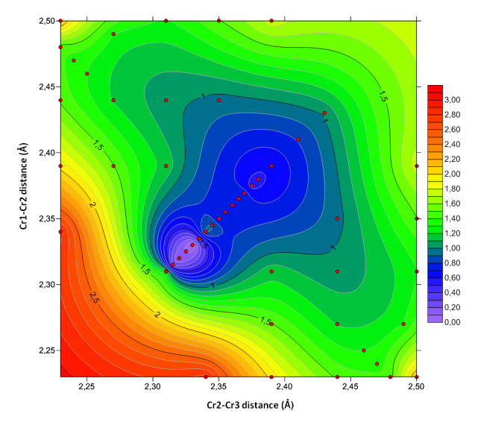
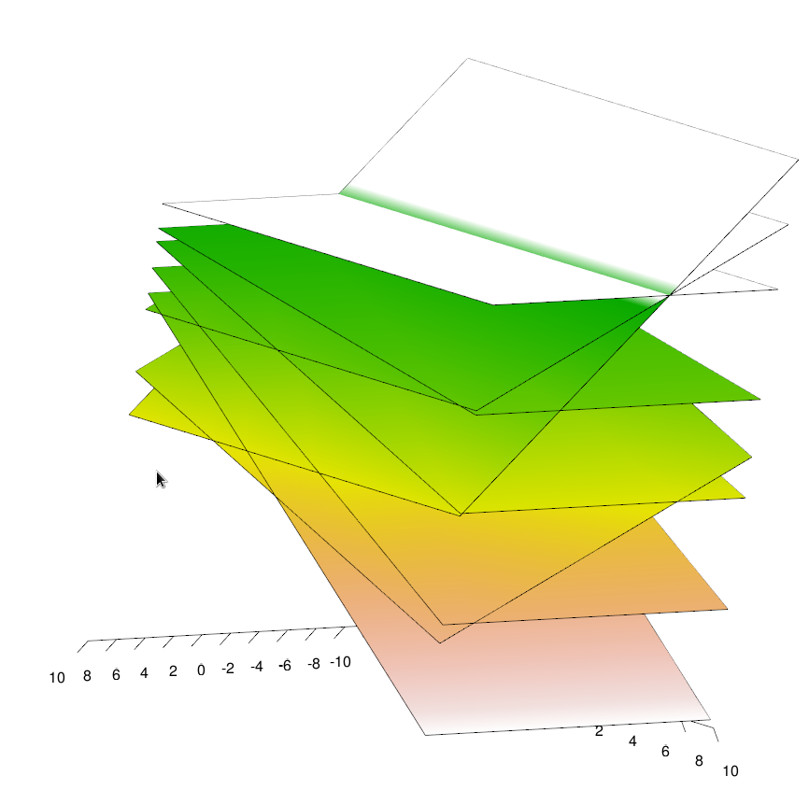
What will CML allow?
Anything researchers need to boost their research
New reports types, and graphs
New build formats
  R plots
  Datasets
  (Your code here)…
Notes:
We can convert them into any coordinate file format, we can conve

Slide 17
Features
Data syntheses : HTML5 reports
Data easily exportable and viewable
Ease of use web app
Integrated with other external software :
  Jmol, Chemaxon, HighCharts, DOI …
Fully and dynamically customizable on which fields :
  to capture
  to display
Notes:
Data synthesis: 90% garbage 10% interesting data
There is rule (unofficial) that is called the three clicks rule that states that every content in a web page must be at most at three clicks of distance from main page. We have tried to do so, so generate a supporting information report will take three (in this case two) clicks to build it. And that can be extended to any other type of report and visualization.
Our software take advantage of third party packages to display and manage information in very different ways.
Make this software you own

Slide 18
Architecture : ioChem-BD modules
Create
Private use
Single page web
Entry point for HPC centers
Upload via web/shell
Productivity oriented
Search by chemical substructure / metadata
Notes:
Create : Private use, entry point of your calculations
Browse : Public access

Slide 19
Create module

Slide 20
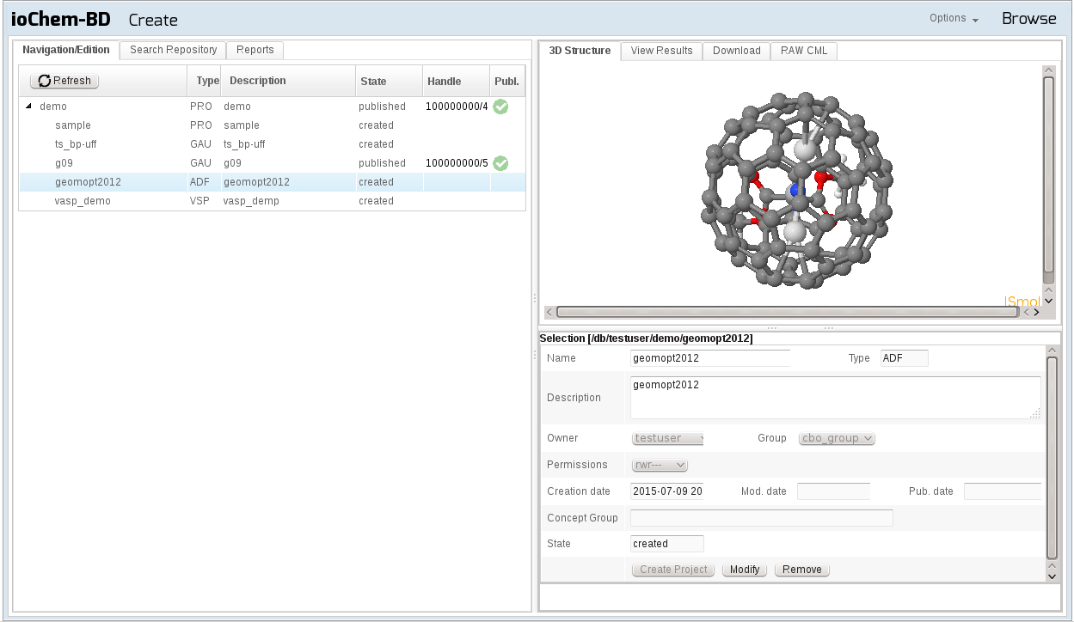
Create module

Slide 21
Create
Manage – Post-processing
  Organize projects collections
  Enrich Data: Description, keywords, additional files
  Reports: Generate Sup. Info. files (pdf) for publishing
  Reaction Energy paths
  Consistency (level of theory)
  Thermodynamic corrections
  Kinetic Analysis ( TOF, % e.e.)
  Molecular descriptors (QSAR)
  etc …

Slide 22
Architecture : ioChem-BD modules
Browse
Public content
Multiple web pages
Data coming from Create
Data browse, search
Community generated
Content syndication

Slide 23
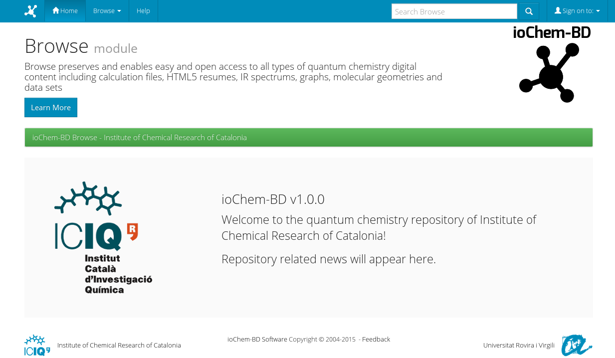
Browse module

Slide 24
Browse

Slide 25
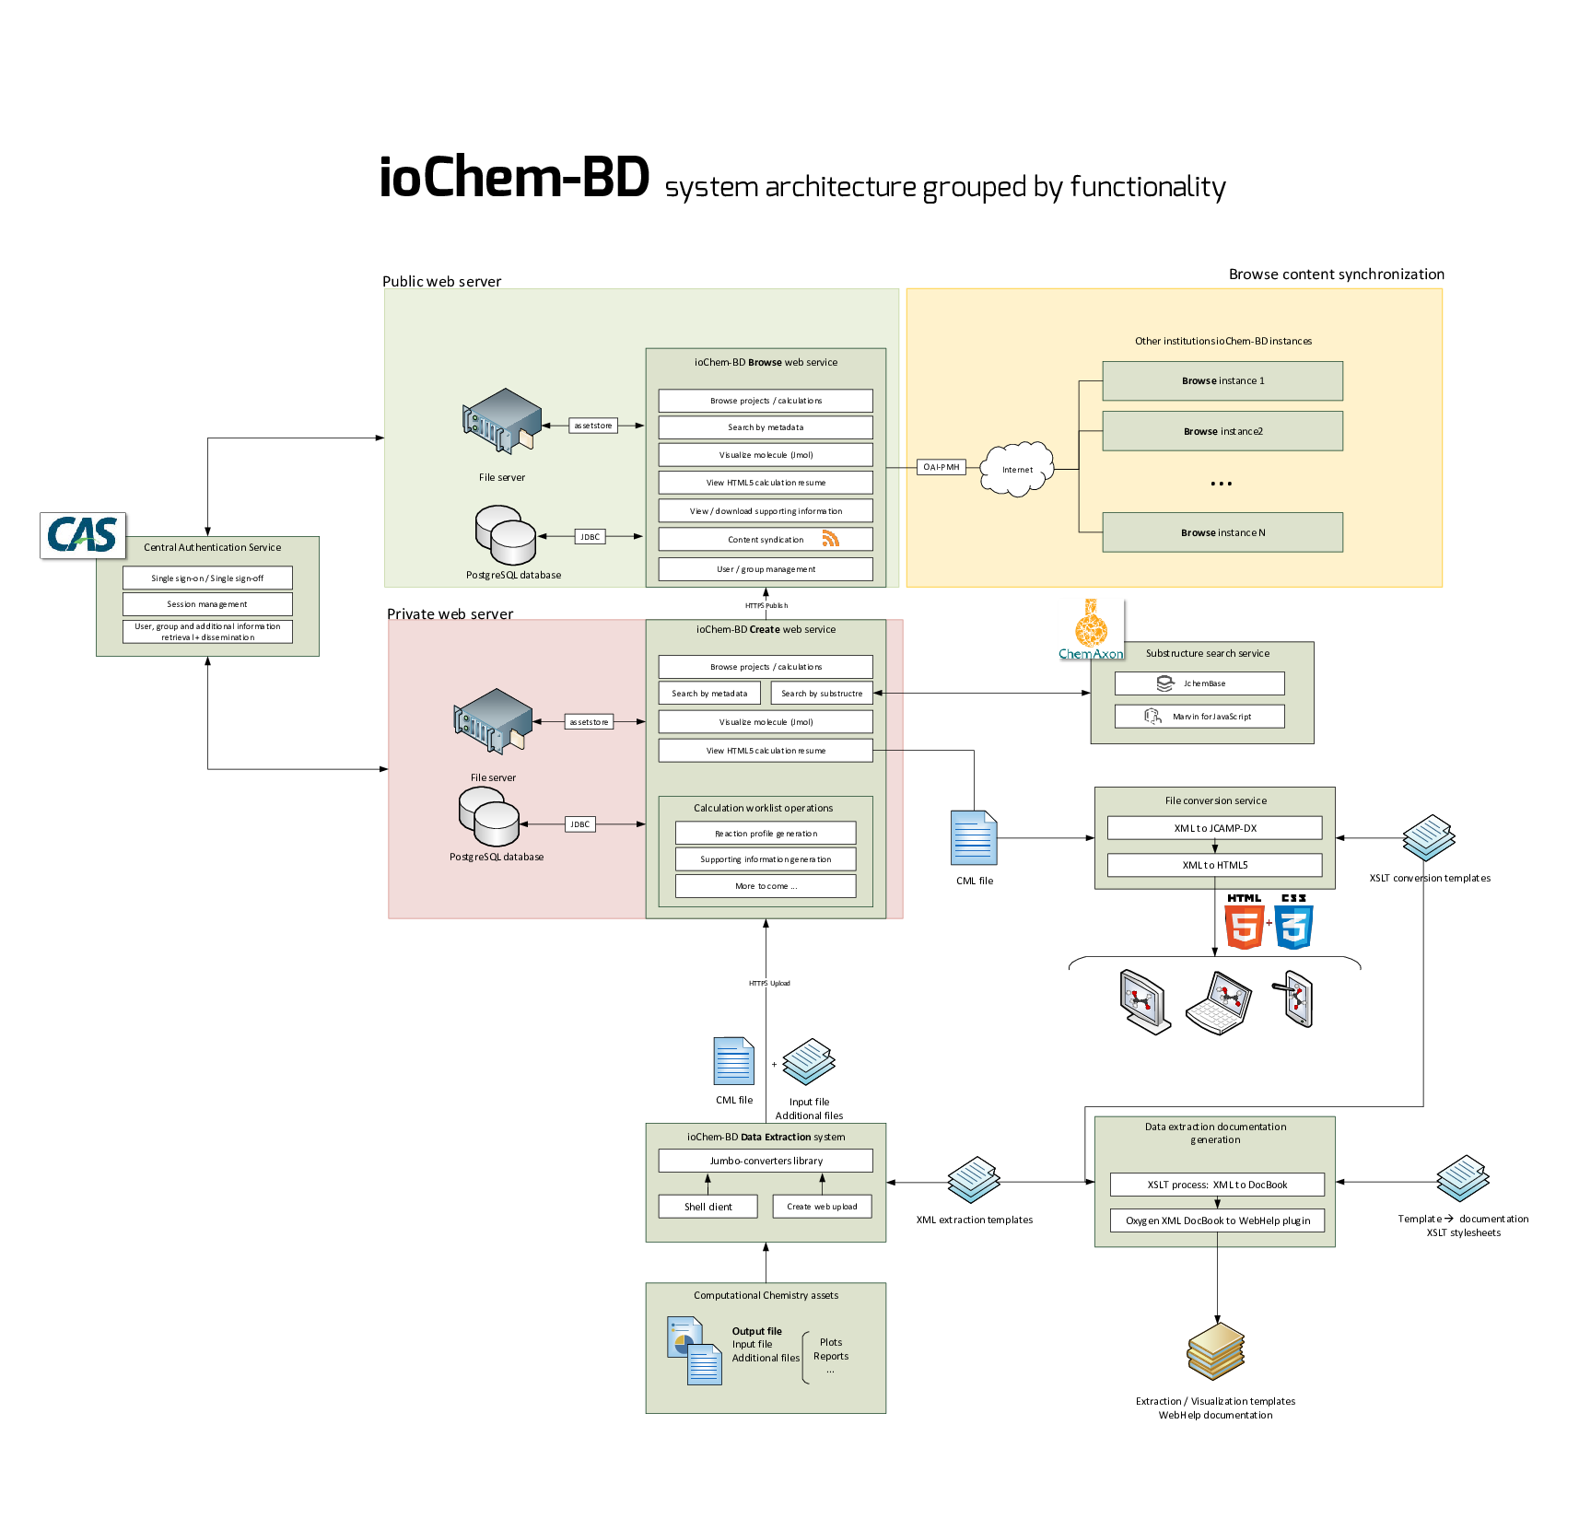
Notes:
So to achieve this goal of simplicity we need to get complex in the background.
This is a diagram with the most relevant workflows in our systems, won’t explain them.

Slide 26
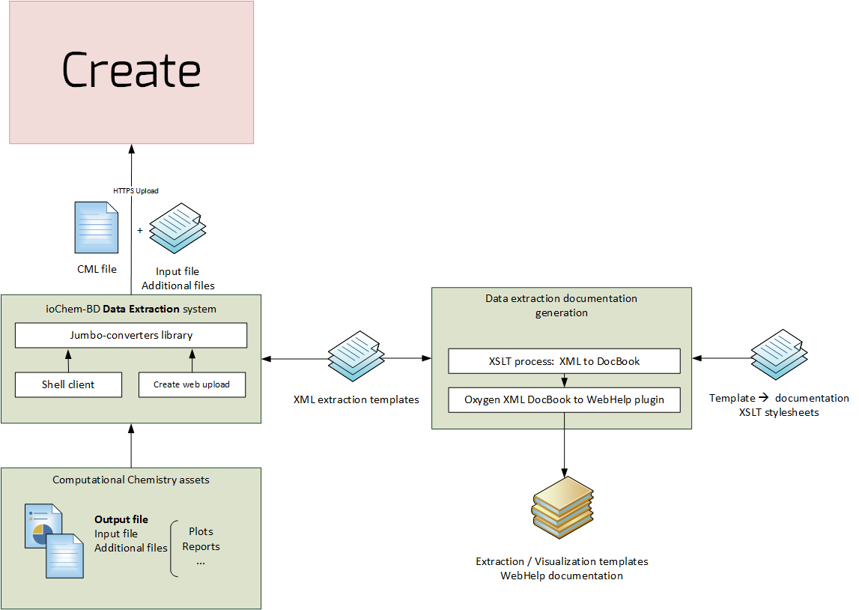
ioChem-BD
Data conversion workflow

Slide 27
Performance of our new extraction library
≈4x

Slide 28
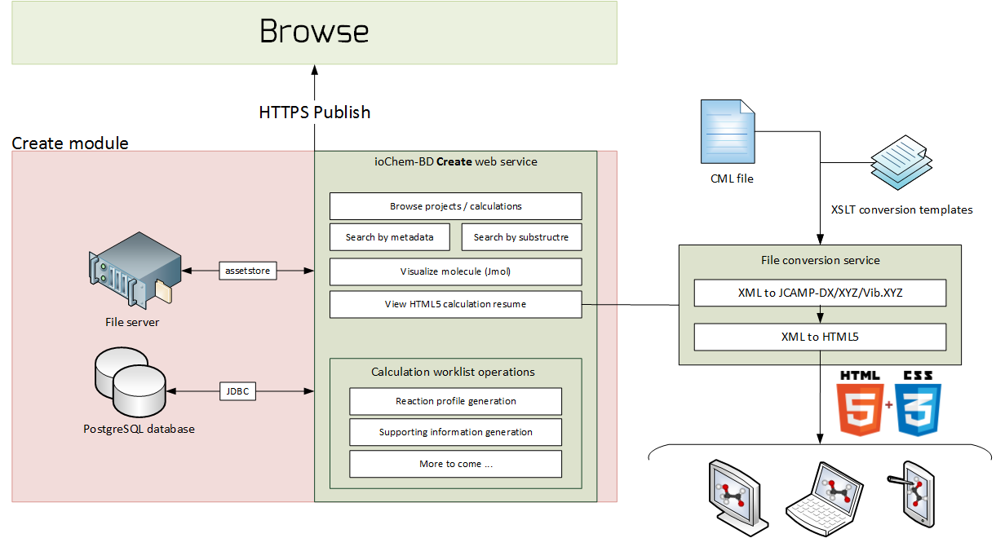
ioChem-BD
Create module features

Slide 29
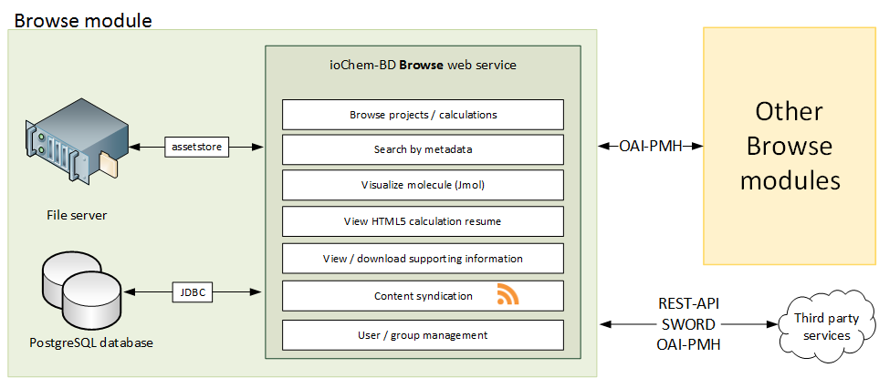
ioChem-BD
Browse module features

Slide 30
Current project status
In production (ICIQ, URV, UdG) & Demo servers up ( www.iochem-bd.org)
Supported formats:
  Gaussian, ADF, VASP, Turbomole, Molcas, ORCA
Reports Module (Sup. Info., Reaction Energy profiles)
Download just one single file installer
Documentation (www.iochem-bd.org/wiki)
Álvarez-Moreno, M.; de Graaf, C.; López, N.; Maseras, F.; Poblet, J. M.; C, Bo J. Chem. Inf. Model. 2015, 55, 95.
On going projects:
ERC Proof-of-Concept (N. López, ICIQ): Catalytic materials
La Caixa/Crysforma: molecular properties database for APIs
DOI
Query other databases (ChemSpider, CheBI)
TO DO:
Sindicate distributed browsers
… and much more

Slide 31



Acknowledgements

Slide 32
Taming the Big Data in Computational Chemistry
www.iochem-bd.org

