Slide 1

ERIH PLUS
Making the SSH visible, searchable and available
Gry Ane Vikanes Lavik* and Gunnar Sivertsen**
* Norwegian Centre for Research Data (NSD), Bergen
        ** Nordic Institute for Studies in Innovation, Research and Education (NIFU), Oslo
NSD©2016

Slide 2
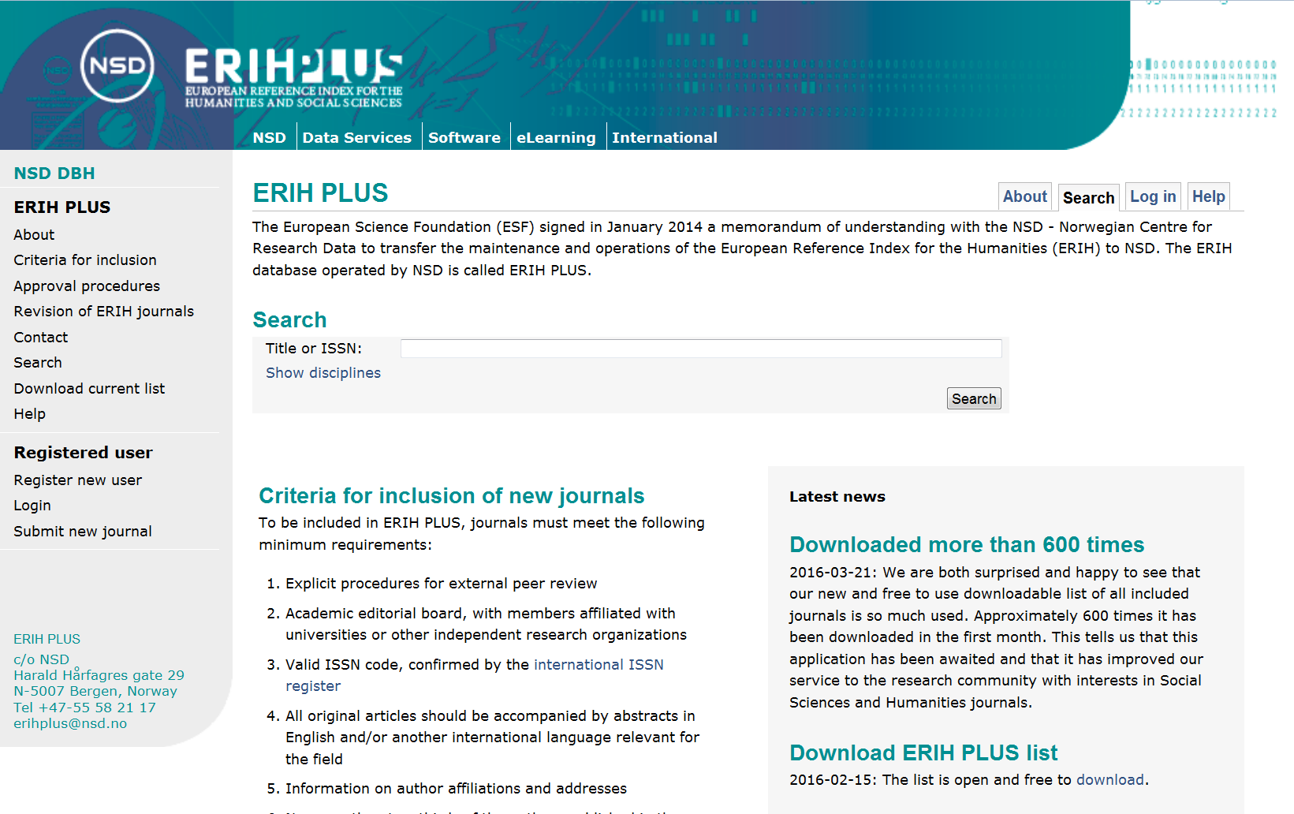

Slide 3
General description of ERIH PLUS
Created and developed by the Standing Committee for the Humanities (SCH) of the European Science Foundation (ESF).
Continues as The European Reference Index for the Humanities and the Social Sciences (ERIH PLUS)
Aims to increase the visibility of the humanities and the social sciences by providing an international infrastructure for a comprehensive bibliographic coverage of the scholarly communication and publishing in the fields.
A well-defined, standardized and dynamic register of scholarly journals is already up and running.
Covers so far 7,500 journals in all European languages. The journals must correspond to six verifiable criteria.

Slide 4
Relevance for euroCRIS and CRIS in general
The ERIH PLUS register of journals provides a basis for standardizing the bibliographic data and making them available and comparable across different CRIS systems.
A well-defined, standardized and dynamic register of scholarly journals is already up and running.
Covers so far 7,500 journals in all European languages. The journals must correspond to six verifiable criteria.

Slide 5
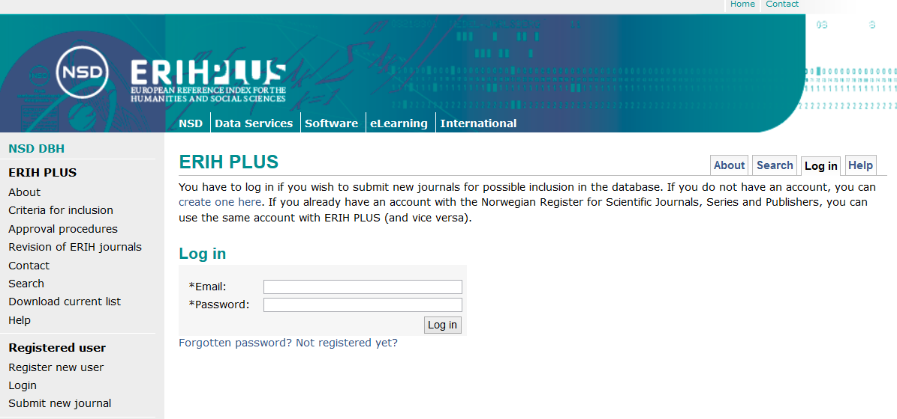
From ERIH to ERIH PLUS
Now includes the social sciences as well as the humanities.
Journals are not ranked any more (A, B, C). Instead, more objective criteria for inclusion have been established.
The register has become dynamic. Additions can be proposed at any time:

Slide 6
Criteria for inclusion
    Explicit procedures for external peer review.
    Academic editorial board, with members affiliated with universities or other independent research organizations.
    Valid ISSN code, confirmed by the international ISSN register.
    All original articles should be accompanied by abstracts in English and/or another international language relevant for the field.
    Information about the affiliations and addresses of the authors should be published for each article.
    Minimum national level: No more than two thirds of the authors published in the journal are from the same institution.

Slide 7
Project organization
Daily activity: Submissions are reviewed continuously and checked according to formal criteria
Advice is sought from appointed National Experts, if needed.
An International Advisory Group provides expert guidance on strategy and principal matters

Slide 8
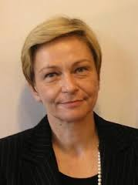
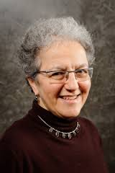


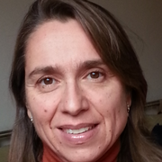
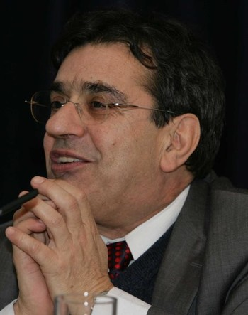
The International Advisory Group
Milena Žic-Fuchs, University of Zagreb, former Croatian Minister of Science and Technology and Chair of the ESF-SCH, Cognitive linguistics
Nina Kancewicz-Hoffman, Former Head of the Humanities and Social Sciences Unit in the ESF, Polish literature
Alain Peyraube, Directeur de Recherche at the Centre National de la Recherche Scientifique (CNRS), Chinese linguistics
Cláudia S. Sarrico, Associate Professor, University of Lisbon, Economics, Higher Education Policy Studies
Gunnar Sivertsen, Research Professor, NIFU (Oslo), Scandinavian Literature, Bibliometrics
Stefan Hornbostel, Professor, Director of Institut für Forschungsinformation und Qualitätssicherung, Berlin, Sociology, Science Studies

Slide 9
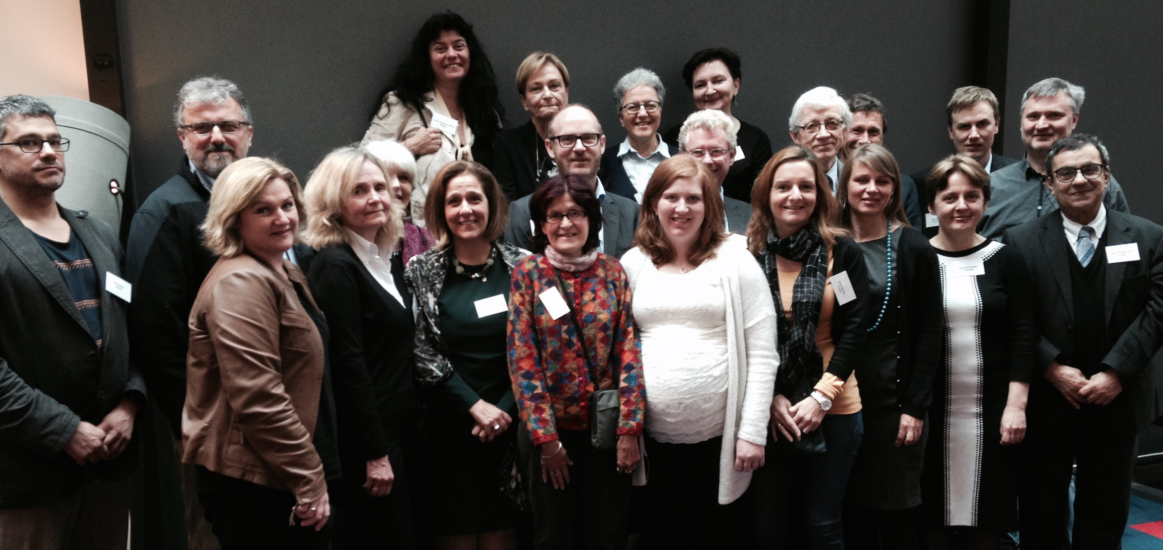
National Experts

Slide 10
Effects and achievements
An increasing awareness about on-line transparency among researchers involved in SHH journals throughout Europe
Many European journals within SSH are now giving more detailed information about the editorial board, the peer review procedures, and about authors as well as abstracts in English on their web site, all in accordance with the ERIH PLUS criteria.

Slide 11
The ambitions of ERIH PLUS
Continue to challenge the limited coverage of the SSH in the commercial data sources.
Become increasingly important as a resource for the running of CRIS-systems worldwide.
Guide a more proper coverage of the SSH in performance-based funding systems.
Become an agreed standard and resource in the development of a proper evaluation methodology for the SSH.
Become an important information source for supporting Open Access and research quality in OA journals.
Develop from being a "list" to becoming an enriched information resource - through European collaboration.

Slide 12
