Slide 1
Swepub Analysis
Offering High Quality Institutional Repository Publication Metadata Using Linked Data Technologies
Theodor Tolstoy, Developer, National library of Sweden

Slide 2
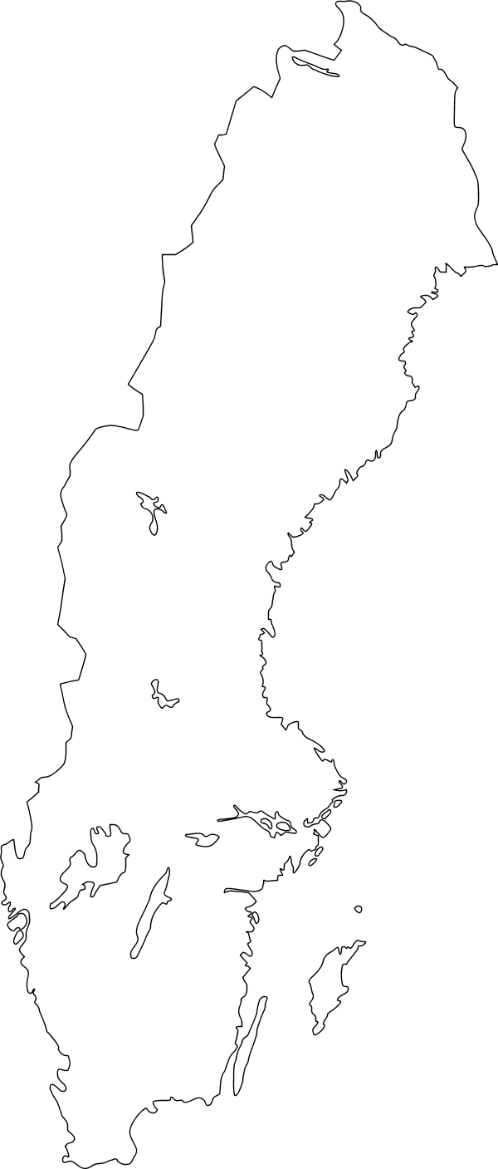

Swepub Search
Developed by the National Library of Sweden in 2009
Aggregates data from Swedish universities and higher education institutions
Offers various search and bibliographic data services for academic publications
swepub.kb.se

Slide 3
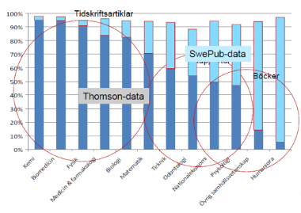
Swepub Analysis
Government assignment to further develop Swepub, making it possible to offer high quality publication metadata aimed at researchers and analysts working in the areas of bibliometrics and scientometrics.
First public beta release in 2015.
bibliometri.swepub.kb.se
Notes:
Due to poor coverage in commercial database

Slide 4

The journey of data in Swepub
Harvesting
Triplification
Data validation
Deduplication
Enrichment
  OA-validation
  Publication Channel enrichment
Quality issues
Swepub
<MODS />
Triplification
DOAJ
ROAD
External data sources

Slide 5
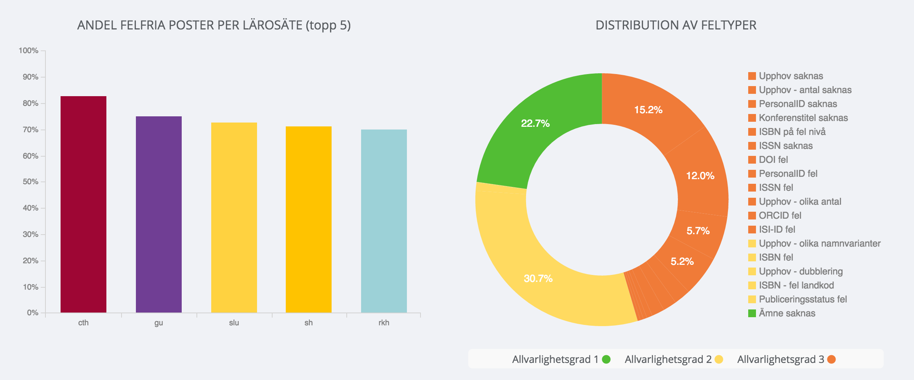
Encouraging data quality improvement

Slide 6
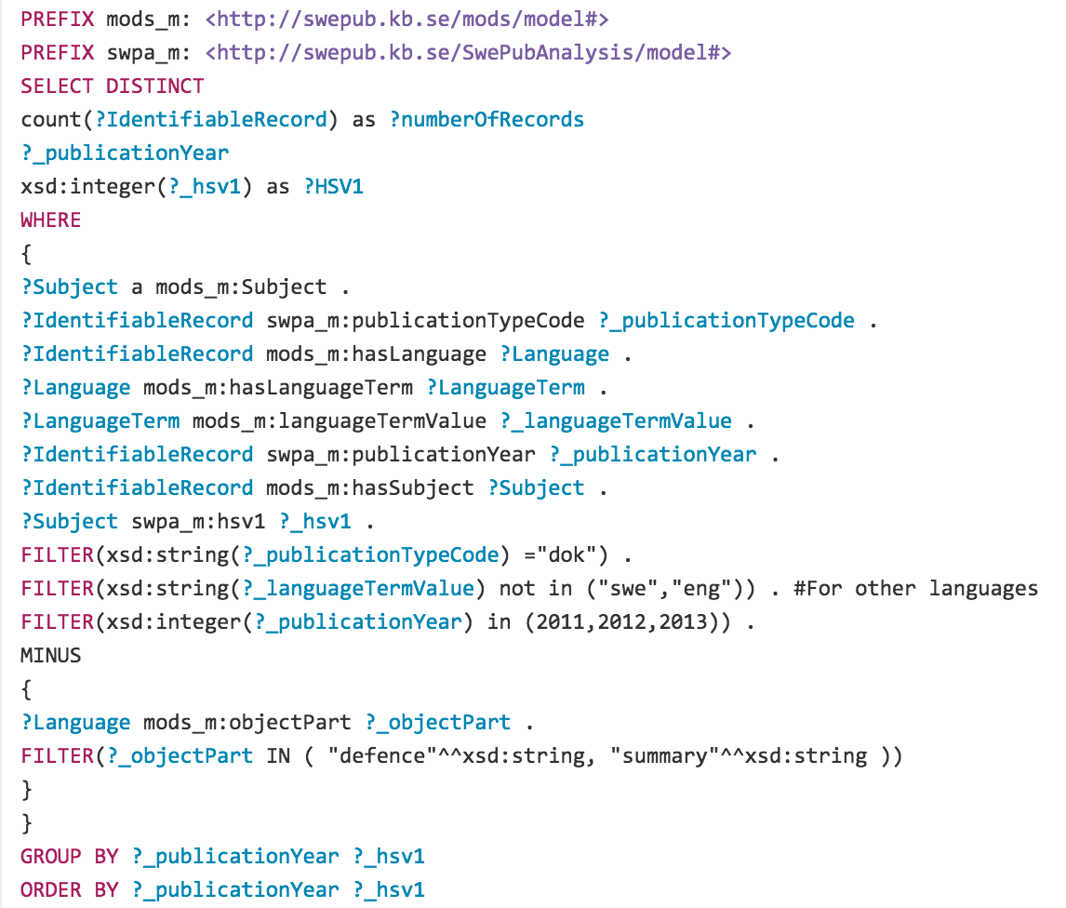

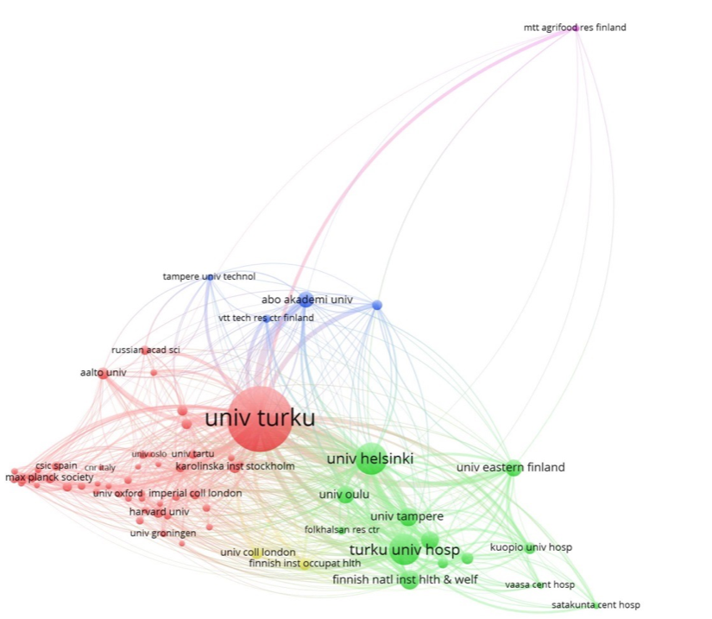



Getting data out
SPARQL
Bibliometric
.csv
Raw

Slide 7
Getting data out
SPARQL
Bibliometric
.csv
Raw

Slide 8
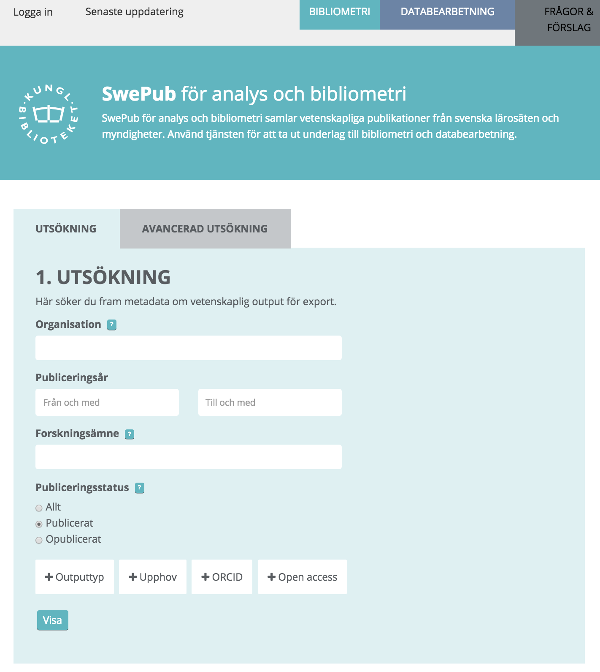
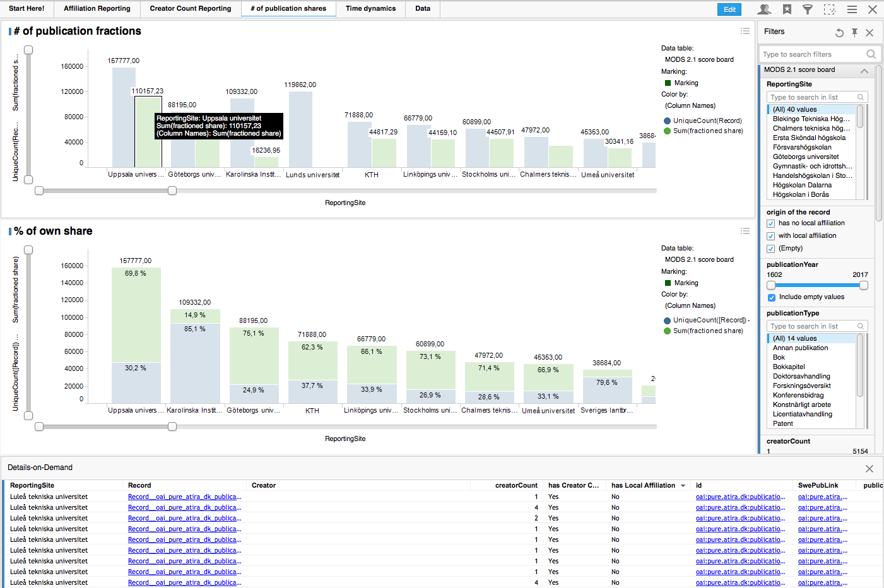
SPARQL alternatives
Web interface
Spotfire- BI Tool

Slide 9
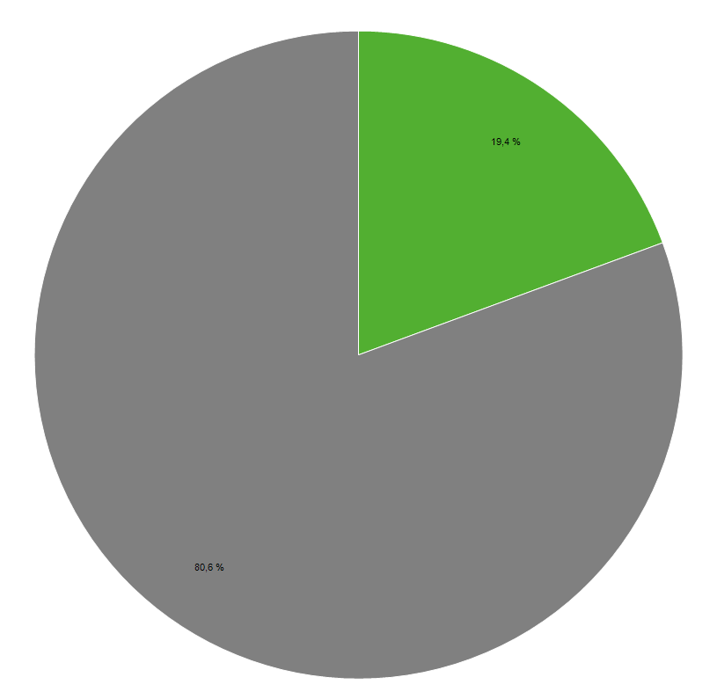
Open Access in Swepub
Why enrichment?
Getting a better picture of OA publishing
Catching up on embargo
Enabling different definitions
Verifying claimed OA publishing
Green OA = Full text link to free version
(Apx. 50% are linking to own IR)

Slide 10

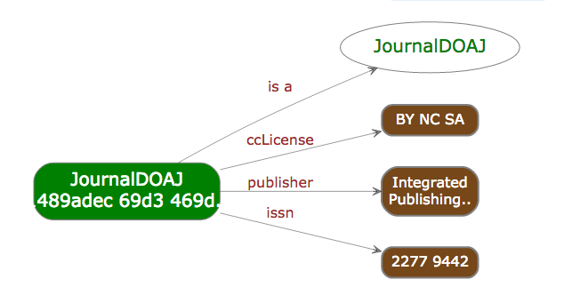
Directory of Open Access Journals (DOAJ)
Contains 8 900 journals
Strict definitions and criterias for inclusion
Data on copyright licence, APC prices etc
Gold OA = If a publication is published in a journal in DOAJ
Notes:
As you can see, coverage is increased

Slide 11
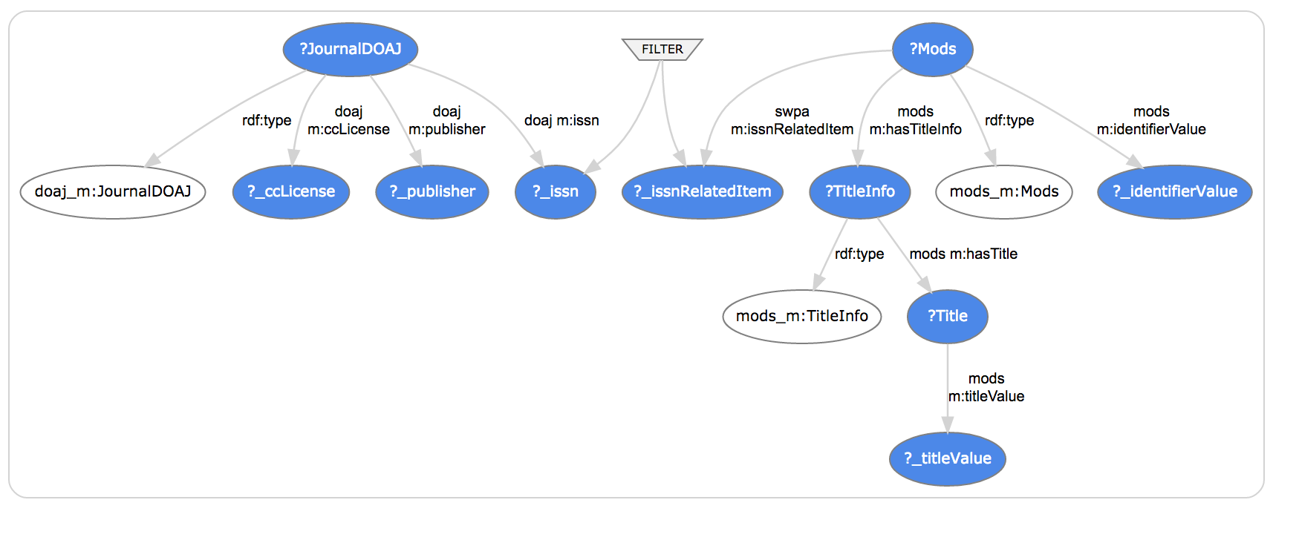
Connecting the graphs

Slide 12
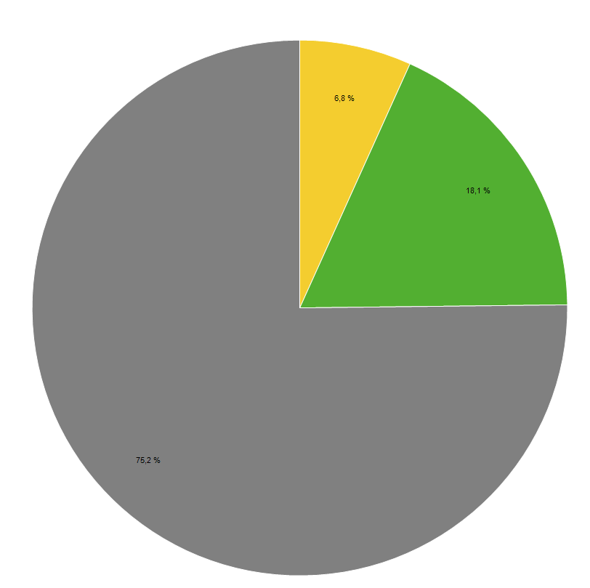
Increased Coverage

Slide 13
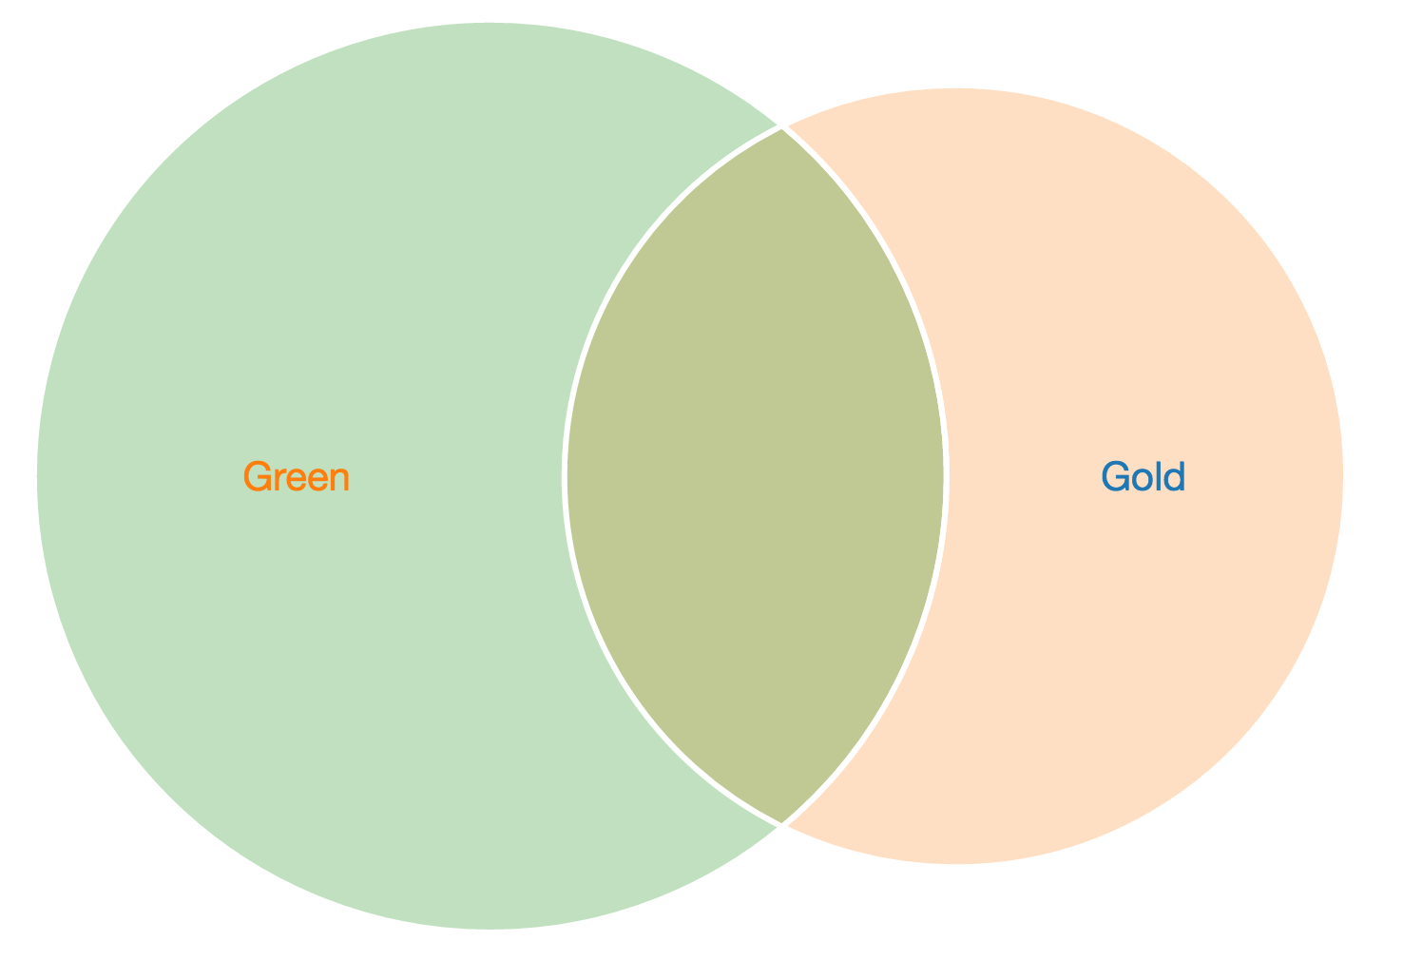
Overlap

Slide 14
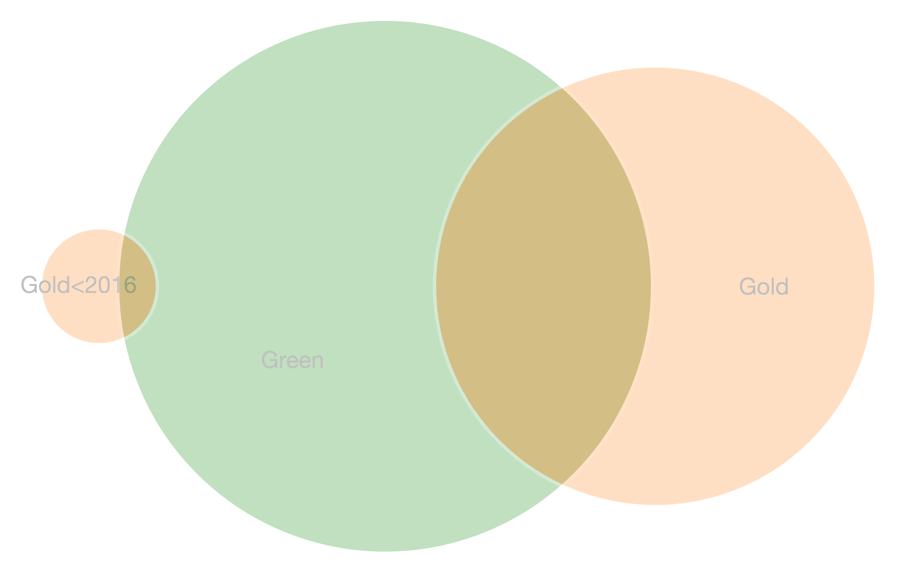
DOAJ Reapplication process
In 2014, older journals had to reapply for inclusion in DOAJ
2 year window for reapplication
2 850 journals removed May 9th 2016
Publications before 2016 in removed journals are still considered Gold OA
So far 56 publications are excluded.
300 publications per year in excluded journals

Slide 15
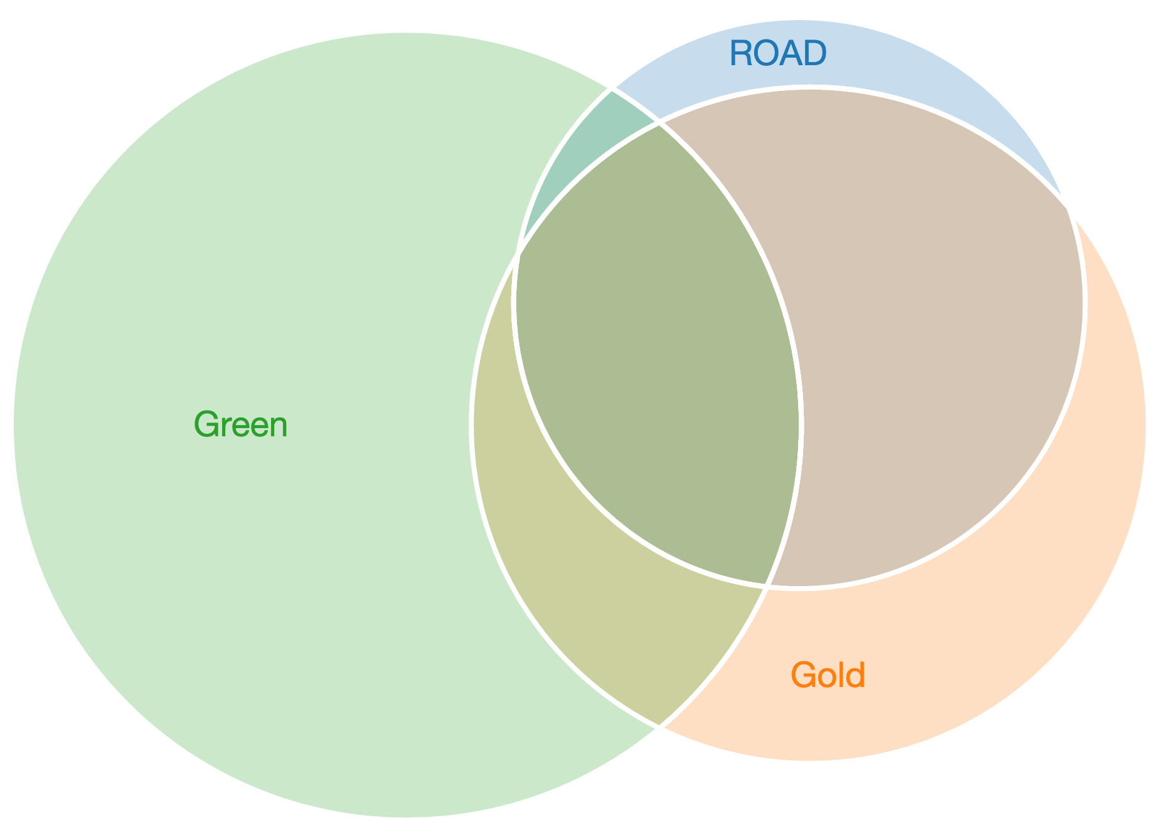
ROAD - Directory of Open Access scholarly Resources
Currently under consideration
Provided by the ISSN International Centre
ISSN records that are Open Access
Criterias differ from DOAJ
RDF Data available!
Increases OA coverage in Swepub

Slide 16

Directory of Open Access Books - DOAB
4700 + Open Access books
96 Swepub publications matching books in DOAB.
Notes:
Can be due to Quality issues in Swepub

Slide 17
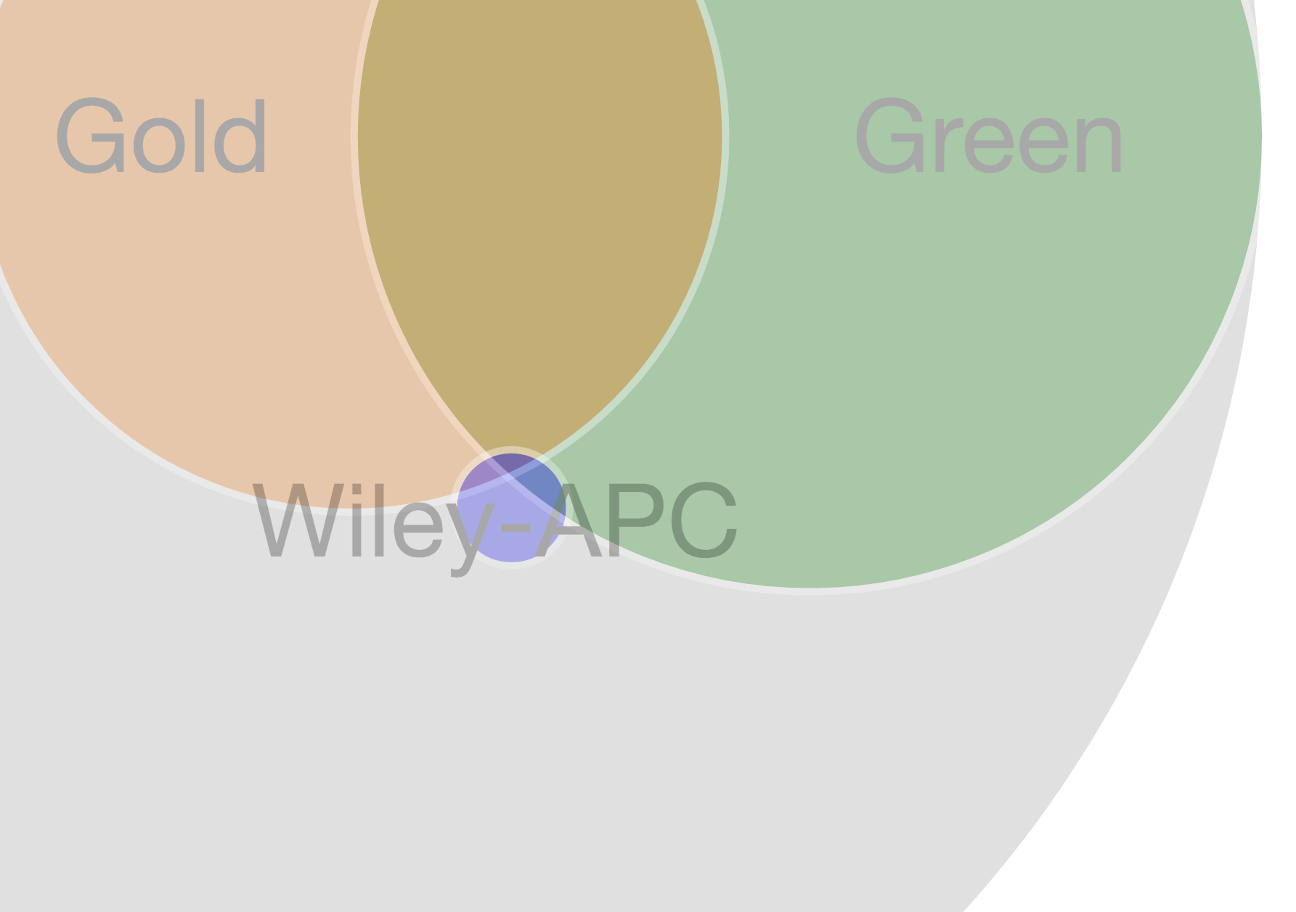
Hybrid publications - Data from the publishers
Trial on APC data from Wiley
Easier to obtain than to track down invoices,
Only list prices, no actual costs
Poor, fragmented bibliographic data
More OA coverage in Swepub
Can be used for approximations on total costs and signs of double dipping

Slide 18
Conclutions & further development
Consuming and querying Linked Open Data is very powerful.
The hard part is exposing Linked Open Data the right way
  Swepub will be working on exposing its data and mapping it to established vocabularies.
Invloving external sources early in the process is beneficial for both analysis and quality.
  Constantly looking for data sources that could help validate data or enrich the database.

Slide 19
Questions!
@tedde, @swepub
bibliometri.swepub.kb.se

