Slide 1
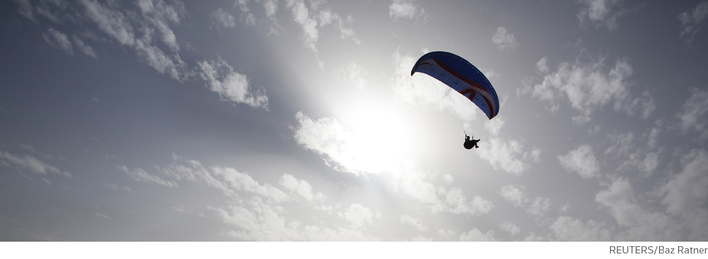
Thomson Reuters’ engagements with
Open – Access, Data, Standards
Brigitte Joerg, Lead Product Standardization Egineer
Sebastien Vellay, Country Account Manager, Iberia
Katrin Jaehnke, Converis Solution Specialist

Slide 2
Outline
More openess: Changing research landscape
  Trusted Information
  Intuitive Technology
  Dynamic Reporting
Powering innovation: Standarization initiatives
Future Developments

Slide 3



The innovation process is rapidly becoming more open, providing challenges for those managing and tracking open research.
Notes:
The innovation process is rapidly becoming more open, from self-archiving in an institutional repository or central repository/open access website, to Open Access journals which may be subsidized or require payment on behalf of the author.

Slide 4
How Do You Succeed In Today’s Open World?

Slide 5
You Succeed With THOMSON REUTERS
Trusted
Information
Intuitive
Technology
Dynamic Reporting
Strategic Decision Making
Support
Trusted Information
Web of ScienceTM is continuously expanding the boundaries of access to open science. Open starts with access to data.
Approx. 11% of the current Web of Science Core Collection journal coverage are Open Access journals
The Data Citation Index provides access to research data output alongside traditional publications
Direct full text links in the Chinese Academy of Sciences international repository (coming soon)
Notes:
OPENESS starts with Access to Data (OA Journals)12,5% core collection
How does TR support that change towards openess?
WoS OA availability / increased open access coveradge
Chinese Academy of Sciences—full text link
10.3%= 12,665 journals (https://thehub.thomsonreuters.com/docs/DOC-978892?utm_medium=search&utm_source=full), 1,313 open Access titles (https://thehub.thomsonreuters.com/docs/DOC-1077519)

Slide 6
By The Numbers
Directory of Open Access Journals
10,487 Journals
6,351 Searchable at Article level
134 Countries
1,940,408 Articles
With our rigorous content selection process, 1,313 Open Access titles are indexed in Web of Science Core Collection
That’s 12.5% of all DOAJ Open Access journals!
Web of Science Core Collection coverage:
Notes:
https://doaj.org/
Beyond the Core Web of Science indexes we also cover millions of open access data sets in DCI, and the SciELO Citation Index is comprised exclusively of OA publications, covering over 700 journals primarily in Spanish and Portuguese.

Slide 7
You Succeed With THOMSON REUTERS
Trusted
Information
Intuitive
Technology
Dynamic Reporting
Strategic Decision Making
Support
Intuitive Technology
Converis Open Access Repository functionality
Currently connects with Dspace and Eprints
Sherpa/Romeo colours at the article level
Extended Open Access support (coming soon)
Integration with Thomson Reuters’ Products information and data
Notes:
Technology needs to support these requests towards more openess
Extended: To support funder policies in Europe e.g. HEFCE/REF UK, Narcis NL

Slide 8
Discovery Standards support with Converis
OAI-PMH — in support of Open Access harvesting
CASRAI – Standard Terminology support
OpenAIRE — compliance (coming soon)
VIVO Connector — in support of Open Data initiatives and applications (coming soon)
DINI 2013 — Germany’s standardization initiative to guide Open Access implementation
Notes:
Concrete technological examples how to support the discovery of what is publically acessible and how the information is provided
INTERFACES
STANDARDS

Slide 9
You Succeed With THOMSON REUTERS
Trusted
Information
Intuitive
Technology
Dynamic Reporting
Strategic Decision Making
Support
Dynamic Reporting
Unique data analysis in InCitesTM allows to understand your Open Access research performance
Compare how you perform in Open Access
Notes:
InCites based on WOS, OA flags (year, author, research area)
Converis Sherpa Romeo

Slide 10
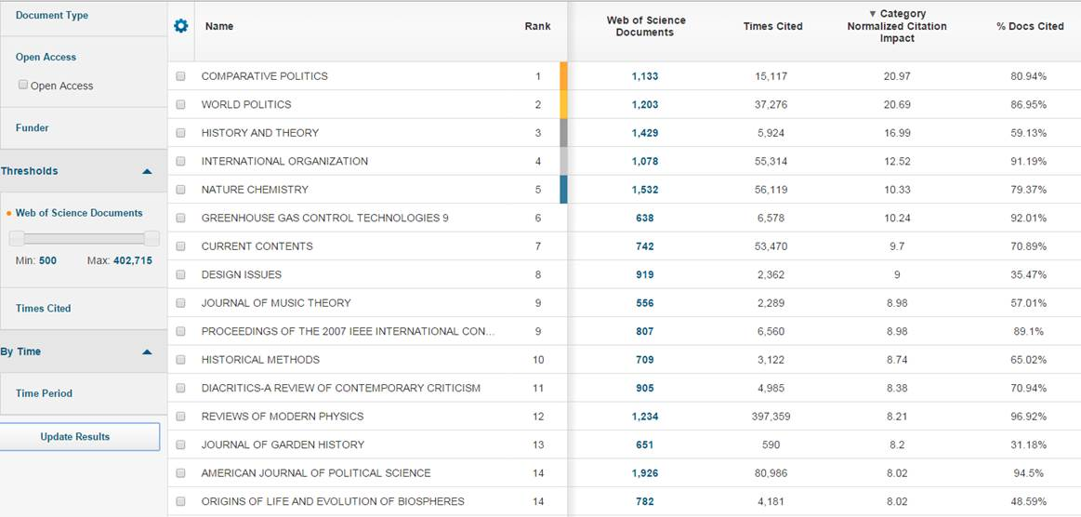
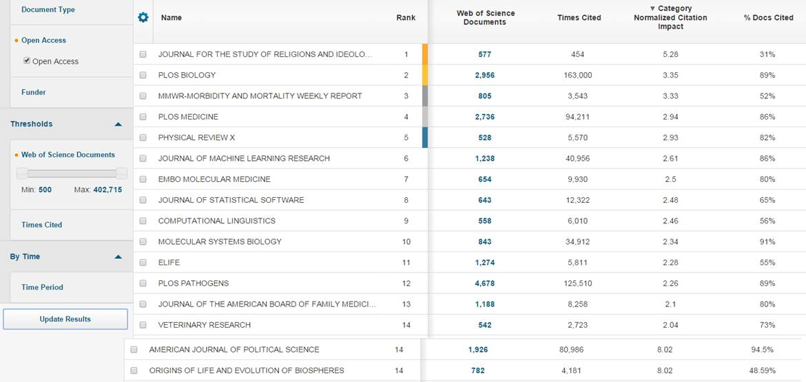

InCites
Filter on OA within B&A. All journals – sorted by Category Normalized Citation Impact vs. Open Access titles (gold) only

Slide 11
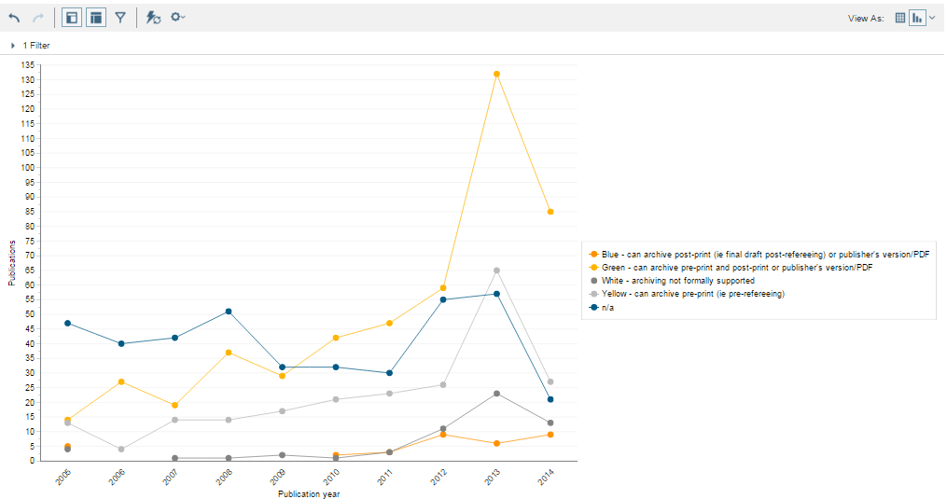
WOSP & Converis

Slide 12
Standardization Efforts

Slide 13
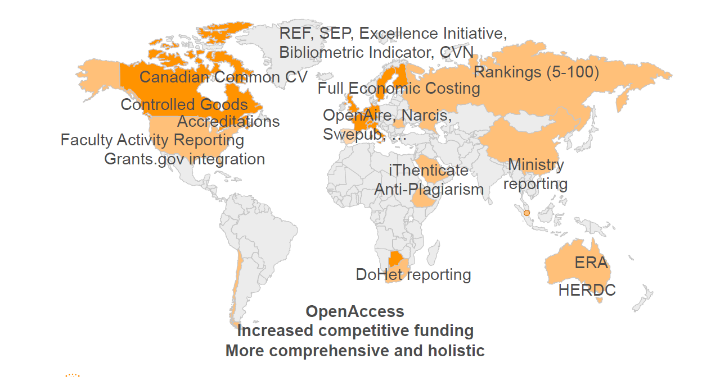
Requirements differ while core software remains
- Standards vs. Regional Solutions
Stability through core standards
High flexibility with specific needs
Notes:
Bridge between Regional requirements and global initiatives
as global as possible as local as necessary (technological flexibility)

Slide 14
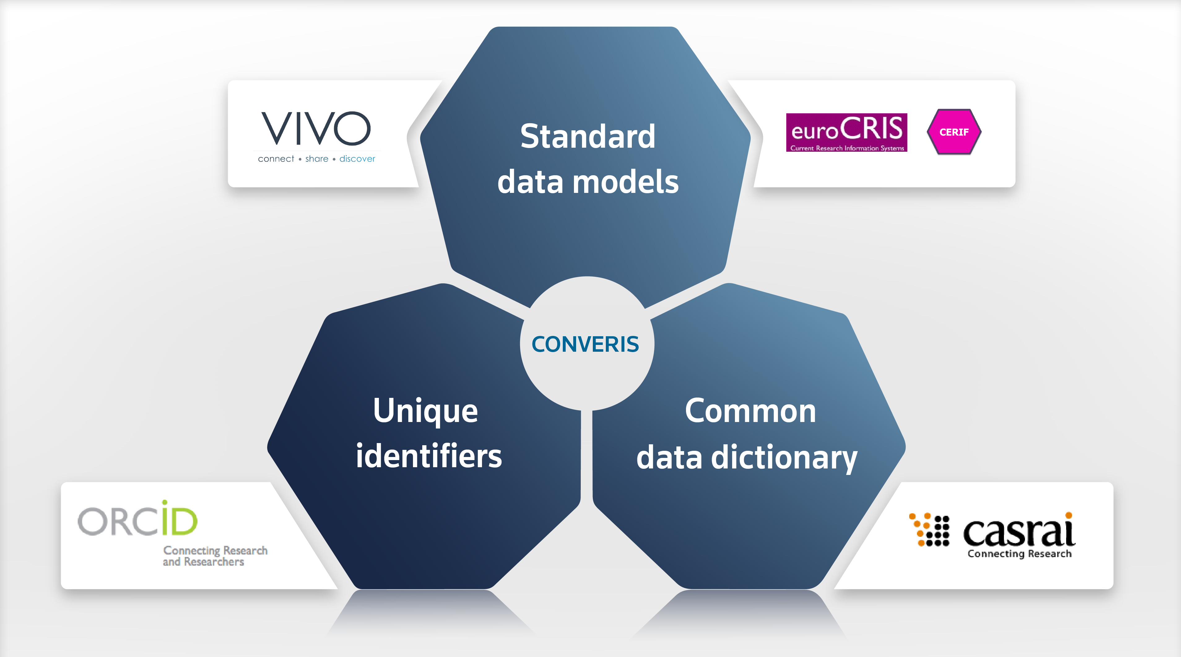
Standardisation Engagements
Notes:
In this context, where more and more institutions manage research information, and e.g. funders and national research performance assessment exercises like the ERA require the actual data to be submitted, and not only a printed report, the channels increase where the research information needs to be exchanged between systems. We see this as a digital ecosystem of research information.
We are therefore strong advocates of using standards to facilitate this exchange and ensuring that the information can flow seamless through the ecosystem and be reused to a maximum, and avoid that researcher and administrators have to retype the same information. We are actively involved in these and other initiatives to on the one hand ensure that we stay on top of the trends and that CONVERIS is able to exchange data e.g. in CERIF-XML, provide data to VIVO, make extensive use of ORCID and make use of CASRAI for a common vocabulary, e.g. for the generation of CASRAI compliant CVs and make use of the CASRAI thematic classifications. But we are also keen to drive these standards forward by making use of the input we get from our implementations. One example is the extension of CERIF to accommodate the use of federated identifiers, which is a result of our close collaboration with ORCID.

Slide 15
Open Engagements
euroCRIS (Strategic VIVO Partner):
  Member of Board for multiple years and leader of CERIF workgroup to develop a data model for research community (Brigitte Jörg)
  OpenAIRE: Guidelines CRIS Managers (Brigitte Jörg,Thorsten Höllrigl)
CASRAI working group Engagements (Thorsten Höllrigl, Brigitte Jörg)
VIVO
  Duraspace and VIVO Leadership Group (Thorsten Höllrigl)
  SHARE: VIVO Connector (Julia Laurin, Thorsten Höllrigl)
  ORCID-VIVO Connector (Thorsten Höllrigl)
  CERIF-ISF Ontology Integration (Thorsten Hölligl, Melissa Händel)
  VIVO Apps & Tools Working Group co-chair (Ted Lawless)
ORCID: Output syncronization
Notes:
How our lead product standardization engineers, head of technology & product have been and will be engaged in the different standardization initiatives

Slide 16
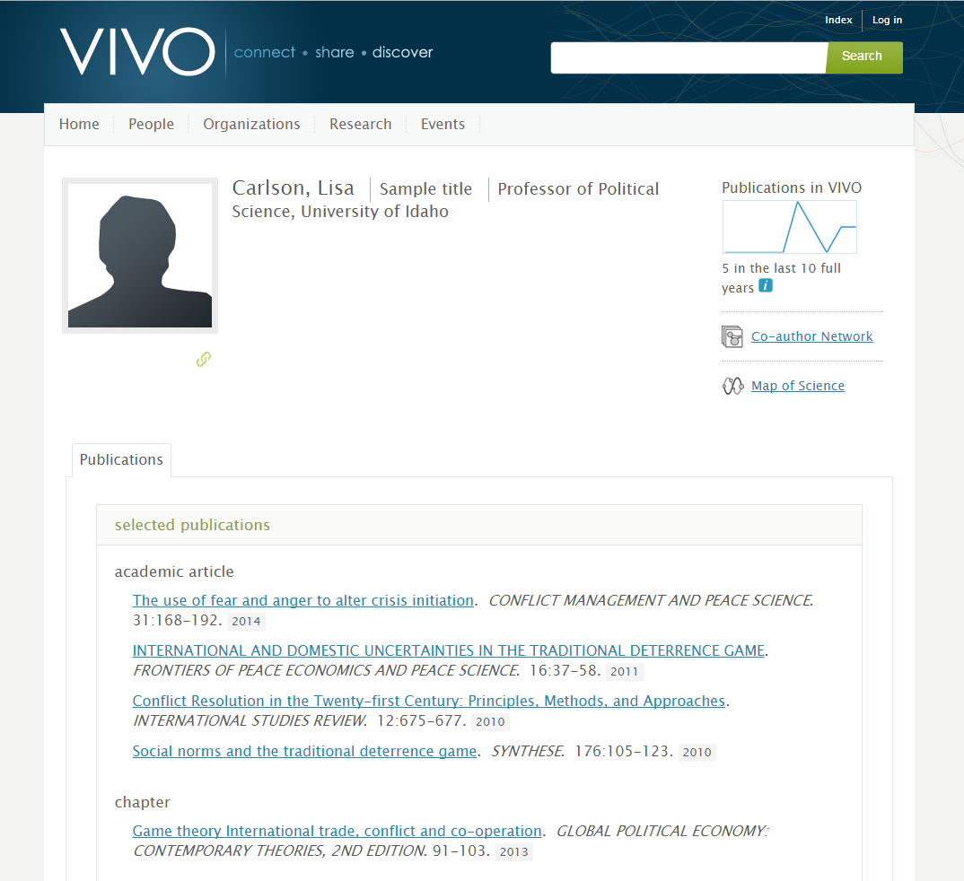
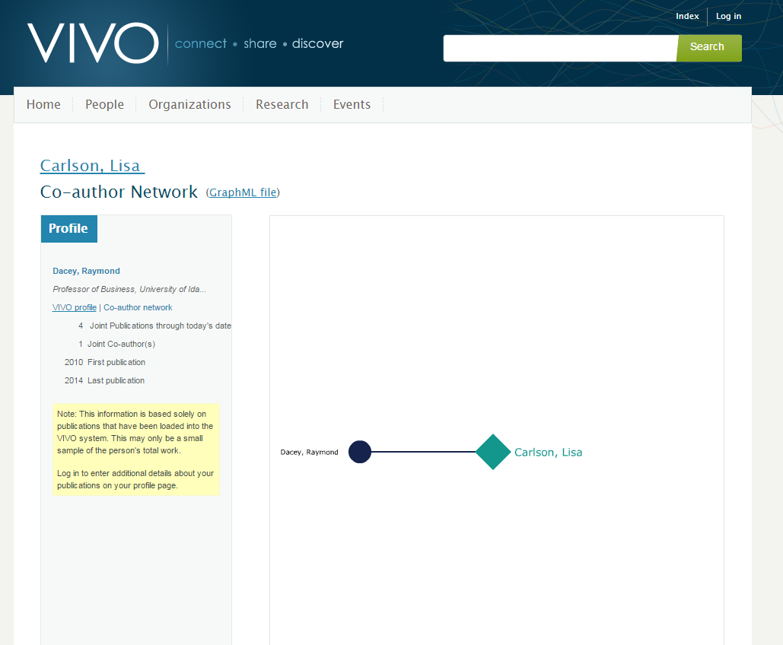
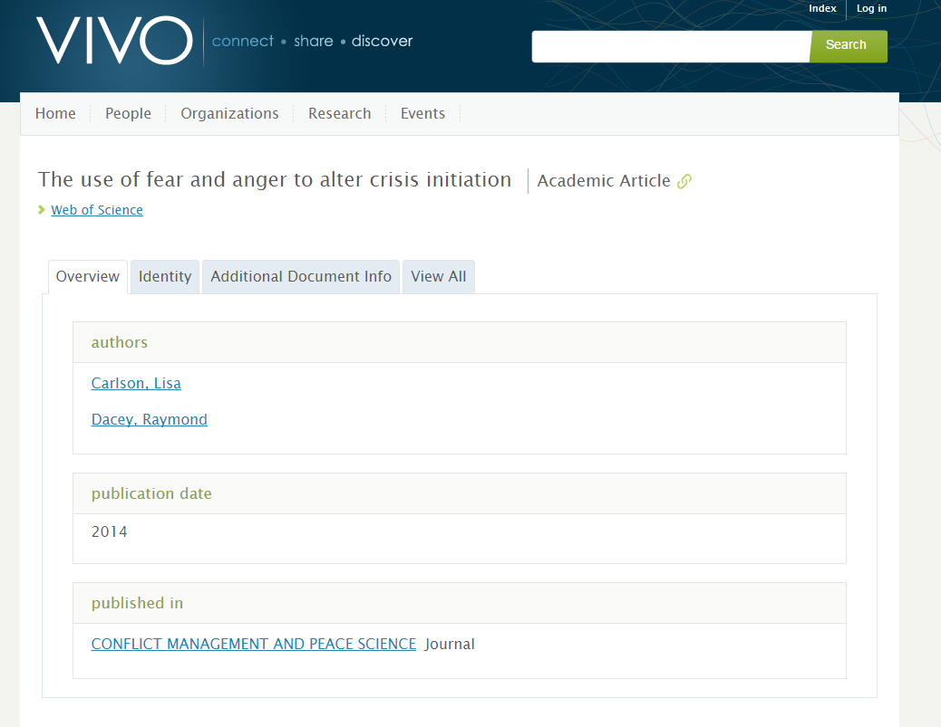
VIVO – Web of Science API & VIVO
Utilizing the Web of Science API, a search for publications since 2010 yielded several publications for this faculty member
We’re able to identify and link through VIVO Co-Author Network visualization. Cross-departmental on publication highlighted
VIVO displaying Web of Science publication via API. Link to Web of Science and published version via DOI (Built into VIVO)

Slide 17
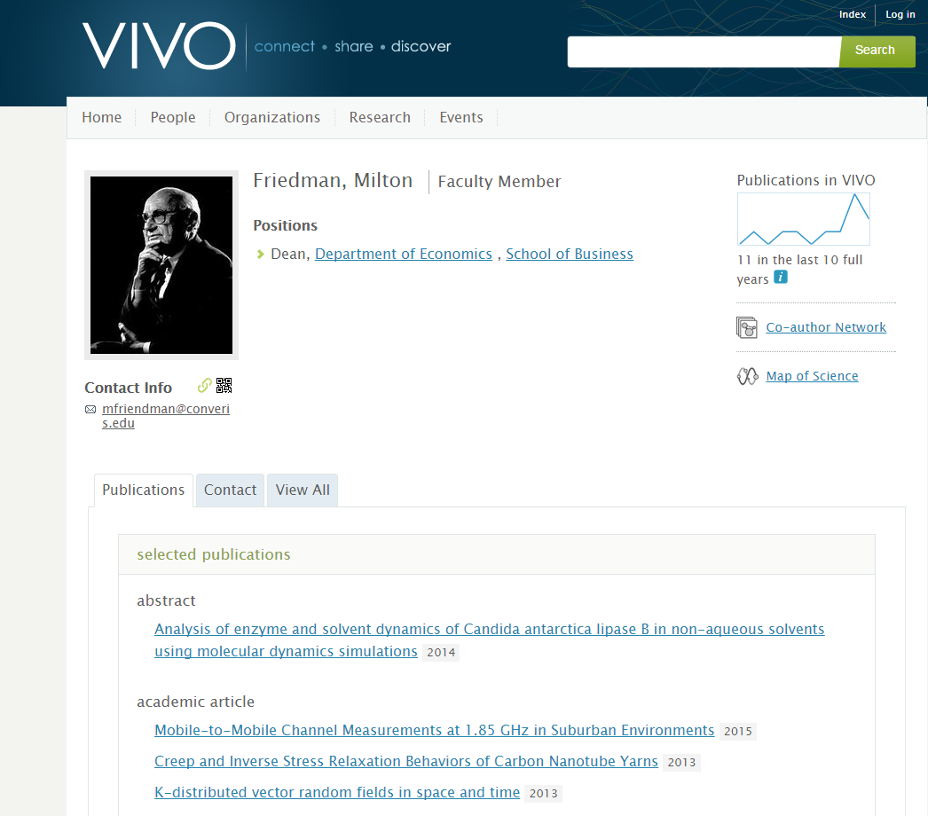
VIVO & Converis
VIVO Profile - Publicly available. Supports search, browse, and data visualization. Uses the latest version of VIVO

Slide 18
Future Developments

Slide 19

CONVERISTM
Converis is a research information system enabling a pro-active research management along the complete research lifecycle, with unique configuration capabilities to tailor the data model, user rights, workflows, reports and integrations to your institution’s individual needs.
Recent enhancements include:
Data reuse
-Synchronization with ORCID from Converis
- New saved searches for auto-import of pubs
Usability
- Edit items in chains without popups
- New list page navigation
- Deduplication for all entities
Open Access
- Overhauled OAI-PMH support
- New connectors for Eprints and Dspace
Extended Reporting
- Dynamic data marts with new metrics & dimensions
- Google Analytics for Research Portal
- CV formats for NIH and NSF
Technology Upgrade
- Leading architecture
-Significant performance boost
-Support for Oracle and Postgres
COMING SOON!
REF2020 Open Access compliance
WGAC 2.0 AA compliance
Extended validation capability
Localisation: Integrations with Swepub, Narcis, Canadian CCV
Automation of publication import & author disambiguation
Localization for Russian, Arabic
& Welsh
Document management capabilities
Populate your VIVO instance with Converis
Notes:
Web content accessibility guidelines (Including people with disabilities)

Slide 20
CONVERISTM
Converis provides a single destination to access the data and tools you need to accurately manage, assess and report on the results of the research that helps advance your organization.
Recent enhancements include:
ORCID
-Extended integration to support synchronization
Integration
-Extend Dspace and Eprints integration
Open Access
-Overhauled OAI-PMH support
-Support for the pre-print workflow & approval process
Extended Reporting
-New InCites metrics and charts
-Google Analytics for Research Portal
-NIH and NSF biosketches
Technology Upgrade
-Boosting performance significantly
-Support for Oracle
COMING SOON!
Improved
Automation of publication import UI/UX
WGAC 2.0 AA compliance
Extended validation capability
Enhanced faculty activity reporting, enabling review & assessment workflows
Support submissions to national assessment exercises, including REF
Document management systems integration
Localization for Russian
Populate your VIVO instance with Converis

Slide 21
Thank you for your attention!

