Slide 1
CASRAI
Consortia Advancing Standards In Research Administration Information
More research, less paperwork, better information
#casrai #casraiuk
Notes:
Introductions
Introducing the ground work done so far towards development of UK chapter of Casrai
15 minutes / Questions at end / Tweet #casrai and #casraiuk

Slide 2
What is CASRAI?
International non-profit association by and for universities
Develop reusable agreements to support sharing of information
Topics chosen by members. Local and national priorities first, with international linkages and integration following
Stakeholder members – universities and their partners - funders, suppliers, publishers
Agreements and Definitions are free to use. They are maintained in the CASRAI dictionary
Notes:
CASRAI – Consortia Advancing Standards In Research Administration Information
It works Developing reusable agreements to support the sharing of research information – publications, funding information, project members, other research activities
Crucially it is University-led, topics chosen by members. University partners and stakeholders are also involved and dialogues with partners are important to the success of the work done
International organization with membership from different countries. Canadian chapter, looking at national priorities.
What are some the issues with sharing research information? What pain points when asked for research info

Slide 3

Duplication
Can’t reuse existing info - must re-key + across multiple requesters
Complexity
Granularity higher than warranted by business step
Maturity
Feasibility
Meaning/relevance of info needs more shared analysis
Info clearly useful but very hard to collect
Change
Too frequent changes to info requests + across multiple requesters
Comparability
Info cannot be compared across requesters and suppliers
Information Request ‘HOTSPOTS’
Notes:
Problems encountered when asked to provide research information
Comparability – how can we know that we’re talking the same language when sharing information?
Change – have the information requests changed over time? How does that affect what is provided?
Granularity- is the information requested at a too granular level?
Tackling these hotspots will lead to tackling the key hotspot: Duplication of effort – seeking to reduce the admin burden on academics and research managers/admins
Look in more detail about how this works in practice

Slide 4
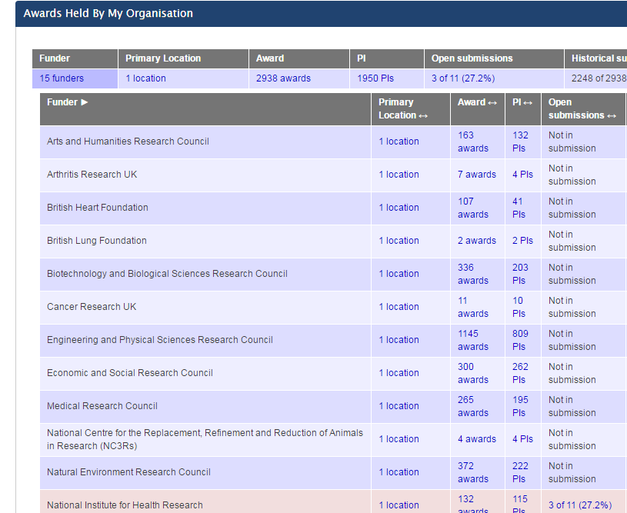
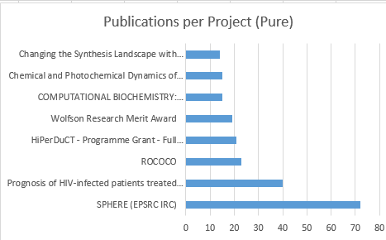
University Perspective: Interoperability
Produce a CASRAI standard question-set and definitions for a business process
Choose a common data model e.g. CERIF XML
Use persistent identifiers e.g. ORCID, DOI, ISNI
Develop system agnostic definitions
Implement via solution providers to move data between systems
Increases opportunities for data sharing
Notes:
This example is about reporting on funder outcomes. Pis and Universities get asked to report on funding outcomes by different funders. Reasonable request but can place burden on Universities. Often similar requests but with different terminology used, different levels of granularity etc. Information is held in internal systems but without common definitions it is difficult to share it.
System-focussed benefits to CASRAI approach – researching what standards/definition already exist and what might be used. Is free to use (definitions in dictionary) and system agnostic so can be implemented in different systems.
Timely: BIS/RCUK are developing and the opportunities for that system to be more interoperable, and that they are keen to engage with many stakeholder groups, including CASRAI-UK

Slide 5
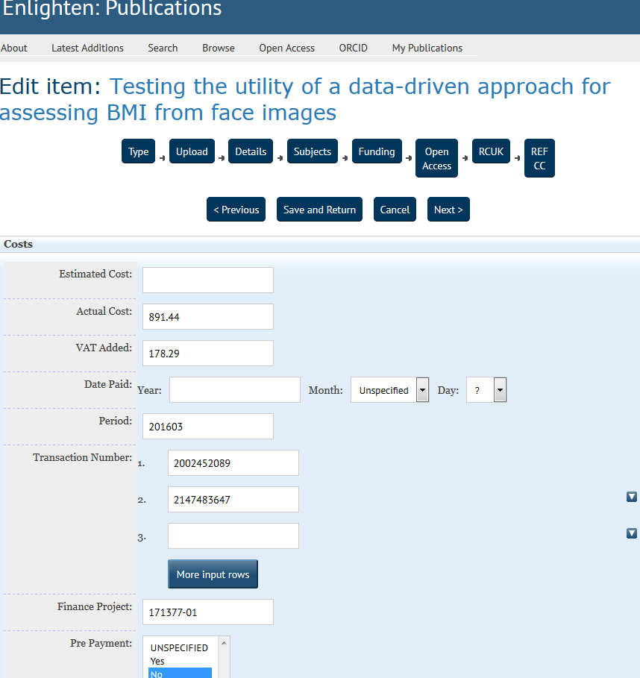
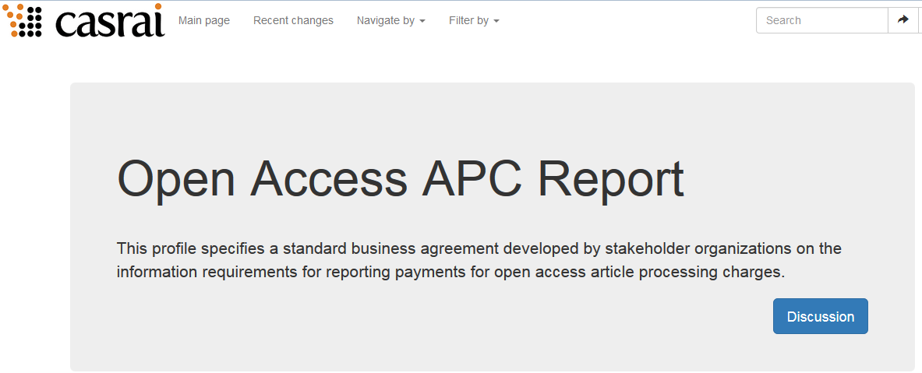
University Perspective
Example: reporting OA activity and APC payments
All Re-inventing classifications
Cost to tax-payer
Stakeholders work together
Will facilitate common understanding of what’s being requested
http://e2eoa.org/
Notes:
This example about reporting on article processing charges for Open Access.
There has been a lot of wasted time individually re-inventing classification.
Human benefits to the CASRAI approach: stakeholders in the same room to work together for mutual benefit, valuable. Facilitates better understanding.

Slide 6
UK Pilot 2013-2015
What worked well?
Community spirit between stakeholders
Reached agreement on some common terms
Vision embraced
Lessons learned?
Process was not clear to all – communicate it better
Research previous work
Focus on defining a clear scope for each working group
Notes:
e.g. for Open Access Inputs included REF, RCUK/RIOXX, Horizon 2020, Charities Open Access Fund, Institutional Requirements…..
Linkages included our system suppliers (Symplectic, EPrints etc.), ARMA, SCONUL, SCURL, RLUK, UKCoRR, COAR, CCC, Jisc initiatives, other countries work, the CASRAI dictionary….

Slide 7

CASRAI: Accomplishments to-date
Jisc-CASRAI Pilot
Research Data Management Profile
Open Access Reporting
OrgID
Canadian Chapter
Academic/Student/Abridged CV agreements
Funding Award standard
Research Classification Codes
Global Work
Contributor Roles Taxonomy (CRediT)
Peer Review Citation agreement

Slide 8

UK Output 1 – Organisational Identifiers
This group recommended an International Standard Name
Identifier (ISNI) model for unique identifiers for organisations.
http://jisccasraipilot.jiscinvolve.org/wp/2015/03/06/organisational-identifiers-working-group-outputs-and-update/
http://dictionary.casrai.org/Org_ID_Types/ISNI

Slide 9

UK Output 2 – Data Management Plans
Produced a profile for Ethics Compliance in data management planning. The profile is also being considered for use in Canada.
http://jisccasraipilot.jiscinvolve.org/wp/working-groups/data-management-plans/
http://dictionary.casrai.org/Research_Dataset/Ethics_Compliance
Credit: justgrimes on flickr.(link is external) CC BY-SA 2.0

Slide 10

UK Output 3 – Open Access
Produced a profile for Article Processing Charges.
http://jisccasraipilot.jiscinvolve.org/wp/working-groups/open-access/
http://dictionary.casrai.org/Open_Access_APC_Report
Notes:
e.g. for Open Access Inputs included REF, RCUK/RIOXX, Horizon 2020, Charities Open Access Fund, Institutional Requirements…..
Linkages included our system suppliers (Symplectic, EPrints etc.), ARMA, SCONUL, SCURL, RLUK, UKCoRR, COAR, CCC, Jisc initiatives, other countries work, the CASRAI dictionary….

Slide 11

UK Meeting 16th May 2016
Enthusiasm
Acknowledged Challenges
Willing to share
Must research and re-use previous work
Notes:
68 people on the attendance list

Slide 12

Brainstorming to find UK ‘hotspots’
Think of info requests you encounter that suffer from one or more of the 6 ‘hotspots’
Prioritise those:
  That bring the most burden to each researcher/administrator affected
  That affect the highest number of researchers/institutions
  Are feasible to tackle if key stakeholders are engaged
  Can ‘piggyback’ onto a current new UK implementation project

Slide 13

UK Meeting 16th May 2016 – Popular Topics
Questions to ask when reflecting on these topics:
Can we achieve something via CASRAI
approach?
Will scope be specific?
  Topics:
  Research Outputs Reporting – impact?
  Open Access Terminology gaps
  Career level definitions
  Research Excellence Framework
  Institutional Identifiers – other initiatives exist
Notes:
Research Outputs Reporting is timely: BIS/RCUK are developing and the opportunities for that system to be more interoperable, and that they are keen to engage with many stakeholder groups, including CASRAI-UK

Slide 14
How it works
Identify Info Request(s)
Develop Standard(s)
Demo/Feedback/Iterate
Step 1
Step 2
Members and partners shortlist problematic info requests
Apply criteria to prioritize hotspot(s)
Identify 1 to 3 to advance in next annual work cycle.
Issue an open call for interest & subject experts
Assess responses and convene working groups
Deliberations followed by open review
Publish new/revised standard(s).
Promote the new/revised standard(s)
Solutions providers create compliant tech demos or live rollouts in their products
Learning feeds into next annual work cycle.
Notes:
So we have started to think about the use cases or hotspots.
There will be an open call.
We plan to establish a few working groups for September 2016 and then get on with producing or amending the definitions.

Slide 15
Get Involved – Multiple Levels of Engagement
Universities can join as members and sit on steering group
Suppliers can join as partners
Members and partners can propose work, and be involved in working groups
Review of work is open to anyone at a Higher Education Institute
Products are freely available for anyone to use
Notes:
UK chapter currently has 12 members: 11 Universities and Jisc, plus 4 solution provider Partners.
Membership is £350
This is not only about the existing chapters though – an opportunity to consider whether a chapter would work in your country. Or are there Europe-wide information requests that we’d like to tackle via CASRAI?

Slide 16
  Enquire about joining or creating a chapter: info@casrai.org
  Browse the dictionary:
  http://dictionary.casrai.org/Main_Page
http://casrai.org/Call_for_Participation_in_UK_Chapter
Contact us:
Valerie McCutcheon valerie.mccutcheon@glasgow.ac.uk
Helen Newnham Helen.Newnham@bristol.ac.uk

