Slide 1

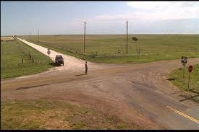
euroCRIS at the Crossroads
(10 years on)
CERIF
Keith G Jeffery
Outgoing President

Slide 2
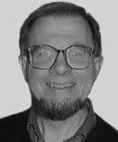

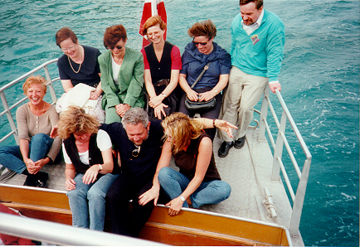
Before 2002
1987-1990 Expert Group ➔ CERIF91
1991 First euroCRIS conference Bergen
1993-2000 euroCRIS conferences supported by EC
1995-2001 Platform Group
  Jostein Hauge, Marga van Meel
1997-1999 Expert Group ➔ CERIF2000
2002- euroCRIS as a registered not-for-profit organisation

Slide 3
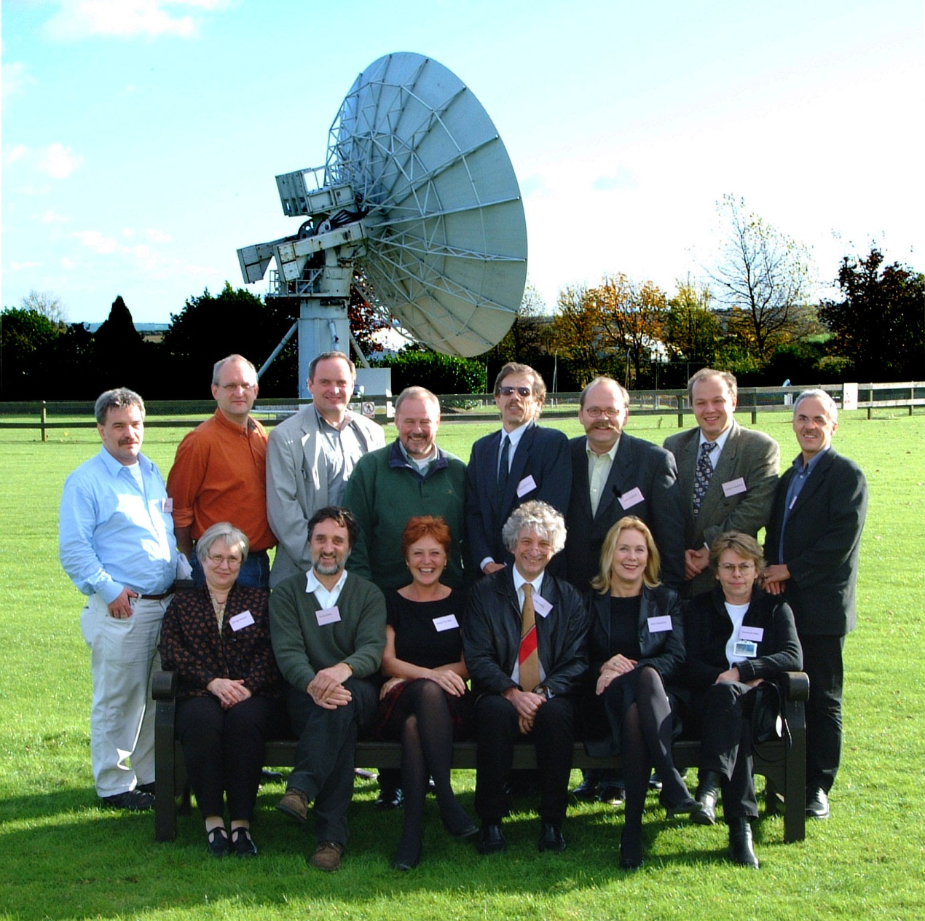
October 2001: Member Meeting RAL: Decision to set up euroCRIS
Future Board Members
Geert van Grootel
Wolfgang Adamczak
Andrei Lopatenko
Annemarie Nase
Anne Asserson
Keith Jeffery
Harrie Lalieu

Slide 4
What has been Achieved
2002-2012
Membership
Finance
Strategic Partners
  Seminar
Communications
  Website
  Newsflash
  Conference
CERIF
CRIS-IR
DRIS/Best Practice
LOD
Architecture
Projects
Commercial vendors

Slide 5
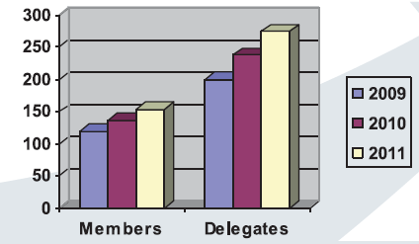
Membership
Starting in 2002 with around 20 delegates…

Slide 6
Finance
Early in 2002 euroCRIS had no income (and was sustained by employers of some members providing resources)
We set the registration fees as they are now keeping them low to allow maximal participation
2012: euroCRIS now has steadily increasing budget of ~ 25k€/year and with project and other income the amount of money passing through the account is several times larger

Slide 7
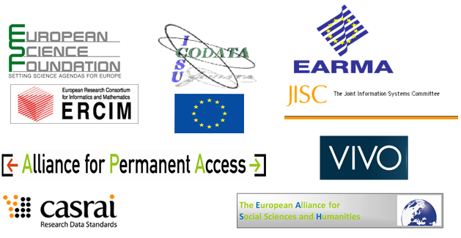


Strategic Partners
In 2002 – none! Now….
Signing with COAR
And formalising with LATTES

Slide 8









Seminar
Nothing in 2002
Very successful series starting 2003
Much participation by European Commission
And of course strategic partners
Has a real impact

Slide 9
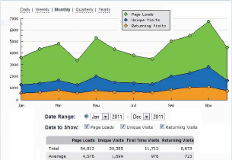
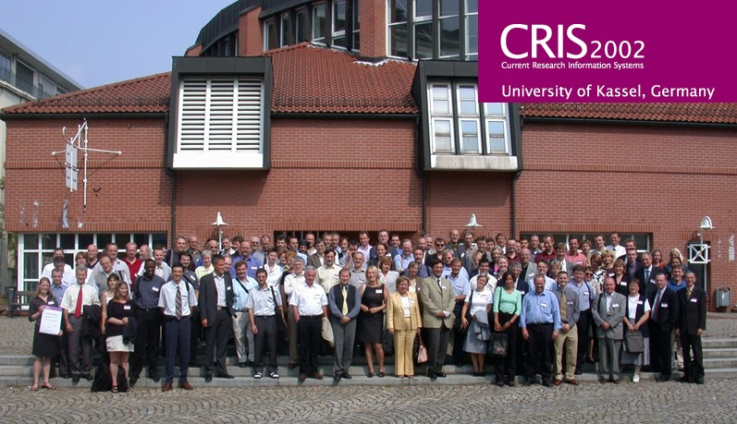
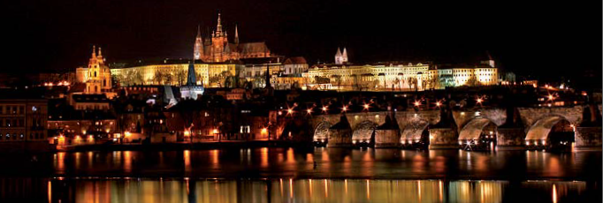
Communications
Website: nothing in 2002 – now (from 2011 annual report)
Newsflash
Annual Report (since 2010)
Conferences – first one under euroCRIS August 2002; 2012 largest and best ever

Slide 10
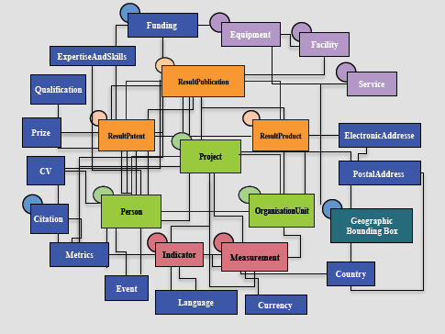
CERIF
CERIF
2002 basic EER data model
  Formal Syntax
  User semantics
Extensions
  Facilities
  Indicators
Language variants
Semantic layer
XML version
LOD version
Federated IDs

Slide 11
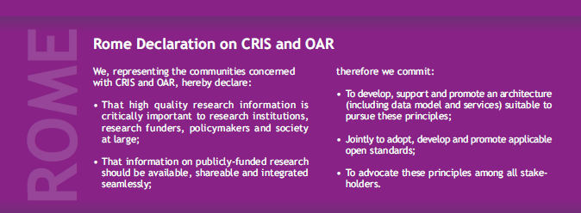
CRIS-IR
In 2002 CRIS and IR were different worlds.
Progressive integration.
Catalogue of IRs in DRIS
Recognition of value of CERIF as metadata for IR
OpenAIRE
COAR
2011 Rome Declaration

Slide 12
DRIS / Best Practice
2002 early DRIS – list of CRIS and URLs
DRIS database now becoming available on euroCRIS website
CERIF-driven
Basis for portal over heterogeneous CRIS
Original document being revised
Other valuable documents being incorporated into the corpus

Slide 13
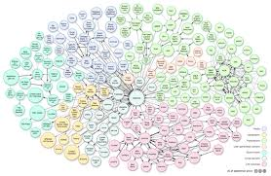
LOD
Popular way to browse / query data
W3C
RDF
Metadata standards in RDF
  CKAN, eGMS
Some work on triplestores
Generating from CERIF
  Integrity
  Consistency
  View over CERIF
Relates to ENGAGE ➔
Relates to VIVO ➔

Slide 14
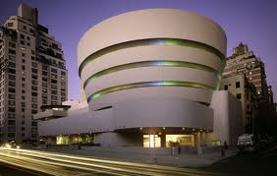
Architecture
2002 no architecture
  Implementations ad hoc
Progressively developing a specification
  Based on services required around a CRIS datastore
  Atomic and composable
  Open source
  Probably RESTful
  Includes the mappers and translators required
Can we implement the architecture proposed at CRIS2012?

Slide 15

Projects
2002 – no projects
2008 – considered strategic
2010 first successes UK, EC
Provide
  Exposure and PR
  Funding
  Technology
  Know-how
UK JISC Projects
  CRISPool, IRIOS, R4R, MICE, Snowball, CERIFy, BRUCE, CIA, RMAS, RMAS-EE, IRIOS-2, UKRISS, C4D, REDIC, DESCRIBE, UniQuip
UK RC Projects
  REF, GtR, ROS, EVAL
EC Projects
  ENGAGE
  euroRIs-Net
  OpenAIREPlus

Slide 16
Commercial Vendors
Atira
Avedas
Symplectic
Other nationally-based companies
VIVO
Elsevier SCIVAL
Thomson Reuters RIV
Commercial market has arisen since 2003
Partly because of research evaluation
Partly because of the desire to communicate the research of an institution
Partly because of a desire to interoperate
  Benchmarking
  Administration (B2B)

Slide 17
Crossroads
PAST
euroCRIS has been very successful in all these aspects
But
  the demand is increasing,
  the market for our expertise and services is increasing
  we must keep our leading position
Our major asset is CERIF as a standard
Looking back at a successful past
A special thanks to retiring board members
Geert van Grootel
Anne Asserson

Slide 18
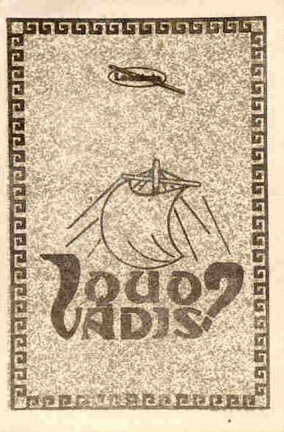

Slide 19
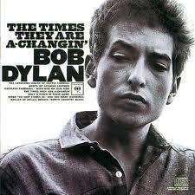
Future
Requirements are changing
  Users more demanding
Way of working is changing
  Changing research communications / output
  Changing research methods – especially workbench / workflow and use of RIs
  Changing evaluation
  globalisation
Technology is changing
  More resources, less cost, more usable

Slide 20
Crossroads
FUTURE
Reference Implementation
Compatibility System
Accreditation system
More interaction at national level
  Policy, projects
More interaction at International level
  Standards, projects for interoperation
Anticipating a successful future
New Board starting January
Previous members re-elected
Four new members replacing 3 retiring

Slide 21
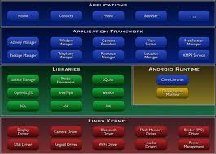

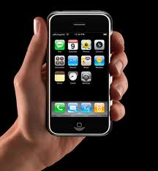
Future in More Detail
Non-Technical
  More outreach
    Website, newsflashes, member meetings, conferences
  More directed communications
    Funders, institutions
  More strategic partnerships
    Build international consensus
    Set agenda
  Closer liaison with commercial world
    Products to meet requirements
Technical
  Move to architecture
    Data model
    Service (processing) model
    Resource model
    User model
  Deployable in a virtualised environment
    (GRIDs, CLOUDs)
  With mobile personal interaction
    CRISBOT
  (see CRIS2012 paper)

Slide 22
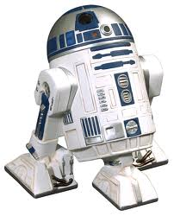

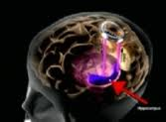
The Plan: Architecture
Resource Model
User model
CERIF
Processing model
CERIF
User model
CRISBOT
Virtualised
CRIS
CRISBOT
Data Model
CERIF
Research Information

Slide 23
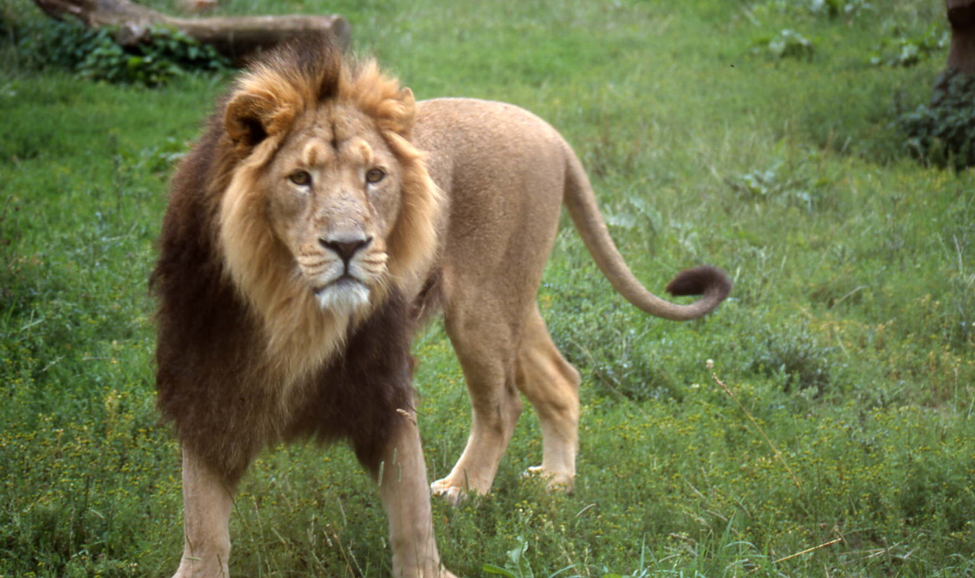
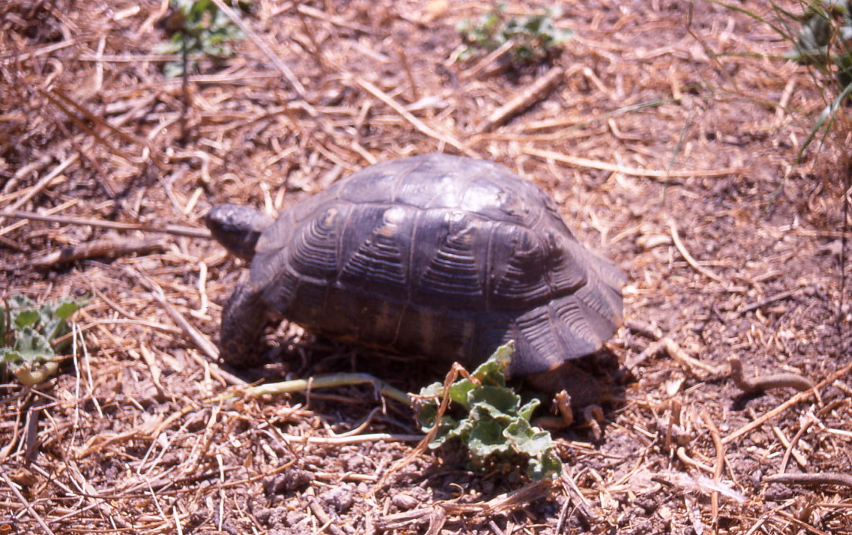
The Choice: Moving Forward
Slowly and cautiously
Quickly and confidently
From new President 2002 Conference presentation

Slide 24
