Slide 1
11th euroCRIS Strategic Seminar
Brussel, Sep 9 – 10 2013
Discovery Metadata
Friedrich Summann
COAR / Bielefeld University Library

Slide 2
Discovery Metadata
Overview
Introduction
Institutional Repositories – Metadata Issues
Institutional Repositories – future challenges
Examples

Slide 3
COAR
Confederation of Open Access Repositories
Enhances the visibility of research outputs
Paves the road to interoperability
Fosters knowledge exchange on repository issues
Strengthens international open access implementation

Slide 4




Metadata Background
DRIVER Guidelines 2008
OpenAire Guidelines
DINI Certificate 2010 (2013)
OAI-PMH Harvesting for BASE / DRIVER / OpenAire

Slide 5
Discovery Experience
Harvesting (OAI-PMH) (BASE, DRIVER, OpenAire)
3300 Repositories (2700 active)
70 Mill. Metadata Records (50 Mill. active)
Ingesting (proprietary APIs) (local PUB system)
Local unit/person data
ISI, ArXIV, INSPIRE, PubMed import
UK PMC Research Data import
Metadatenfetch ISI, ArXIV, INSPIRE, PubMed
ISI citation information

Slide 6
The IR – past, present, future
Started late ninetees
Contents starting with thesis
OAI-PMH definition 2001
Open Access movement
Establishing a global repository network
Extending
  Size
  Quality
  Services

Slide 7
DRIVER Guidelines
provides orientation
for managers of new repositories to define their local data-management policies
for managers of existing repositories to take steps towards improved service
for developers of repository platforms to add supportive functionalities in future versions

Slide 8
DRIVER Guidelines
Focus on:
Textual Resources
Using oai_dc as metadata format
OAI-PMH: Protocol Requirements
OAI-PMH: Additional Requirements
DRIVER DC: Metadata Requirements

Slide 9
OAI-PMH : Protocol Requirements
Stability
Protocol compliance (OAI-PMH 2.0)
XML validity
Support of Incremental Harvesting
Deleting strategy
(persistent, transient)
Set for OA documents (driver)
Batch size (100 - 500 records per response)
Resumption Token life span (at least 24 hours)

Slide 10
OAI-PMH : Metadata Requirements
Fulltext link
Content Recommendations
  identifier
  creator
  contributor
  source (citation)
Standardized Contents
  type
  language
  date

Slide 11
Repository Metadata
Repository Type
Technical Platform
Country
Classification used
Geocodes
Start page
Institutional affiliation

Slide 12
The IR – past, present, future
More than 3000 repositories, around 70 Mill. Objects
World-wide coverage
But: Institutional Repositories are at a turning-point:
More and more overlapping systems
  local(CRIS, Publishing Platform, etc)
  external (Subject Repositories, ResearchGate etc.)
Scholarly communication process changes

Slide 13

COAR Interoperability Project
Phase 1: The Case for Interoperability for Open Access Repositories
Phase 2: Open Discussion
Phase 3: The Current State of Open Access Repository Interoperability (2012)
Phase 4: COAR Roadmap for Future Directions for Repositories Interoperability

Slide 14
The repository landscape
(internal and external)

Slide 15
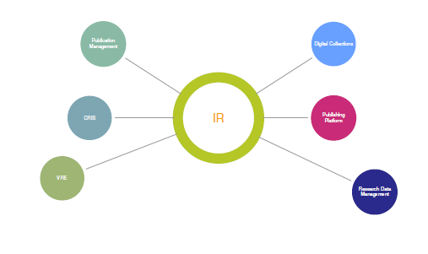
Local Repository Landscape

Slide 16
Draft Interoperability Roadmap
Current Situation and Strategic Challenges
Vision, Goal, Objectives
Users and Stakeholders Needs
  Scientists (author, reader)
  Institution
  Funder organizations
  Publishers, information companies
The Repository Landscape
Interoperability Issues
The Road Map

Slide 17
A special case:
Interoperability CRIS systems - IRs

Slide 18
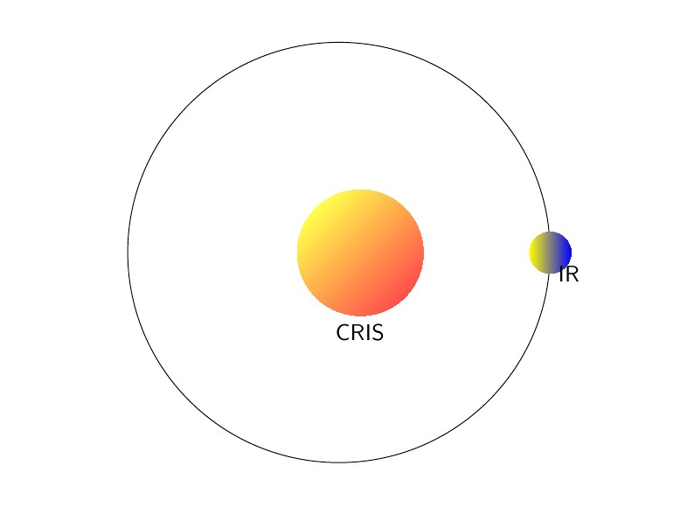
The CRIS – IR relation

Slide 19
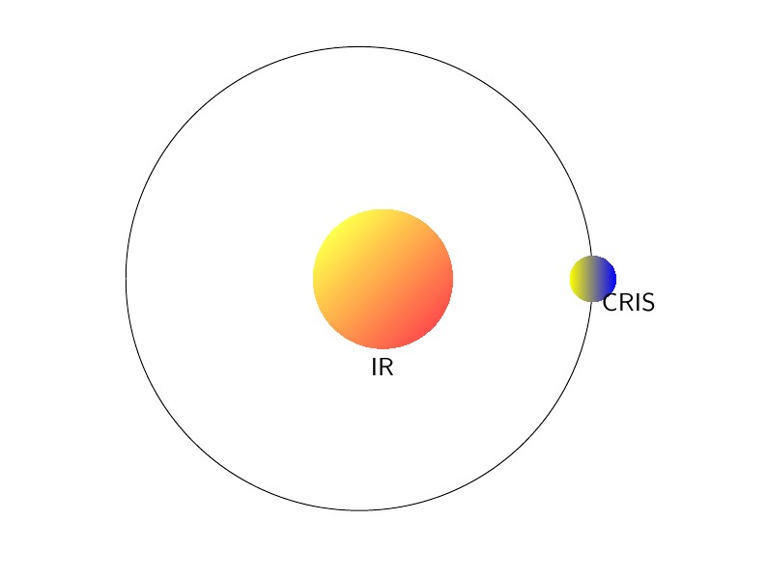
The IR - CRIS relation

Slide 20
Interoperability issues and use cases
Visibility (google metrics, webometrics, statistics)
Data issues (Formats, quality, enhanced publications, linked data, research data)
Sustainability (services, documents)
Add-on services and features (embedding, publication lists, export, bibliometrics)
Technical basics (architecture, protocols)

Slide 21
Metadata Issues
Extended Metadata Formats
Data Curation (manually/automatically)
Metadata Enhancement
  Linked Open Data
  Enhanced Publications
  Automatic Classification
  Research Data

Slide 22
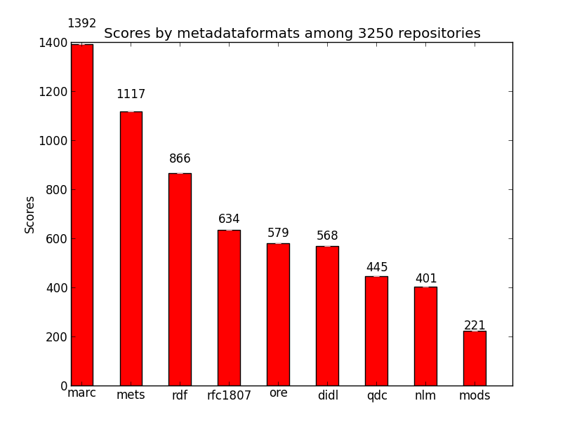

Slide 23
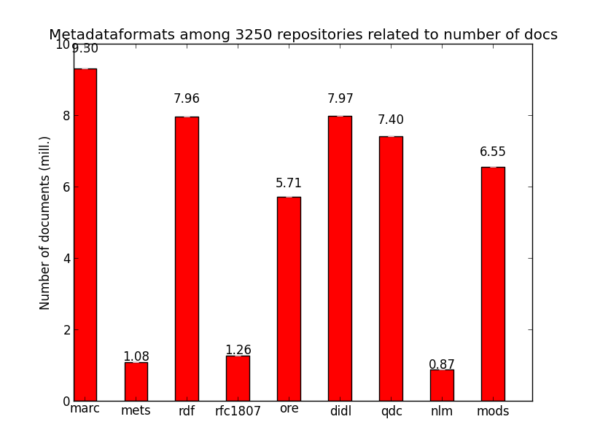

Slide 24
Metadata Ingest
Based on proprietary APIs
Local unit/person data
ISI, ArXIV, INSPIRE, PubMed import
UK PMC Research Data import
Metadatenfetch ISI, ArXiv, INSPIRE, PubMed
ISI citation information

Slide 25
Metadata Requirements
Quality (following the guidelines)
Richness
Stability
Updated
Relations information
APIs (bi-directional)

Slide 26
Example: our local approach
No CRIS system available
No repository platform anymore
but a publication management system
(open source cooperation with UL Lund, UL Gent)
Extending this system
  Research Data
  Project Information
  Awards Information

Slide 27
Institutional Repository
some examples of future
developments

Slide 28
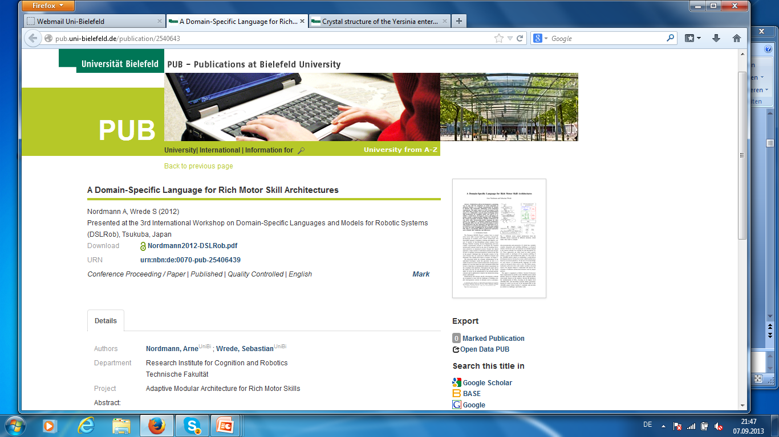

Slide 29
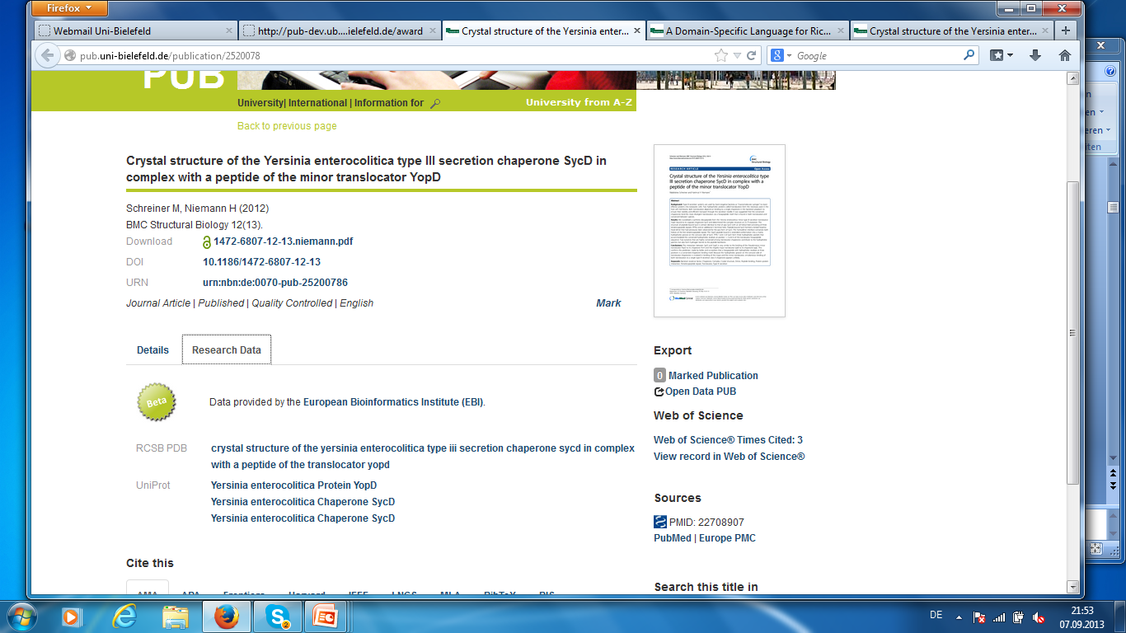

Slide 30
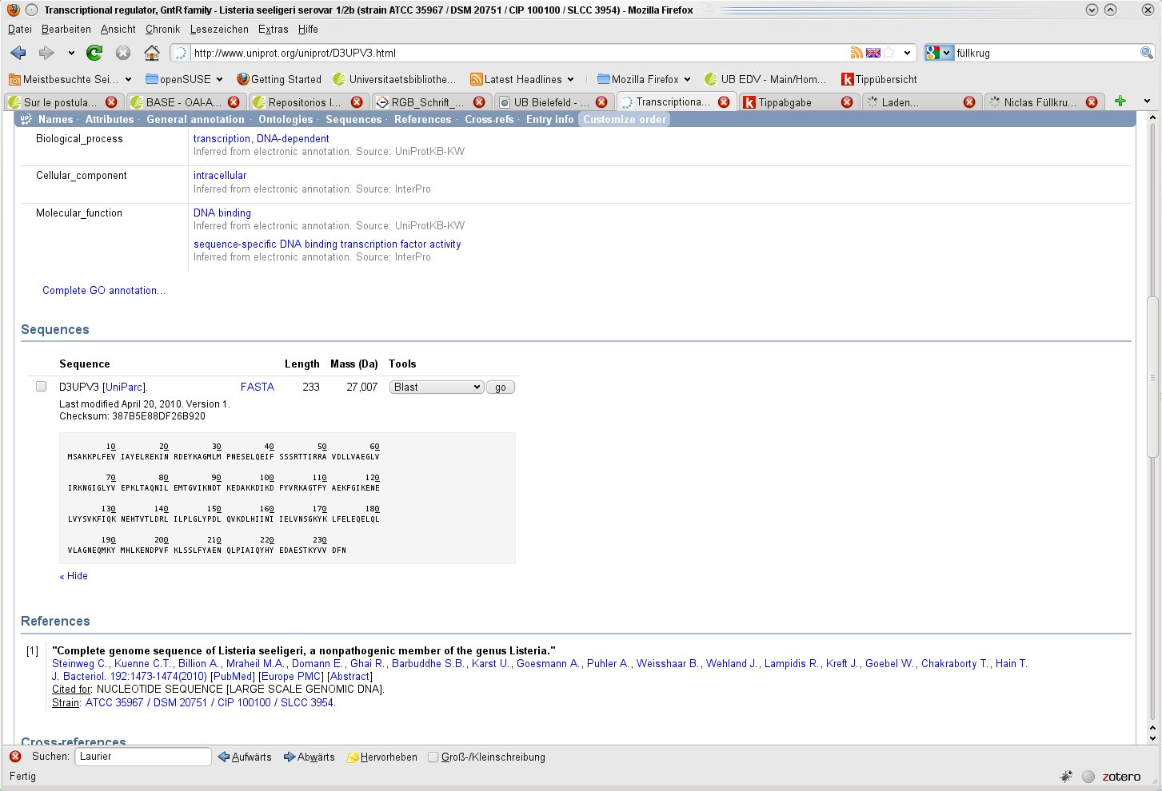

Slide 31
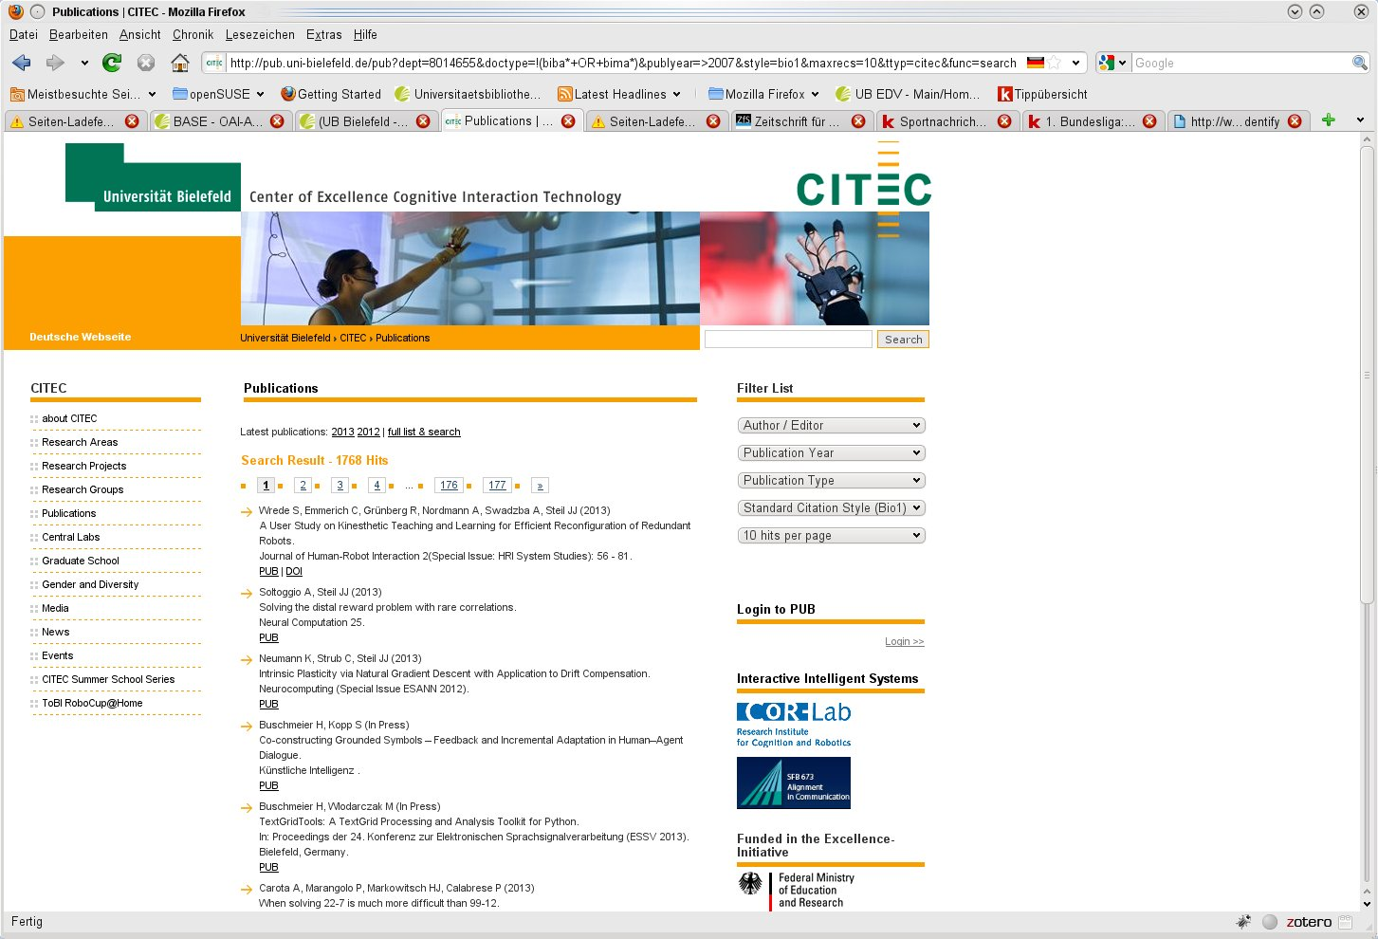

Slide 32
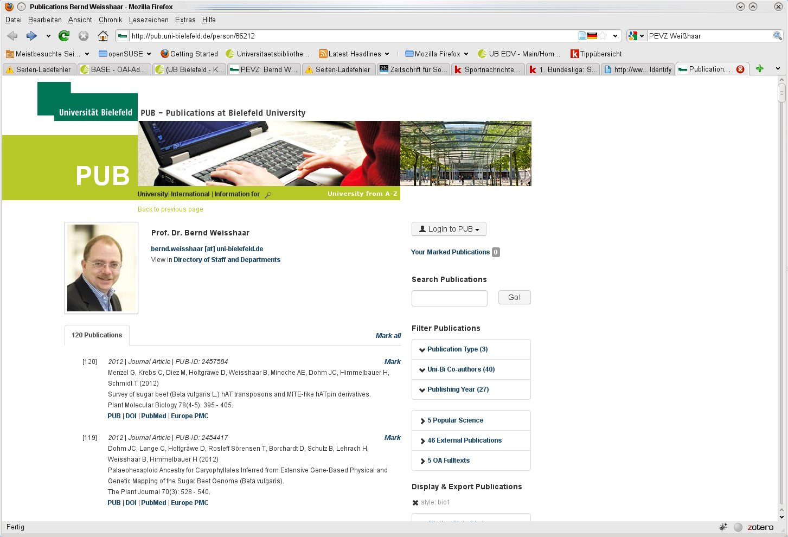

Slide 33
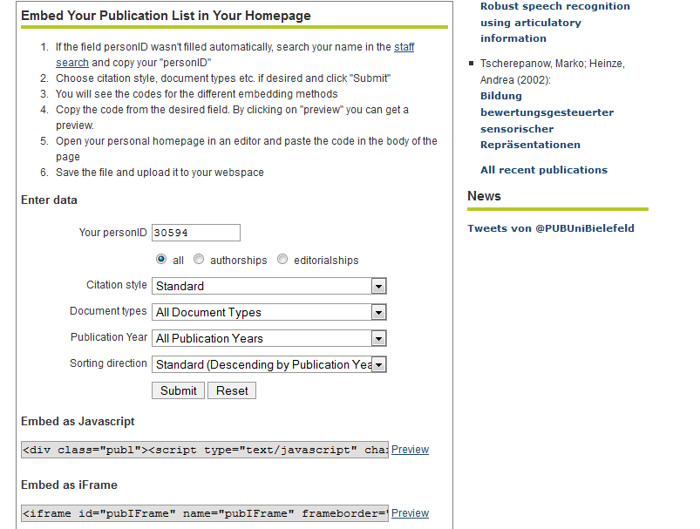
Embed Generator (Publication Lists)

Slide 34
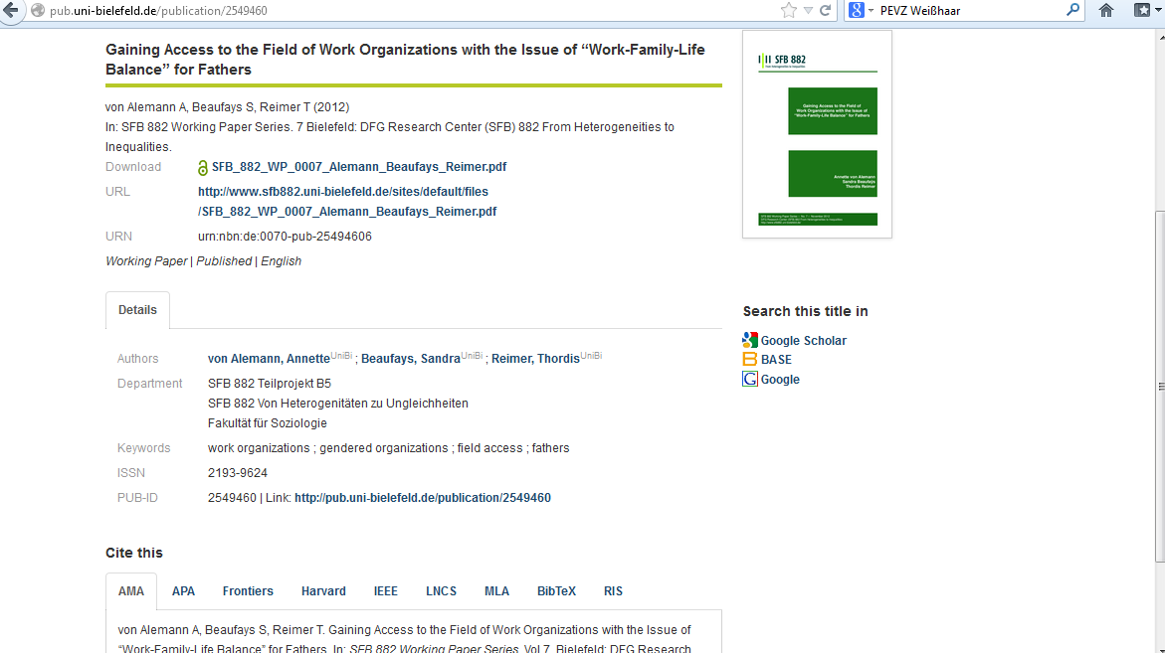

Slide 35
Thank you!
Friedrich Summann
friedrich.summann@uni-bielefeld.de

