Slide 1
CroRIS Development Update
Neven Balenović, Davorin Kremenjaš
University of Zagreb University Computing Centre (Srce)
2 December 2022, Nijmegen NL

Slide 2

About CroRIS

Slide 3

CroRIS is…
CERIF-based Croatian Research Information System
a partnership with Centre for scientific information of the Ruđer Bošković Institute (RBI)
developed as a part of a broader project of Scientific and Technological Foresight
Work on CroRIS includes
Planning and development
Data cleansing and migration
Integrations
Promotion and education
Maintenance and further development

Slide 4

The Scientific and Technological Foresight Project
Led by Ministry of Science and Education, with Srce as a partner
Approx. 2M €, 85% funded by EU
Three main components:
  Legal adjustments regarding the data about research in Croatia
  Development and implementation of CroRIS
  Scientific and technological mapping and foresight exercise
Project is co-funded by European Union from European Regional Development Fund

Slide 5
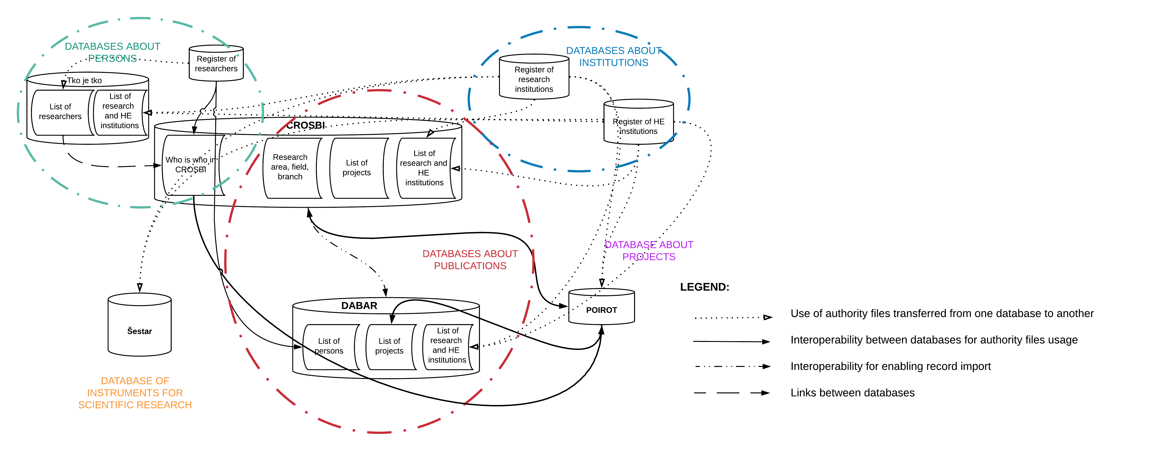
Before CroRIS: Croatian Research Information Landscape

Slide 6
Our vision – CroRIS will
ensure comprehensive and accurate data about all elements of the research system in Croatia
be the decision-making ground when it comes to research, on all levels
enable and promote open science
efficiently support business processes on all levels (MSE, institutions, researchers, ...)
be open and interoperate with other systems (national and international)
integrate existing information and incorporate them into unique and sustainable information system
enable the connection between research and the real sector

Slide 7

CroRIS today

Slide 8


CRIS 2022 (Dubrovnik, May 2022)
Products
Patents
RBI
“CROSBI”
Events
Publications
Journals
Services
RBI “Šestar”
Equipment
RBI “POIROT”
Projects & Funding
MSE Register
Researchers
MSE Register
A&R institutions

Slide 9
Current status (Early December 2022)
Products
Patents
RBI
“CROSBI”
Events
Publications
Journals
NOSC Ready
Services
RBI “Šestar”
Equipment
RBI “POIROT”
Projects & Funding
MSE Register
Researchers
MSE Register
A&R institutions

Slide 10
New CroRIS modules
Projects
  Reimplements Database of Project Activities in Science and Higher Education (POIROT)
  Live from 14 June 2022
  228 new projects registered
Equipment and Services
  “Equipment” submodule reimplements Database of Scientific Equipment (Šestar)
  “Services” submodule – new feature in Croatian Research and Scientific Landscape
  Live from 7 July 2022
  787 new instruments and the first two services
  Source databases (POIROT and Šestar) – developed and maintained by RBI

Slide 11
System and Data Migration challenges
Expansion of existing vocabularies and their implementation in the CERIF data model
Source data quality
  lack of structure
  many free text inputs
  duplicate values (alternative spellings, misspellings)
Data cleansing and structuring (creating catalogues, where possible)
Integration of new data into CroRIS – linking to existing entities in the system (persons, institutions), which was often not easy due to the lack of appropriate identifiers.
Taking care of active integrations to other systems during migration (API migration)

Slide 12





Supporting Open Science
SRCE services supporting Open Science
Education and networking with the European and global research community
National Open Science Cloud
Croatian Open Science Cloud
(HR-OOZ) Initiative
National Open Science Plan
HR-OOZ Catalogue of services, tools and resources

Slide 13







HR-OOZ as a part of EOSC
ZG2
HR-OOZ
National Open Science Cloud
EOSC
European Open Science Cloud
ZG1
OS
RI
ST
National
e-Infrastructure
Service and service providers
Key aspects:
Open Science and FAIR data
Alliance of existing and planned infrastructures
Collaboration between different disciplines and countries
CroRIS can now serve as a NOSC Service catalogue!

Slide 14
Under construction: CroSBI – Publications module
Overall the same challenges, but on a much higher scale
Source database – CROSBI (about 0,7 M entries)
Current efforts
  Preparing data import and test imports
  User interface development
New challenges specific to publications
  preparation of a separate import for each publication type (due to source data structure)
  time consuming import (large quantity of data)
  new program components (e.g. “claim a publication”)
Work on new modules – Journals, Events – for the purpose of CroSBI development

Slide 15







Implementation into community
Superadmins (system admins)
Management
< Global Institutional >
CroRIS Coordinator
Module admins
Data editors
End-users
Researchers
Librarians
...
Global user support

Slide 16
Growing number of active users
Starting May 2022
Institutional CroRIS coordinators appointed
Institutional Data Editors for existing modules appointed
Trainings and workshops were held for CroRIS Coordinators and Data Editors
Stronger community involvement, feedback, system improvements

Slide 17

Thank you
www.croris.hr

