Slide 1
CNRIS
CNRIS 2.0
Challenges for a new generation of Research Information Systems

Slide 2
Summary
Context
CNR Information Systems
Ongoing activities
Conclusions

Slide 3
General context
Information Systems organization
CRIS interoperability:
  Institutional Repository
  Enterprise Resource Planning
Technology challenges: wider accessibility, need for certification and linkage with other knowledge bases

Slide 4
Source data bases
Research product archives
Research Management System (planning, monitoring, accounting)
Financial Accounting System
Human Resource Management System

Slide 5
Interoperability and data reusability
Commonly agreed policies
Organization, workflows, procedures
Adoption of standard metadata formats
Adoption (or definition) of authority files (e.g. for authors’ or organizations’ names)
Adoption (or definition) of persistent identifiers (e.g. for digital resources or authors)
Implementation of standard interfaces and protocols
Data quality control and certification

Slide 6
CNR Central Administration Information Systems

Slide 7






Global architecture
Access layer
Infrastructural services
Application access portal
Institutional web site
Informational web sites
Authentication
(LDAP)
Application system layer
Authorization
Enterprise Resource Planning
Business Intelligence
Services for the personnel
…
Workflow managemen
Accounting
DWH CNR
SIPER
…
Research
SSO
HR
Digital signature
Enterprise Information Systems
Administrative data bases
Administrative document management system
OA Research product archive
Certified mail
Articles
Accounting
HR
Research
Documents
Protocol
Technical reports
Persistent Identifier register
....

Slide 8
ERP components 1/2
SIGLA (Financial Accounting)
  Accounting
  Financial Resource Planning
  Job position management
  Contract management
NSIP (Human Resource Management System)
  Salaries
  Careers
  Online services for personnel (payrolls, income certifications, benefits, etc.)
  Absences (holidays, illnesses, etc.)

Slide 9
ERP components 2/2
Research Management Systems
  Information about Institutes and Departments
  Project Management
  Scientific “Accounting”
  Patents

Slide 10
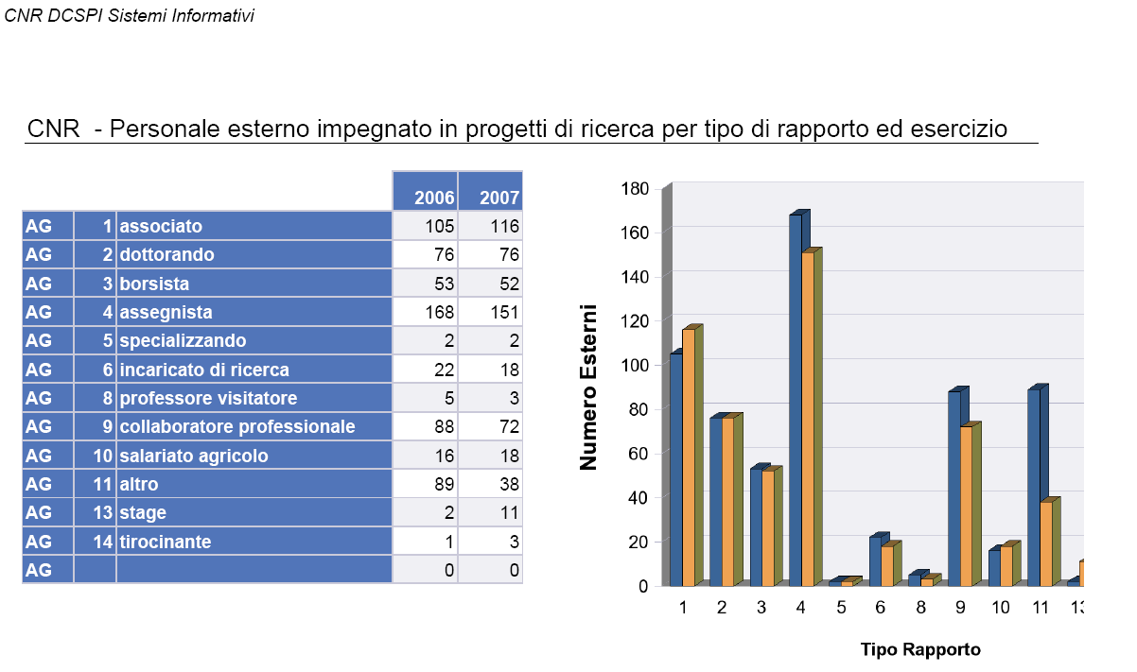
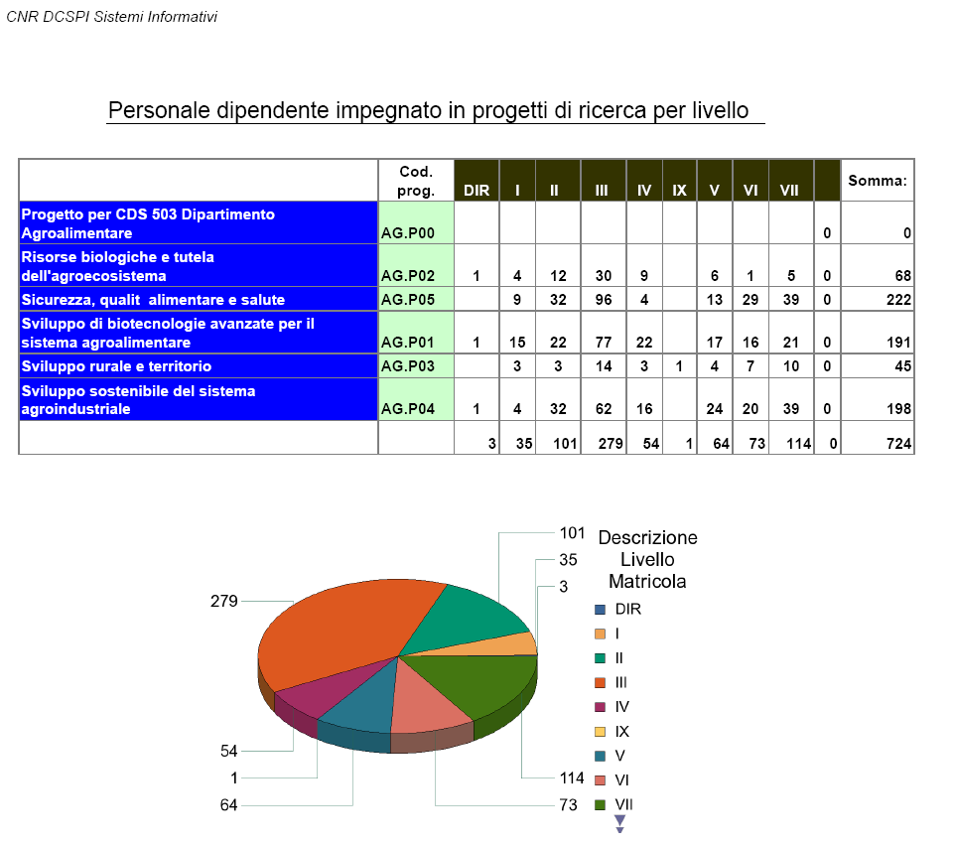
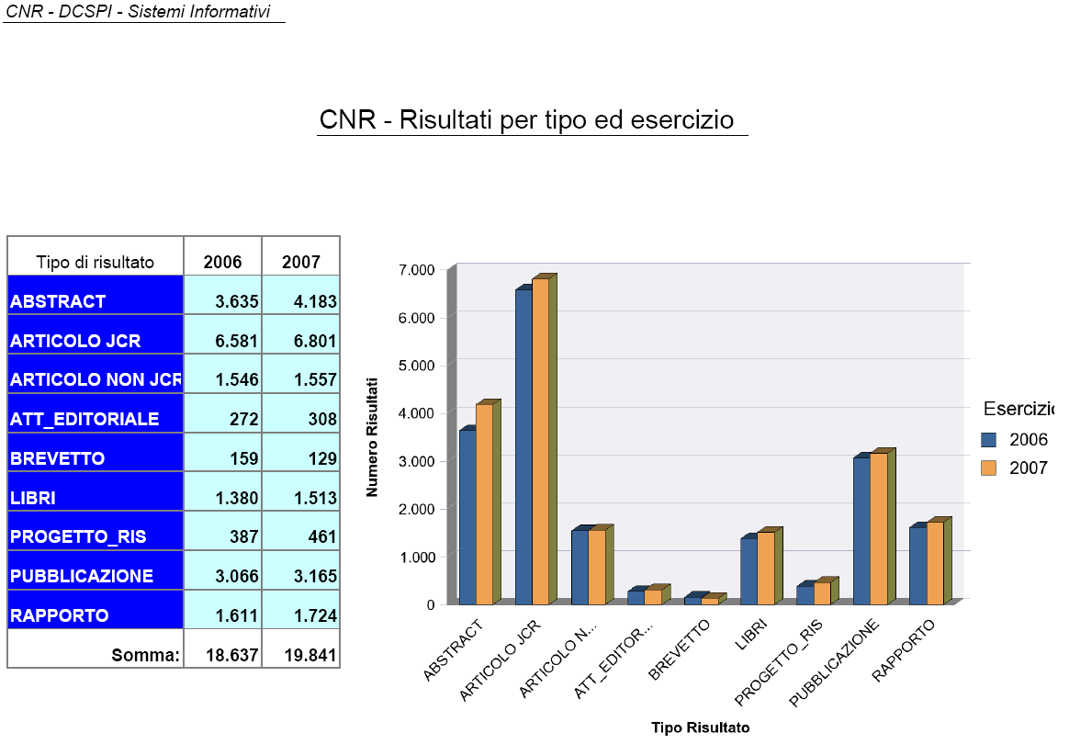
Data Warehouse

Slide 11
Software factory
A software factory has been established within CNR Central Administration
Development activities mainly based on open standards and open source platforms
Complete open-source-based infrastructure for software lifecycle management.

Slide 12
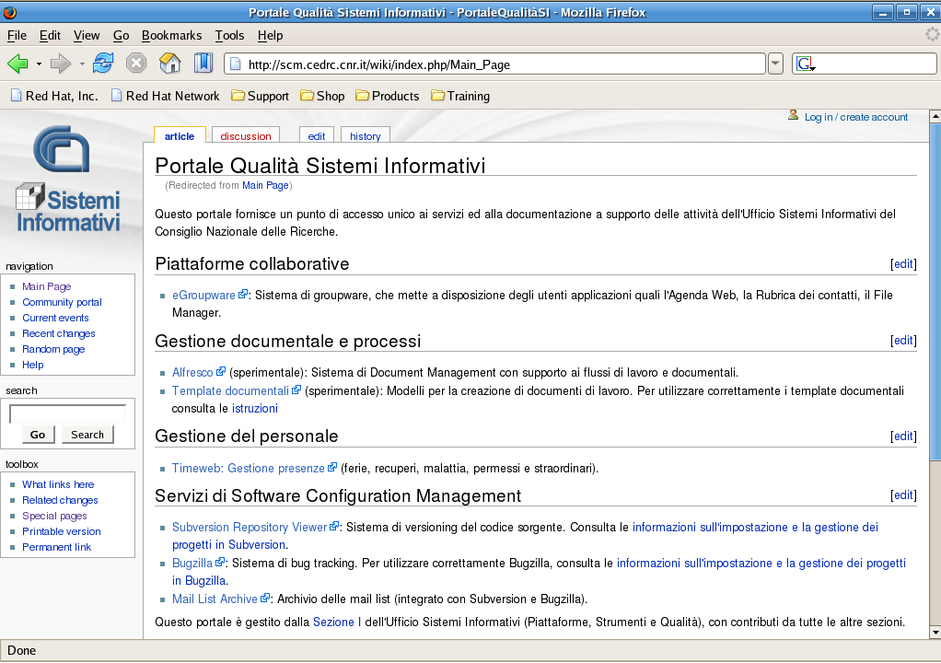
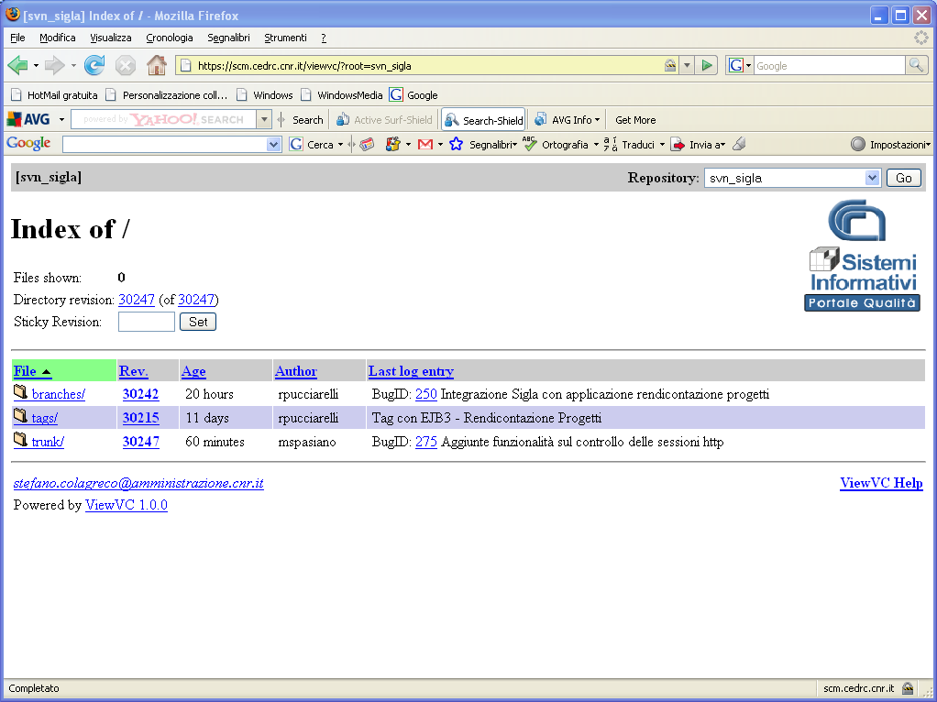
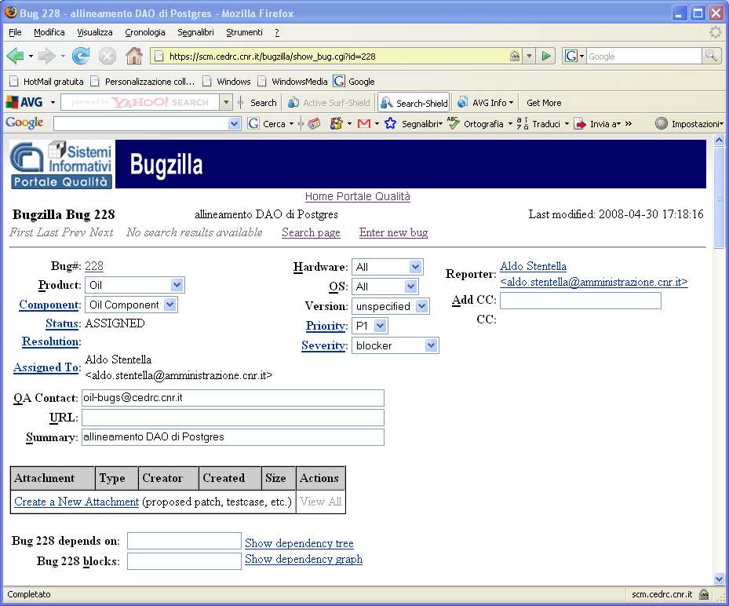
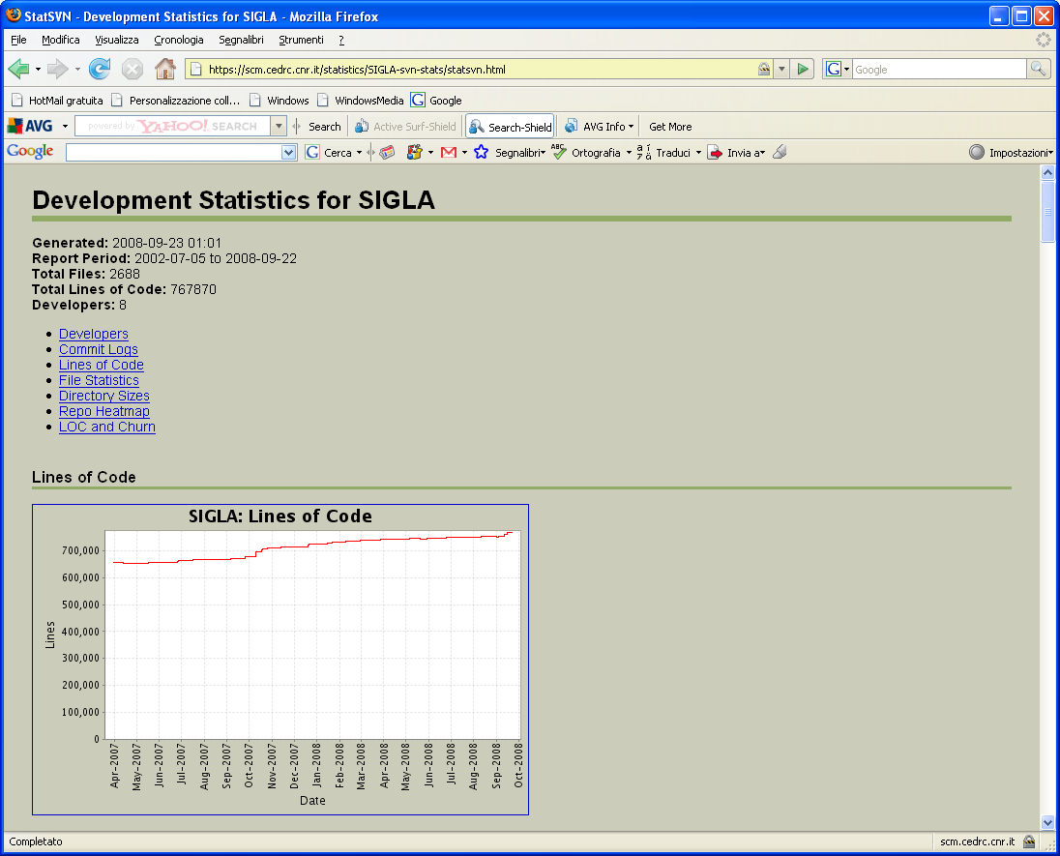
SCCM

Slide 13














OS products
Full coverage of all application domains and all phases of sw lifecycle
Significant cost savings
Ad hoc migration projects aimed at decommisioning legacy/proprietary applications
Apache
Tomcat

Slide 14
Ongoing initiatives

Slide 15
Criticalities of OA archives
interoperability at the policy, organizational and technological level (both at the internal – e.g. CRIS - and external level – e.g. national CRIS, etc.)
extensive coverage of the institutional scientific production
quality control as regards the scientific contents of the deposited items
unique and persistent identification of works and authors
quality control and certification of the descriptive metadata (bibliographic and authority control)
version history tracking

Slide 16
Strategy
Foster cooperation and develop open technologies, which will favor the creation of a diffuse Information System network in the R&D field. This will allow the production of certified, verifiable and reusable data for all the stakeholders in the international R&D scenario
Share our experience and knowledge (Information and Knowledge Sharing) with all the R&D players.

Slide 17
CNR’s environment: OA initiatives
Cooperation between the CNR’s libraries and the CNR’s organizational units providing ICT services have triggered some OA initiatives.
Outcomes:
  some specialized Open Archives of research products
  Participation to national and international funded projects
CNR is carrying out activities for the implementation of an integrated system connecting all CNR’s OA research product archives

Slide 18
CNR’s Research Product Open Archive Working Group
CNR is going to establish a working group gathering experts in the fields of libraries, open archives, institutional repositories, CRISs and ICT
The goal is to define organization, policies and technical solutions for a CNR open archive of research products

Slide 19
Interoperability: Authors information
CNR is cooperating with other Italian institutions in order to establish authority control systems.
The goal is to produce certified data which can be used by institutions working in the field of R&D

Slide 20
JDIAM 1/2
JDIAM, Open Archive software featuring:
  Customizable workflows
  Customizable metadata sets
  Authority file management
  Document versioning
  Document classification
  Information retrieval
  User profiling
  Support to a hierarchical organization of digital libraries
  Support to OAI-PMH

Slide 21
JDIAM 2/2
JEE technology platform
Currently using an Alfresco document repository but …
Supporting any CMIS compliant enterprise content management system (e.g. Nuxeo)
zKoss based user interface
Support for PID assignment

Slide 22
Conclusions and future work
Importance of the cooperative approach within a distributed environment
The results of our work may represent a starting point for future cooperative developments and are made available to the scientific community in order to ensure the maximum consensus about the choices to be made.

