Slide 1
Users in the spotlight: study on the use of the Dutch scientific portal NARCIS, 2009
Elly Dijk, Arjan Hogenaar, Marga van Meel
Royal Netherlands Academy of Arts and Sciences
KNAW Research Information
CRIS 2010 , Aalborg, 3 June 2010

Slide 2


Royal Netherlands Academy of Arts and Sciences
  Department of Research Information
  Mission:
  National focal point of research information
  Member of EuroCRIS

Slide 3
Outline
  Dutch portal NARCIS
  IP analysis
  Surveys
  Interviews
  Conclusions

Slide 4
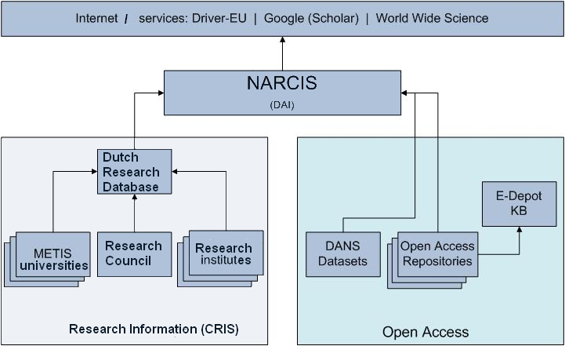
Information infrastructure in the Netherlands

Slide 5
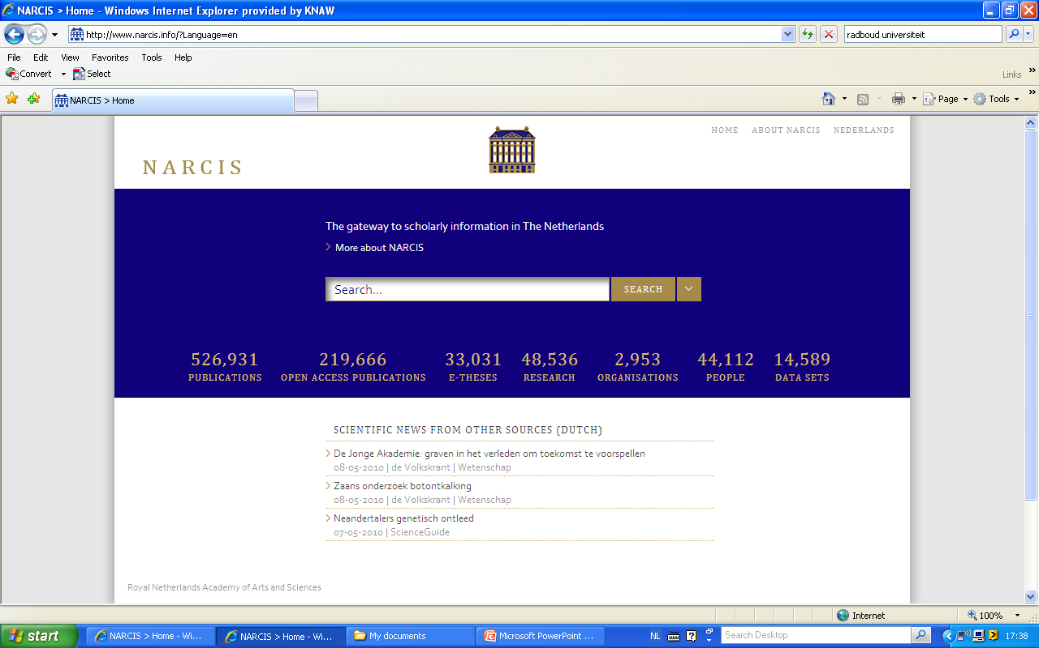

Slide 6
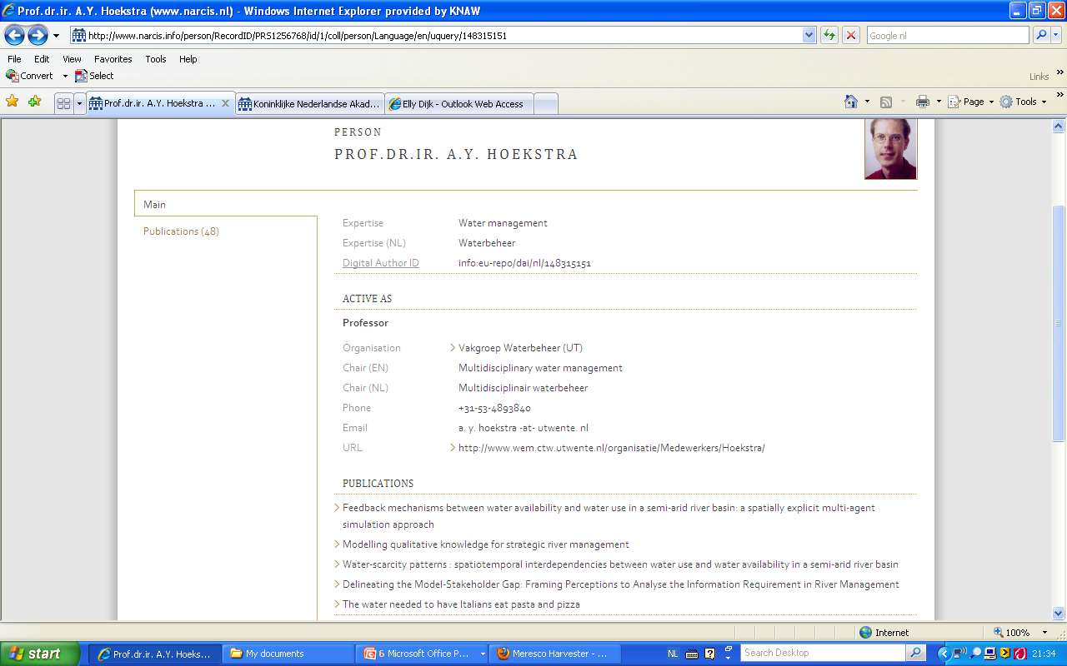

Slide 7
Use of NARCIS in 2009: 1.2 million users

Slide 8



IP address analysis, 2 surveys, 17 interviews
Ip nummer | Name | Views | Category
192.107.175.11 | WWS, Department of Energy Office of Scientific and Technical Information | 217322 | University not NL
137.224.252.10 | Wageningen University and Research Centre | 27792 | University NL
156.83.1.251 | Erasmus Medisch Centrum | 9864 | University NL

Slide 9
IP address analysis
Ip nummer | Name | Views | Category
192.107.175.11 | WWS, Department of Energy Office of Scientific and Technical Information | 217322 | University not NL
137.224.252.10 | Wageningen University and Research Centre | 27792 | University NL
156.83.1.251 | Erasmus Medisch Centrum | 9864 | University NL
130.37.210.210 | VU UniversitY Amsterdam | 5014 | University NL
10.20.32.124 | Private | 4990 | Provider NL
145.88.209.33 | Leiden University Medical Centre | 4720 | University NL

Slide 10
Origin of NARCIS users based on IP address
Category | Origin of NARCIS use in %
Research university | 36%
Research institution | 4%
University of Applied Sciences | 8%
Government | 6%
Not for profit | 2%
Hospital | 1%
Business | 11%
Media | 1%
Provider | 32%

Slide 11
First Survey
  Online survey on NARCIS website - SurveyMonkey
  Purpose:
  Gather information on NARCIS users
  What information were they looking for?
  Closed answers with one open answer option
  268 respondents (207 Dutch version; 61 English version)

Slide 12
6 questions
  What is your field of activity?
  What is your profession?
  How often did you visit NARCIS in the past six months?
  What were you looking for?
  What do you find important in a system such as NARCIS?
  NARCIS is being developed continually. What are your suggestions?

Slide 13
  WHAT IS YOUR FIELD OF ACTIVITY?

Slide 14
  WHAT IS YOUR PROFESSION?

Slide 15
  HOW OFTEN DID YOU VISIT NARCIS IN THE PAST SIX MONTHS?

Slide 16
What were you looking for?

Slide 17
What do you find important in a system such as NARCIS?

Slide 18
  WHAT ARE YOUR SUGGESTIONS FOR FURTHER DEVELOPMENT?

Slide 19
Second survey
  44 respondents from the first survey
  Goal: survey usage of various NARCIS sections and the users’ satisfaction
  Same characteristics as respondents of first survey
  Only difference: greater use of NARCIS

Slide 20
What are you looking for and why?

Slide 21
satisfied or very satisfied with the results of NARCIS use

Slide 22
17 semi-structured interviews
  Nine researchers: 3 humanities, 3 science, 3 social sciences
  Policy makers: 4
  Information specialists: 4
  Journalists: 2

Slide 23
Main questions
  To what extent does the target group for whom NARCIS may be relevant actually use the service? Can any conclusions be drawn about non-users?
  To what extent could NARCIS be useful for non-users given their information behaviour?

Slide 24
Script
  Which information sources are used?
  How does the interviewee search for information?
  What problems does she/he encounter when searching for information?
  Not about NARCIS!

Slide 25
Why respondents use CRIS information
  They use their own networks, except for exploring new areas or finding information about lesser-known researchers
  Individuals and organisations:
  Researchers: to get background material that may add value to their publications
  Non-researchers: to find experts in a particular field in order to gather more information
  Current research: to gain an early impression of work being done in new fields of research

Slide 26
Information sources
  Digital Library of the respondent’s own university
  Search engines (Google, Google Scholar)
  Personal contacts/participation at conferences/workshops
  Blogs and Twitter
  Dissertations and journal articles
  Subscription to alert services
  Personal (online) networks (LinkedIn)
  Datasets (surveys, audio-visual material) and statistical information

Slide 27
Problems for researchers
  Quality
  Accessibility
  Coverage
  Context
  Persistence
  Information overload

Slide 28
Problems for non-researchers
  Absence of very concise abstracts of scientific publications
  No free access to some texts
  Difficulty in finding experts

Slide 29
Conclusions: surveys
  Half of the NARCIS users: universities/of applied sciences), research institutions
  Most searches are for dissertations; also for other Open Access publications, information about research and expertise
  Appreciated: downloading, one-stop-shop; links from persons to publications
  Development: access to international information

Slide 30
Conclusion Interviews
  Many of the respondents’ wishes can be met by NARCIS
  Garanteed quality of the NARCIS content
  Access to Open Access publications
  Finding experts

Slide 31



Main conclusion
What we need is a better PR effort!

Slide 32
Thank you for your attention!
www.narcis.nl
Acknowledgements:
Repke de Vries and Henk Voorbij

