Slide 1

Current developments in Germany
euroCRIS Spring Meeting 2017

Slide 2
Overview
CRIS in German Universities
The Core Data Set

Slide 3
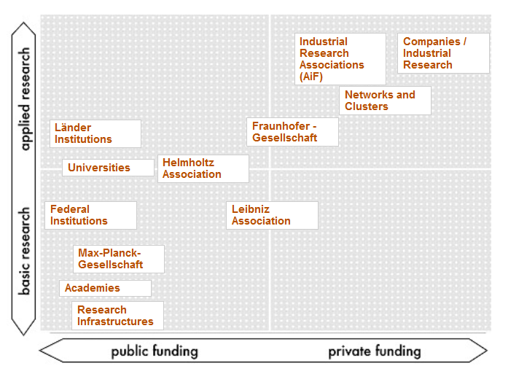
The Landscape
Source: www.research-in-germany.org
Notes:
16 Federal states (Länder) and Bund
Four majour research organisations
Facts and Figures
http://www.research-in-germany.org/dms/downloads-en/rig-publications/RiG-Research-Landscape-2015/The%20German%20Research%20Landscape%202015%20Barrierefrei.pdf
Almost 1,000 publicly funded research institutions (2013)
605,000 staff in R&D including 361,000 R&D researchers (2013)
Approx. 500 innovation clusters and networks (2015)
Gross domestic expenditure on R&D (GERD): 80 billion euros (2013)
Facts and Figures
Approx. 400 higher education institutions (including more than 230 universities of applied sciences; 2015)
662,000 staff in total, 370,000 academic staff (2013)
2.7 million students in total, 320,000 international students (11.8%); (2014/15)
Gross domestic expenditure on R&D (GERD) at institutions of higher education: 14.3 billion euros (2013

Slide 4

Research and research assessments in Germany
No REF
421 Higher Eduction Institutions (HEI)
  140 universities and HEI with equal status (allowed to award doctorates)
Subject-based evaluations
  Wissenschaftsrat (voluntary)
  Federal State initiatives
Performance-based funding
  Third-party funding
  Awarded university degrees
  Student numbers
State Research Institutions
  Max Planck Society
  Leibniz Association
  Fraunhofer
  Helmholtz Association
Institutional evaluations
Annual federal performance report
  86 indicators
  Awards, bibliometrics, cooperations, external funding…

Slide 5
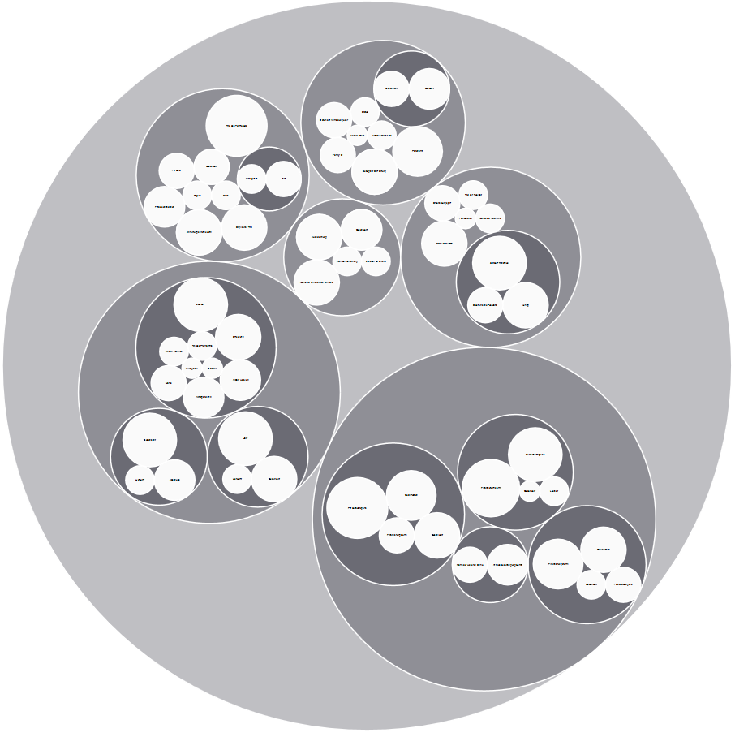
Core data set: An attempt to unify
Patents
Funding
and
Projects
Publications
Research Infrastructure
Researcher Training
Staff
Notes:
http://www.forschungsinfo.de/kerndatensatz/en/index.php?home
The German Council of Science and Humanities initiated this project based on the results of a recent pilot study on research rating. With its recommendations on the specification of a future research core dataset, the German Council of Science and Humanities delineated the structure and content of the approach. The project partners (Institute for Research Information and Quality Assurance, German Council of Science and Humanities and the Fraunhofer Institute for Applied Information Technology FIT jointly develop a standardised specification of these recommendations. This will provide the foundations for a quality-assured data exchange between universities or research institutions and recipients of the information in the German research system. The specification of a research core dataset is meant to be an offer to actors in the research system. On the basis of the specification, institutions will be able to agree on an efficient process for data collection and storage to reduce the cost of future development and implementation of local research information systems. Moreover, being based on international standards the specification provides the foundations for the future international exchange of research data. The project does not implement or recommend a central database. Rather, it initiates a definitional process and assesses the technical and organisational practicability.
he project for the specification of a "Research Core Dataset" has developed standards for research information based on the recommendations by the German Council for Science and Humanities of January 2013. The project period was from October 2013 to October 2015.
In the context of the recent winter meetings (20 – 22 January 2016) the German Council of Science and Humanities discussed and evaluated the specification for a Research Core Dataset (RCD) (release 1.0) and recommended the RCD standard for implementation at research institutions in Germany. The recommendations summarise the background and goals of the project, illustrate the process of development, present the contents of the RCD standard and make suggestions for implementation and future development of the Research Core Dataset.

Slide 6
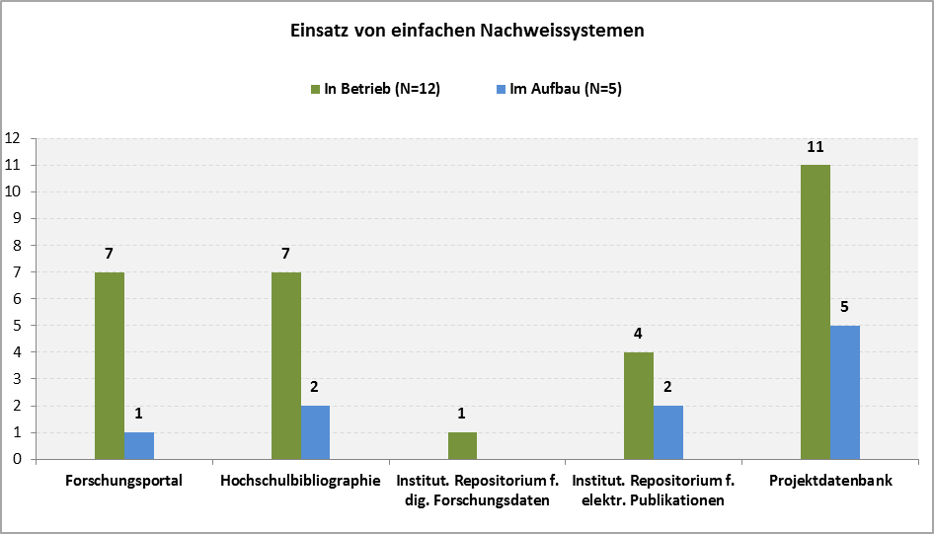
Research information systems (Universities) in 2014
Source: https://zenodo.org/record/13841#.VLPTqSuG98E
Notes:
Not able to deliver the core data
January 8, 2015 Report Open Access
Einsatz von Forschungsinformationssystemen an Universitäten und Hochschulen mit Promotionsrecht in Deutschland. Ergebnisbericht
Sticht, Kendra
Ergebnisse aus der Masterthesis „Untersuchung zum Einsatz von Forschungsinformationssystemen an Hochschulen in Deutschland“ am Institut für Bibliotheks- und Informationswissenschaft an der Humboldt-Universität Berlin, 2014
Zugrunde liegende Forschungsdaten und Dokumentation der Online-Befragung unter 10.5281/zenodo.17169 abrufbar.

Slide 7



DINI Working Group on Research Information Systems (DINI AG-FIS)
Established in May 2012
11 members from 9 research organizations, today 15 members
Lots of connections
  German Initiative for Network Information (DINI)
  Research Core Dataset
  euroCRIS
  Professional communities, f.e. research management, libraries & repositories
Series of workshops
  Strategy: embedded in events of our partner communities
  http://www.dini.de/ag/fis/veranstaltungen-und-termine/

Slide 8


CRIS and Core Data Set
Workshop in Berlin, January 2017 and beyond
Nearly 200 participants
Lifely discussion on twitter
New infrastructure with the
newly founded „core-data set-helpdesk“
located in Berlin
http://www.kerndatensatz-forschung.de/
(german only)

Slide 9
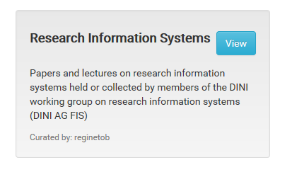
More Information
DINI AG-FIS Community Collection at zenodo
http://zenodo.org/collection/user-ag-fis
DINI AG FIS Position Paper
DOI 10.5281/zenodo.14828 (German)
DOI 10.5281/zenodo.17491 (English)
Study on German CRIS Landscape
DOI 10.5281/zenodo.13841 (Master thesis/German)
DOI 10.5281/zenodo.17169 (Data set)
Research Core Dataset Recommendations of the German Council of Science and Humanities (document in German)
http://www.wissenschaftsrat.de/en/fields-of-activity/core_data_set.html

Slide 10
Many thanks you for attention!

